Slide 1
Commissioning in the sexually transmissible infections and blood borne viruses subsector
Progress recap and outcomes discussion
Fellon Gaida
on behalf of Public Health Regulation and Projects
December 2022

Slide 2
We acknowledge the Ngunnawal people, traditional custodians of this beautiful Country we have the privilege to call home. We pay our respects to their Elders, past and present, and the contribution they make to the life of this city and to its success.

Slide 3
Session objective
Recap progress, priorities and care considerations as identified thus far through the commissioning process
Revisit outcomes and the interplay with commissioning
Explore what level of outcomes reporting would work best within the STIBBV subsector
Revisit and further brainstorm high, medium and lower level outcomes for consideration

Slide 4
The priorities identified so far…

Slide 5
Sexually transmissible infections
Priority to be addressed through commissioning | Service/care/programmatic considerations
Improve health literacy related to STIs, with a particular focus on young people, CALD communities, women and other people with a cervix/uterus of reproductive health age, gay, bisexual and other men who have sex with men, and First Nations people | Health promotion/education campaigns and targeted programs which seek to increase health literacy amongst priority groups and the wider ACT population. Outreach engagements which capture priority groups (e.g small groups facilitated within migrants support services etc). Education programs which explore STIs in the context of consent, sexual safety and autonomy, relationships etc.
Increase screening for: chlamydia gonorrhoea infectious syphilis | Youth-focused initiatives. Outreach screening programs for young people where they frequent (skate parks etc). Targeted and opportunistic screening of women and people with a uterus of reproductive health age. Practice support programs which support primary health clinicians to test proactively. Outreach, flexible, mobile and self-testing programs. Programs which seek to increase testing in other risk cohorts (including sex workers). After hours screening activities. Multidisciplinary programs (clinicians, support workers, peer navigators etc to support individuals into testing and treatment).
Increase cervical screening in under-screened population groups | Clinic-based, outreach and self-sampling services provided in partnership with other agencies including organisations who support CALD communities, victim survivors of sexual assault and people living with a disability. Female cervical screening providers.
Invest in a highly skilled, competent, and diverse clinical, support and peer workforce | Flexible, professional development programs (delivered face-to-face/online and via hybrid models) which upskill clinicians in relation to STI screening and care. Workforce development activities which seek to increase opportunistic screening in primary health settings.
Reduce stigma and discrimination related to STIs | Health promotion/education campaigns that specifically address stigma. Initiatives which specifically address health provider stigma and discrimination. Community development initiatives.
Notes:
These priorities and care considerations have been amalgamated from all the stakeholder engagement activities held to date
All are evidenced based
ACTHD will not be able to commission everything on this list, but these priorities/care considerations will form the basis for the Strategic Investment Plan which will round out the Design Phase
When finalised, the Strategic Investment Plan will be disseminated to the sector for feedback. Once feedback has been reviewed and integrated (where appropriate), the key elements will be translated into tender documents which will go out to procurement.
Are we missing anything here?

Slide 6
Hepatitis B
Priority to be addressed through commissioning | Service/care/programmatic considerations
Increase health literacy related to HBV (with a particular focus on people from countries of high prevalence and First Nations people) | Peer based support services which act as a conduit between hepatitis specific organisations and organisations which support people from high prevalence countries and First Nations people. Easy-to-understand and culturally appropriate education programs related to HBV. Social media campaigns co-designed with community and stakeholders deployed in a variety of languages.
Increase the number of individuals living with HBV who have been diagnosed and who are receiving treatment – Sustained engagement of individuals in the HBV care cascade | Activities which increase HBV diagnosis and treatment uptake. Observe and possibly model the NT’s ‘Hep B PAST Program’, as it is the only evidence-based program for HBV. Data linkage and computerised algorithmic coding to enhance individual clinical care for Aboriginal people living with chronic hepatitis B in the Northern Territory of Australia – Is it feasible? (plos.org) 333685_Hep_B_Past_Bulletin_Volume_1_Issue_3.pdf (menzies.edu.au) Develop programs which address liver disease prevention in the primary care setting. Focus on cohorts from high prevalence countries, noting contemporary patterns of transmission. Incentivised care cascade programs. Holistic, case management services. Peer education/navigator/support programs. Roving nurse/Nurse Practitioner and shared care models between the CHS Liver Clinic/NGOs and community.
Invest in a highly skilled, competent, and diverse clinical, support and peer workforce (including increasing s100 prescribers for HBV) | Promote/incentivise Medical Officers and NP’s to become s100 prescribers. Flexible professional development programs (delivered face-to-face/online and via hybrid models),which upskill clinicians in relation to HBV screening and care. Workforce development activities (particularly for GPs) which seek to increase opportunistic HBV vaccination and screening in primary health settings.
Notes:
These priorities and care considerations have been amalgamated from all the stakeholder engagement activities held to date
All are evidenced based
ACTHD will not be able to commission everything on this list, but these priorities/care considerations will form the basis for the Strategic Investment Plan which will round out the Design Phase
When finalised, the Strategic Investment Plan will be disseminated to the sector for feedback. Once feedback has been reviewed and integrated (where appropriate), the key elements will be translated into tender documents which will go out to procurement.
Are we missing anything here?

Slide 7
Hepatitis C
* Unable to be addressed through commissioning (although remains a sector priority)
Priority to be addressed through commissioning | Service/care/programmatic considerations
Increase health literacy related to HCV | Easy-to-understand and culturally appropriate education related to HCV. Programs which seek to improve HCV related health literacy for people who inject drugs and individuals residing/or who have resided in a correctional setting. Programs which seek to improve HCV related health literacy for people from high prevalence countries (particularly health messaging related to overseas transmission following medical procedures/ tattoos, deployed in a variety of languages).
Increase the number of individuals living with HCV who have been tested, diagnosed and who have completed treatment – sustained engagement with the HCV care cascade. | Services and programs which provide a range of testing options including point of care testing, clinic based/traditional pathology, outreach and/or dried blood spot testing for HCV. Flexible clinic-based and outreach services with after-hours/weekend service options. Activities which engage marginalised and hard-to-reach groups in testing, treatment and care. Incentivised care cascade programs. Programs which connect individuals exiting a correctional setting into testing and/or treatment in a timely manner. Peer navigator programs. Holistic, case management and contact tracing programs.
Increase access to and use of clean injecting equipment for every injecting episode | Needle and syringe programs (NSPs) in correctional settings* Primary and secondary NSPs across Canberra (currently a need for an NSP service in the north of Canberra).
Invest in a highly skilled, competent, and diverse clinical, support and peer workforce | Flexible professional development programs (delivered face-to-face/online and via hybrid models) which upskill clinicians in relation to HCV screening and care. Workforce development activities (particularly for GPs) which seek to increase opportunistic HCV screening in primary health settings. Peer / clinician team models A workforce which can work/liaise across correction settings, alcohol and other drugs (AoD) services, housing services and mental health settings.
Notes:
These priorities and care considerations have been amalgamated from all the stakeholder engagement activities held to date
All are evidenced based
ACTHD will not be able to commission everything on this list, but these priorities/care considerations will form the basis for the Strategic Investment Plan which will round out the Design Phase
When finalised, the Strategic Investment Plan will be disseminated to the sector for feedback. Once feedback has been reviewed and integrated (where appropriate), the key elements will be translated into tender documents which will go out to procurement.
Are we missing anything here?

Slide 8
HIV
Priority to be addressed through commissioning | Service/care/programmatic considerations
Increase health literacy related to HIV | Programs which seek to improve HIV related health literacy for gay, bisexual, and other men who have sex with men. Health promotion programs/campaigns specifically targeting women and the trans/non-binary and broader LGBTIQ+ community, who are at high risk of HIV or who are living with HIV.
Increase opportunistic and routine screening for HIV | Provide choice in testing options including clinician led, peer-supported, self-testing, vending machines and web/tele based ordering. After-hours/weekend services. Outreach testing where high-risk cohorts frequent (e.g. beats and SoPV).
Support people living with HIV to remain on treatment | Multidisciplinary programs which include clinicians and peer navigators. Shared care models and care navigators which work between the hospital, Canberra Sexual Health Centre, NGOs and community.
Optimise quality of life for people living with HIV | Employ a life course approach to HIV care/programs Holistic, person-centered programs which involve families, carers and partners (if safe and appropriate). Provide aged care support for older people living with HIV. Peer-led support programs specifically targeting sex workers and Asian born gay men and other high-risk cohorts.
Increase awareness, uptake, and use of prevention, including PrEP, PEP, treatment as prevention, and NSPs | Health education/health promotion/other interventions which normalise and address PrEP and PEP use. Community based PrEP clinics. Primary and secondary NSPs.
Invest in a highly skilled, competent, and diverse clinical, support and peer workforce | Flexible professional development programs (delivered face-to-face/online and via hybrid models), which upskill clinicians in relation to HIV screening and care. Workforce development activities (particularly for GPs) which seek to increase opportunistic HIV screening in primary health settings. Peer/clinician team models Deploy recruitment campaigns to Increase the number of s100 prescribers for HIV Incentivise GPs and NPS to become s100 prescribers
Notes:
These priorities and care considerations have been amalgamated from all the stakeholder engagement activities held to date
All are evidenced based
ACTHD will not be able to commission everything on this list, but these priorities/care considerations will form the basis for the Strategic Investment Plan which will round out the Design Phase
When finalised, the Strategic Investment Plan will be disseminated to the sector for feedback. Once feedback has been reviewed and integrated (where appropriate), the key elements will be translated into tender documents which will go out to procurement.
Are we missing anything here?

Slide 9
Lets think about outcomes

Slide 10
Background and rationale
Commissioning is a policy shift in thinking about how to build collaborative service systems.
Existing contracts are primarily outputs based and provide limited opportunity to measure outcomes or innovate in response to changing community needs.
A shift towards a commissioning approach for the future delivery of health services aligns with the position increasingly adopted across local and international jurisdictions: that commissioning represents a leading practice approach to designing and investing in community health services and delivering improved client outcomes.

Slide 11
Brainstorming outcomes
ACT Wellbeing indicators, epidemiological/burden of disease data
AIHW/ABS data
Population level outcomes
STIBBV system level outcomes
Program level outcomes
Individual outcomes
???
Program evaluation measures
Self-reported data (e.g. survey responses, quality of life indicators)
Notes:
With more subsectors progressing through the design phase, attention has turned to how outcomes can be integrated into the commissioning process.
There has been discussion on what level of outcomes subsectors should be considering and how outcomes could be measured
The Health System level outcomes, if determined as important to the sub-sector or NGO sector more broadly, will require some consideration

Slide 12
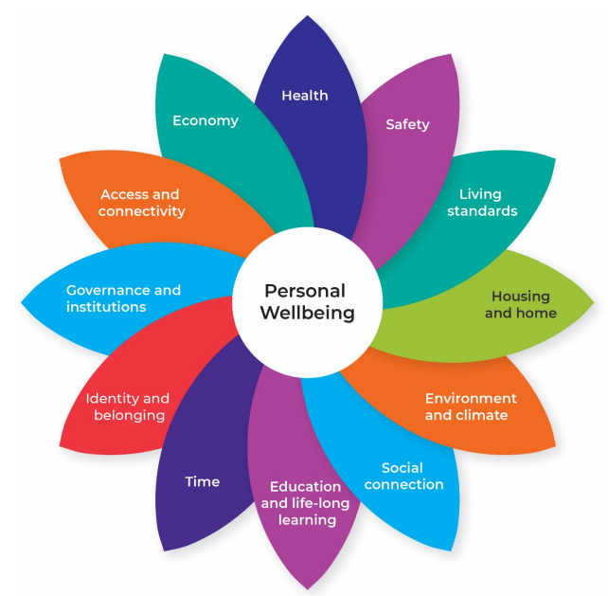
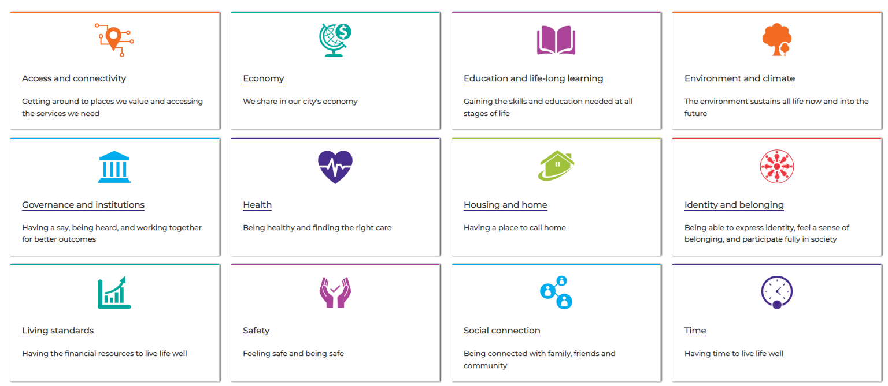
The Wellbeing Framework
Notes:
All outcomes are required to align with the ACT Wellbeing Framework

Slide 13
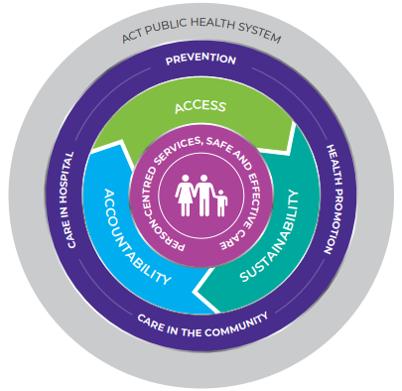
Accessible, Accountable, Sustainable: A Framework for the ACT public Health System 2020-2030
Notes:
All outcomes are also required to align with the Accessible, Accountable, Sustainable Framework

Slide 14
Commissioning for outcomes: Potential approaches
A small number of general, high-level outcomes that can be applied across all subsectors*
A number of medium-level specific outcomes that are tied to individual program/service procurements**
A small number of lower-level widget/demographic data points which describe service use***
These outcomes would be collaboratively deigned by the ACTHD commissioning business units, the Commissioning Team and with input from sector partners. Multiple data sources may be identified.
** These outcomes would be co-designed by ACTHD and the successful tenderer. Data sources may include program evaluation measures or client/participant self-reported data
*** These are largely determined in the agreement drafting stage given there are a number of mandatory reporting points for all agreements. This data would need to be collected by the procured provider
Notes:
This graphic details some approaches to outcomes within the commissioning process
Subsectors may choose all or a couple of these approaches
Thee has been some early support across business units for a small number of general, high level outcomes that are relevant across all subsectors and procurements for a whole of NGO system approach. These discussions are ongoing. We are keen to hear your thoughts on this approach.

Slide 15
Proposed higher-level STIBBV outcomes
What are we missing?
What needs removing?
What needs reworking/amending?
Outcome Domain | Descriptor | Strategic Alignment | Potential data sources
STIBBV related health literacy | People have knowledge about STIBBVs , including transmission, how to reduce their risk, and how and where to access testing, treatment and care | Education and lifelong learning | Self-report surveys
 |  | Health
Notes:
We briefly touched on outcomes towards the end of our collaborative design workshops, I have distilled these further under some high-level domain headings noting there were some similarities and overlaps.
I have also brainstormed some potential sources of data noting it is certainly not an exhaustive list
Whilst these domains are certainly relevant for the STIBBV subsector, they could quite easily be extrapolated to the broader NGO service system.

Slide 16
Proposed higher-level STIBBV outcomes
Outcome Domain | Descriptor | Strategic Alignment | Potential data sources
Health behaviours | People engage in consensual, healthy and safe sexual activity People have access to information and means of prevention to decrease their risk of acquiring and transmitting STIs and BBVs | Education and lifelong learning | Self-report surveys
 |  | Health
 |  |  | HBV and HPV vacation coverage (ACTHD-HPS)
 |  | Social connection
 |  |  | NSP service uptake (Australian Needle Syringe Program Survey)
 |  |  | PrEP/PEP awareness and use (GCPS)
What are we missing?
What needs removing?
What needs reworking/amending?
Notes:
We briefly touched on outcomes towards the end of our collaborative design workshops, I have distilled these further under some high-level domain headings noting there were some similarities and overlaps.
I have also aligned the domains and descriptors with the Wellbeing Framework and have brainstormed some potential sources of data noting it is certainly not an exhaustive list
Whilst these domains are certainly relevant for the STIBBV subsector, they could quite easily be extrapolated to the broader NGO service system.

Slide 17
Proposed higher-level STIBBV outcomes
What are we missing?
What needs removing?
What needs reworking/amending?
Outcome Domain | Descriptor | Strategic Alignment | Potential data sources
Service access and engagement | People can access affordable STIBBV services STIBBV services are located in convenient geographic locations where people live, work, play and love STIBBV services are provided at convenient times across the day/week Individuals remain engaged in relevant care cascades | Health | Service mapping activities (ACTHD and NGOs)
 |  | Economy
 |  | Access & connectivity
 |  |  | Service engagement scale scores
 |  | Time
 |  |  | Late diagnosis indicators
 |  | Living standards
 |  |  | Service user experience surveys
 |  | Housing and home
 |  |  | Care cascade modelling (Kirby/Burnett)
 |  |  | Testing (denominator data)
Notes:
We briefly touched on outcomes towards the end of our collaborative design workshops, I have distilled these further under some high-level domain headings noting there were some similarities and overlaps.
I have also aligned the domains and descriptors with the Wellbeing Framework and have brainstormed some potential sources of data noting it is certainly not an exhaustive list
Whilst these domains are certainly relevant for the STIBBV subsector, they could quite easily be extrapolated to the broader NGO service system.

Slide 18
Proposed higher-level STIBBV outcomes
What are we missing?
What needs removing?
What needs reworking/amending?
Outcome domain | Descriptor | Wellbeing Framework strategic Alignment | Potential data sources
Safety and comfort | People feel physically, socially and emotionally safe, heard and respected when accessing an STIBBV service. Services are culturally safe, inclusive and free of discrimination. People feel comfortable in talking about STIBBV related issues People can be their authentic selves | Access and connectivity | Service user experience surveys
 |  | Identity and belonging
 |  | Safety
 |  |  | Quantitative and qualitative self-reported health and wellbeing data
 |  | Health
 |  |  | Stigma indicator scores
Notes:
We briefly touched on outcomes towards the end of our collaborative design workshops, I have distilled these further under some high-level domain headings noting there were some similarities and overlaps.
I have also aligned the domains and descriptors with the Wellbeing Framework and have brainstormed some potential sources of data noting it is certainly not an exhaustive list

Slide 19
Proposed higher-level STIBBV outcomes
What are we missing?
What needs removing?
What needs reworking/amending?
Outcome domain | Descriptor | Wellbeing Framework strategic Alignment | Potential data sources
Quality of life | People are able to enjoy a good standard of life where they feel healthy, independent, are connected within their communities and are able to achieve their goals. People are well supported within the community with less need for emergency or acute services. | Access & connectivity | Service user experience surveys
 |  | Identity and belonging
 |  | Social connection
 |  | Living standards
 |  |  | Quality of Life indictor scores
 |  | Safety
 |  | Health
 |  |  | Hospital separation data
 |  | Economy
Notes:
We briefly touched on outcomes towards the end of our collaborative design workshops, I have distilled these further under some high-level domain headings noting there were some similarities and overlaps.
I have also aligned the domains and descriptors with the Wellbeing Framework and have brainstormed some potential sources of data noting it is certainly not an exhaustive list
Whilst these domains are certainly relevant for the STIBBV subsector, they could quite easily be extrapolated to the broader NGO service system.

Slide 20
Medium-level procurement outcomes
These outcomes would be best co-designed by ACTHD and the successful tenderer.
These outcomes would be specific to the individual procurement (service/program/intervention)
Data sources may include program evaluation measures or client/participant self-reported data (pre/post data etc)

Slide 21
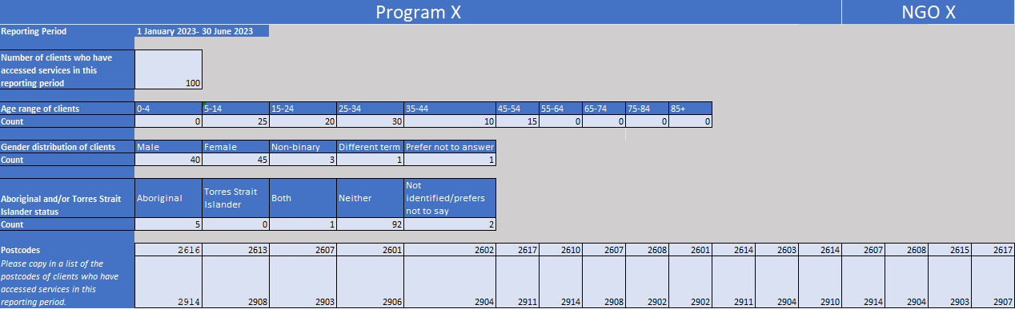
Lower-level demographic data points
Number of clients/participants who have accessed a service/program
Age, age bracket or year of birth
Gender identifier
Postcode of residence
Aboriginal or Torres Strait Islander status
Culturally and Linguistically Diverse status
LGBTIQ+ status
Notes:
Over the past 6-8 months, some of the subsector business units have been working with the ACT Epidemiology (now that Data Analytics Branch) to identify a small number of core demographic data points for reporting.
We know that many NGOs are already routinely collecting this data from their patients and clients
Many of the current NGO agreements already have some or all of these included as mandatory reporting requirements.
There is a push from a Commonwealth perspective to standardise reporting across Jurisdictions so it is highly likely that these points will be included in all post-commissioning agreements. There may be some exceptions, including for accessing needle and syringe equipment, where asking for too much information in what should be a brief encounter may prove to be a barrier to service access.

Slide 22
Next steps
Strategise/Design
Discuss and solidify approach to outcomes
Complete and disseminate next draft of the Planning and Funding Framework and Health Needs Analysis
Invest
Quarter 1, 2023
Complete and disseminate Strategic Investment Plan
Draft Procurement documentation
Notify Director General of intended procurement approaches
Government Procurement Board first and second pass reviews
Quarter 2, 2023
Release Requests for Tender
Quarter 3, 2023
Review of tender submissions
Final procurement decisions released

Slide 23
Questions?
Queries?
Comments?

