Slide 1
ACTHD ATOD Commissioning
Processes, contracts and where to from here
ACT Health Directorate, AOD Policy Section
31 May 2022

Slide 2



What we’ve done so far…
Strategise Phase
    Workshops:
      Women and Families;
      Lived Experience and Peer Representation;
      Mental Health;
      AOD Specialist Services;
      Youth; and
      Future ATOD Policy.
        Strategic Planning:
          System-wide needs assessment (very early stages)
          DSAP Review and Progress Report
          New Drug Strategy Action Plan draft

Slide 3
AOD Sector Contracts: Extensions and Variations
All community partners have been provided with a copy of their respective draft Letter of Variation for review.
The variations offer an 18 month extension to existing Service Funding Agreements (SFA) – covering the period up to 31 December 2023
A list has been provided to highlight the overall proposed language updates, changes, and new inclusions across the sector SFAs, where relevant.
A change to annual performance reporting has been proposed, including end of agreement performance and financial reports or acquittals.
  Performance reporting is inclusive of the Minimum Data Set Collection, Needle and Syringe Program Collection and other related reporting via the usual Attachment A template.
The identified funding amount is inclusive of Equal Remuneration Order funds, where relevant, but it does not include 2022-23 indexation, which will be applied once the rate is known.
Changes have been proposed for some of the items included in the Performance Expectations section.
  Ensure all new clinical policies and program materials are peer reviewed by an external person with specialist expertise in drug treatment
  Participate in each occasion of the ACT Alcohol and Other Drug Sector Workforce and Remuneration Profile and the SUSOS
  Participate in the Workers Group, the Executive Group and when relevant the AOD Contingency Working Group
Two items have been deleted from the Performance Expectation section. They include:
  Drug treatment services will not provide information and education directly to school students (P-10)
  Undertake an external evaluation of one or more program elements over the life of the contract. This requirement will be reviewed for future contracts.
Proposed update to the Reporting of Service Incidents:
  Organisation must notify and fully disclose to the Territory in writing any significant incident on premises in which a Service User has caused harm to him/herself, another Service User.
A new Commissioning Partnership Approach clause has been added. The aim of this clause is to encourage parties to meet regularly to discuss commissioning activities, to raise any issues, and work together to develop solutions.
A transition out date for the Agreement has been added:
  a date four (4) months from the end of the Term; or if this Agreement is earlier terminated and the Organisation is notified that this Item will apply, the date as specified in the notice of termination.

Slide 4
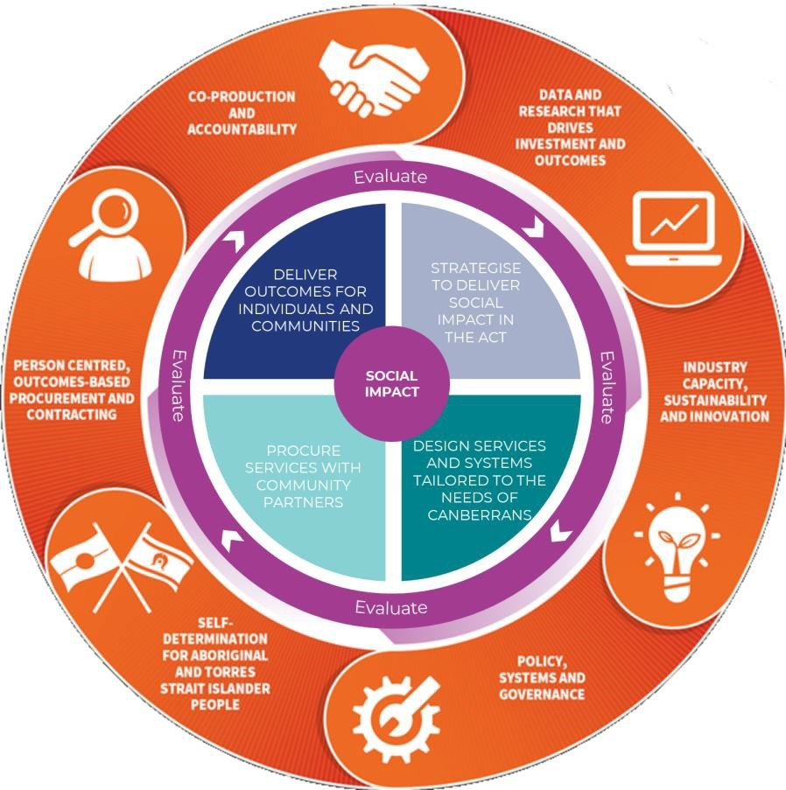

The Commissioning Cycle
The stages of commissioning are presented as four quadrants in a cycle encompassed by evaluation across the full cycle.
The outer ring identifies six key priorities that must inform, and be addressed by, the processes of commissioning.

Slide 5

Commissioning as a new process
Commissioning is new to the ACT: commitment from ACTHD and CSD to align processes in 2020 and engagement commenced in 2021.
Commissioning:
Supports investment that delivers the greatest positive impact on health and wellbeing and focuses on outcomes.
Involves community working together to test assumptions about existing and emerging need and plan and determine the services people want and need and the way they are provided (strategise)
Ensures the collaborative design is client centred, outcomes focused and involves stakeholders including service users (design)

Slide 6
Collaborative Design
A shared commitment to meaningful change and shared principles aims to guide our behaviour to remind us how we intend to work together and what we’re hoping to achieve.
Commissioning is outcomes focussed and characterised by collaboration and relationship building with stakeholders.
The collaborative design then informs government priorities and funding investment.
A collaborative design process is occurring when:
The participants are demonstrably representative
The processes are transparent
There are fewer constraints on which options might be pursued
Shared decision making occurs.

Slide 7


Where to from here… (Proposed)
Strategise Phase
Collaborative Design Phase
Commissioning Workshops
Strategic Planning of ongoing ACTHD AOD plans and policy
August - September
October
June - July
Commissioning intentions paper - onto the CSD website (iterative/living document)
Continued activities to consolidate data and evidence gathered in the strategise phase
Draft a consolidated commissioning intentions document
Consulting on service priorities with stakeholders
Workshops:
Briefing (Outlining the process and initial findings. Highlighting steps to consolidate the evidence base)
Continued collaborative design-focused stakeholder engagement activities to design services
Debriefing the subsector on incremental changes identified in our needs analysis
Possible sub-groups
Release of the Final Collaborative Design Report and agree on Commissioning Intentions

Slide 8

Discussion on approach to collaborative design

