Slide 1
ACTHD Alcohol Tobacco and Other Drugs Policy Team Update
Megan Arnold, Senior Director
ACT Health Directorate, ATOD Policy
27 March 2023

Slide 2
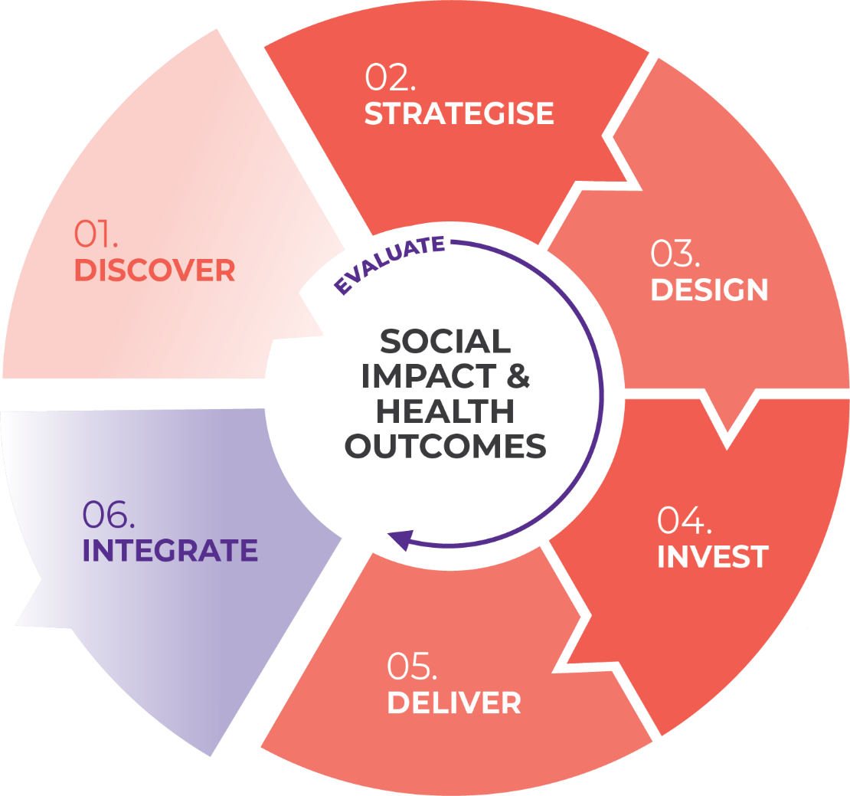

The Commissioning Cycle
Commissioning Cycle updated from four to six phases in December 2022
ATOD Policy moving into Invest phase

Slide 3


What we’ve done so far…
Strategise Phase
    Workshops with partners and stakeholders
    System-wide Needs Assessment– updated and published March 2023
Design Phase
    Workshops with partners and stakeholders
    Specific workshop for outcome indicators and measures
    Listening Report – final version published March 2023
    Invest Phase
    Ongoing work on Strategic Investment Plan
    Planning stages for formal Procurement

Slide 4
What we’re hearing
Design phase is complete, and sector is ready for the next phase
How does the sector engage with the Directorate in this next phase?
Desire for clarity around timeframes

Slide 5
Next steps
Until formal Invest phase, ongoing appropriate business as usual discussions with contract holders and stakeholders, including on:
  Current services
  Pressures and gaps (sector wide or for the service)
  Informal discussion of innovation by a service provider
  Suggestions for sector improvement
Clarify timeline for procurement, noting these are likely longer than previously discussed, and any resultant adjustments to contract completion dates
Move into formal Invest phase and circulate Strategic Investment Plan for sector feedback
  Investment Plan expected to be ready for consultation in coming month
  During Invest phase, business as usual discussions to continue but cannot receive proposals for innovations or improvement outside of the formal procurement process
Procurement and negotiation

Slide 6
Questions?

