Slide 1
STIBBV Policy Workshop #1:
Sexually Transmissible Infections
Commissioning services to meet the needs of people living with or at increased risk of sexually transmissible infections (STI) in the ACT
Health Protection Service, ACT Health Directorate

Slide 2




Country
‘Bush Medicine Leaves’
by Louise Numina
David R Horton (creator), AIATSIS, 1996
Notes:
Acknowledgement of Country

Slide 3
Purpose of the session
Provide a refresher about commissioning and commissioning process in the STIBBV subsector.
Provide an overview of data specific to STI burden of disease in the ACT.
Reflect on what we have heard from the sector to date.
Structured question and discussion session to elicit specific information to inform commissioning in the STIBBV subsector.

Slide 4
Housekeeping and introductions

Slide 5
Who we are as a service sector and what we do?

Slide 6
The ACT STI service sector
Primary health services
General Practitioners (private and bulk-billing)
Non-government primary health services (e.g SHFPACT and the Junction)
Publicly funded primary health services (e.g ACT Walk-in-Clinics and Justice Health)
Speciality services
Canberra Sexual Health Center (only ACT specialist service)
Tertiary Services
Hospital services including emergency departments and gynaecology inpatient units
Notes:
In the ACT, STI services are provided through a combination of publicly funded primary, specialist and tertiary services, as well as private and non-Government primary health organisations.

Slide 7
Key service types
Clinical services (screening, diagnosis and treatment)
Prevention and harm reduction initiatives (including provision of condoms, pre-exposure prophylaxis (PrEP), post-exposure prophylaxis (PEP) and needle syringe programs)
Health promotion and education programs
Support and advocacy
Community development and engagement activities
Workforce training and development
Clinical and practice support services
Disease surveillance, data management and research
Notes:
The STIBBV Subsector currently involves a small collective of government and NGOs who are funded through ACTHD to provide a multitude of local responses to address the burden of STIBBV in the ACT.

Slide 8
Sector stakeholders
Primary stakeholders for commissioning | Potential ACT Government Stakeholders | other non-Government stakeholders
The STIBBV Health Advisory Committee
Consumers | STIBBV Policy Unit (ACTHD) | The Junction Youth Health Service (Anglicare)
Meridian Incorporated | Communicable Disease Control (ACTHD) | Winnunga Nimmityjah Aboriginal Health Service
Sexual Health and Family Planning ACT | Canberra Sexual Health Clinic (CHS) | Canberra Alliance for Harm Minimisation and Advocacy (CAHMA)
Hepatitis ACT | The Liver Clinic/Emergency and gynaecology departments (CHS) | Directions ACT
Capital Health Network-HIV Program | The Women’s Health Service (CHS) | Sex Worker Outreach Program (SWOP)
Australasian Society for HIV, Viral Hepatitis and Sexual Health Medicine (ASHM) | Health System Strategies and Program Support (Health planning) (ACTHD) | The Scarlett Alliance
Haemophilia Foundation ACT | Justice Health | The Youth Coalition of the ACT
 | Other commissioning subsectors/business units (including AoD, Family & Inclusion, Chronic Conditions, Aboriginal and Torres Strait Islander Health & Mental Health) | Health Care Consumers Association
 | The Commissioning Team (ACTHD) | A Gender Agenda
 | ACT Walk-in Centers | The Kirby Institute
 | The School Youth Health Nurse Program (CHS) | Gugan-Gulwan Youth Aboriginal Corporation
 | The Child at Risk Health Unit (CHS) | Companion House
 | Forensic and Medical Sexual Assault Care (CHS) | Multicultural Hub Canberra
Notes:
This table depicts a sector wide consortium of stakeholders including those which provide both STI and BBV services
Stakeholders include a mix of providers who are currently funded by the STIBBV budget, providers who also provide STIBBV related services but of whom may be funded within a different subsector as well as publicly funded STIBBV services, peer workers, peak bodies, academic partners and consumers.
Different stakeholders may be involved in some or all parts of the commissioning process.
We have deliberately invited a broad network of stakeholders to the webinar today as we are aware that there is overlap between subsectors for some of our community partners in terms of the suite of services they provide. Additionally, it is our intention to have widespread visibility of commissioning activities which are taking place specifically in the STIBBV subsector and to ensure that commissioning and procurement decisions are informed by a wide range of perspectives.

Slide 9
Commissioning…a refresher

Slide 10
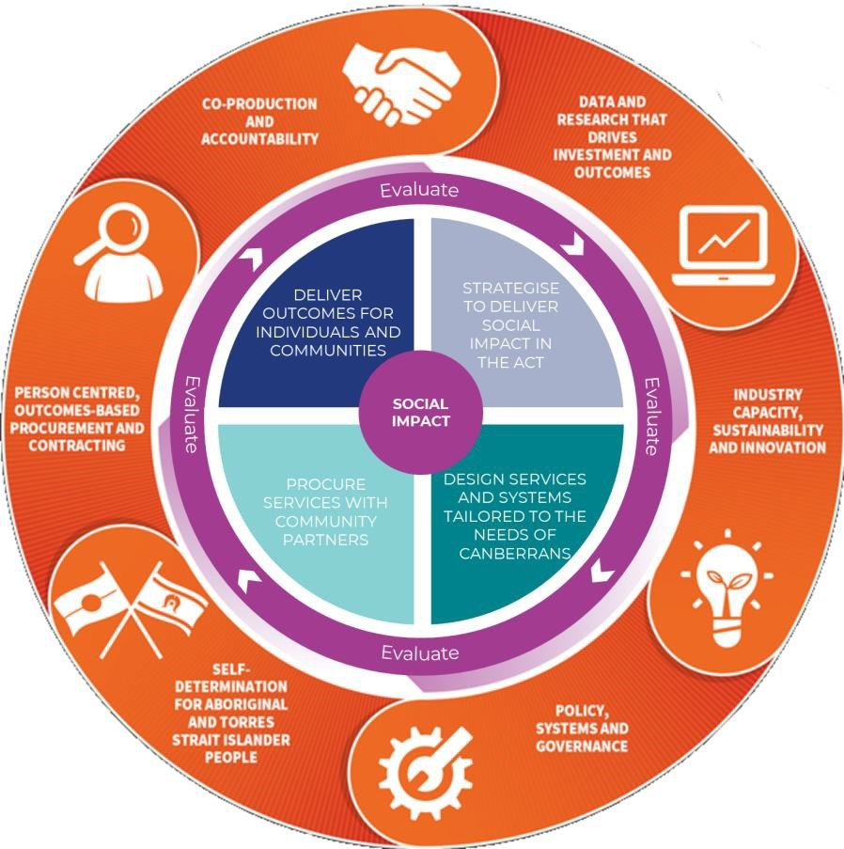
The Commissioning Cycle
Commissioning cycle
Strategise
  Data gathering
  Understand current services and population need
  Identify current over-servicing and service gaps
  Identify current and emerging priorities
  Define system outcomes we are seeking to achieve
  Engage with service providers, service users and other stakeholders to test and refine understanding
Design
Procure
Deliver
Continuous evaluation
Notes:
Commissioning Cycle

Slide 11
Strategic alignment
Statement of Priorities
Commissioning
Sexual Health Services Plan
The Kirby Institute ACT Surveillance Report
Sustainable Development Goals
Notes:
In terms of the STIBBV subsector in the ACT, we see the following pieces of work as integrated and co-dependant.

Slide 12
Scope for commissioning in the STIBBV subsector
To define scope for commissioning activities, the following World Health Organization definition will apply:
‘Sexually transmissible infections (STIs) and blood borne viruses (BBVs) are infections which are spread through unprotected sexual contact and through contact with infected blood and blood products. Some STIs and BBVs can also be transmitted from mother to infant during pregnancy and childbirth.’
Notes:
In line with the title of our subsector and our specific budget remit, commissioning and procurement decisions will relate specifically to services which seek to decrease the burden of disease for sexually transmissible infections and blood borne viruses.

Slide 13
Framework for Commissioning in the STIBBV subsector
Information gathering
Literature review, needs & economic analysis, broad/narrow stakeholder input, consumer engagement
Service system design
Agree on and prioritise services to be provided within the sector from 2024 and beyond and outcomes
Change management
Plan and map incremental change over the short, medium and long term
Procurement
Evaluation of tender applications and final procurement decisions making. Contracts drafted and signed
Tender for agreed services
Draft approach to market documents, Statement of Requirements, services specifications and other required documentation
Service implementation
Implement new services in line with contracts. Continuous review and evaluation
Identification of current & emerging priorities
Identify priority & health system priorities, models of care, current service gaps and potential duplication/overlap of services
Notes:
We have outlined a basic framework for commissioning activities in the STIBBV subsector over the next 18 months and beyond

Slide 14



Questions, comments and queries???

Slide 15
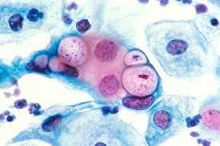
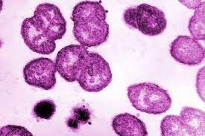
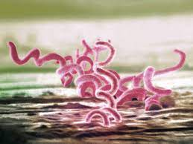
Setting the scene
Sexually Transmissible Infections in the ACT
Notes:
Although there are several notifiable STIs in the ACT, national and jurisdictional surveillance data tends to focus on chlamydia, gonorrhoea and infectious syphilis.

Slide 16
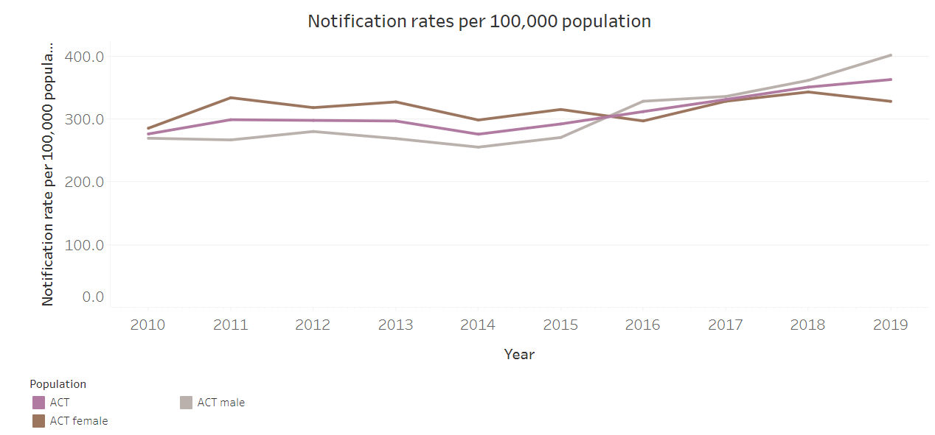
Chlamydia in the ACT
Notes:
Chlamydia remains the most highly notified condition in the ACT, although our notification rates are lower than the national average.
The number of chlamydia notifications in the ACT has steadily increased since 2010. Although nationally, chlamydia notifications are higher in women than men, since the end of 2015, in the ACT we have consistently observed more chlamydia notifications in men than women.
Pleasingly, in the last year or so, we have seen a X% drop in chlamydia notifications in the ACT. Although the impact of the pandemic is an obvious precursor, we are also thinking multiple efforts over many years including health promotion initiatives, media campaigns and more opportunistic screening is starting to yield some result.
Young people aged 20 – 24 years age experience the greatest burden of chlamydia infection, a trend which is similar nation wide.

Slide 17
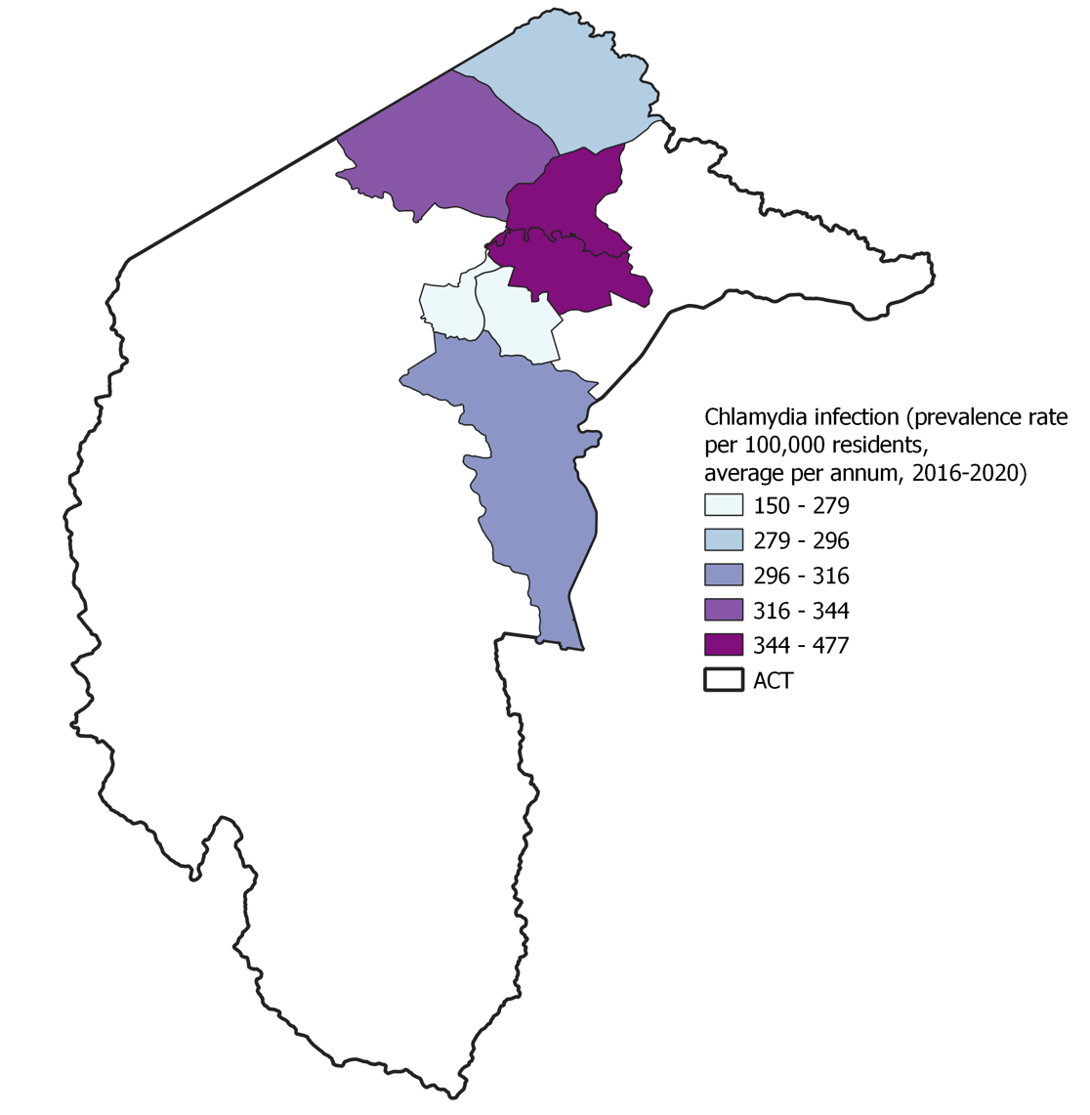
Chlamydia in the ACT
The highest number of chlamydia notifications is observed in individuals residing in the inner north, center and inner south regions of Canberra followed by Belconnen and Tuggeranong.
Notes:
Geo-notification maps provided by Keeley Allen from CDC.
Highest rates of chlamydia infection are notified in people residing in the inner north, center and inner south regions of Canberra followed by Belconnen and Tuggeranong.

Slide 18
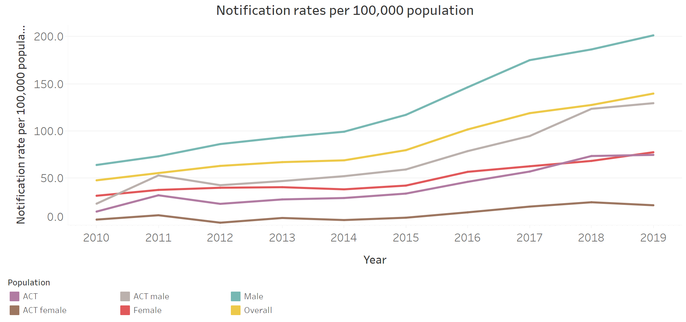
Gonorrhoea in the ACT
Notes:
Gonococcal rates have been increasing steadily since 2010. The incline observed in the ACT is similar to that seen in other jurisdictions and at the national level.
Notifications of gonorrhoea are higher amongst men than women which again is in line with notifications elsewhere. In the ACT the highest rates of gonococcal infections are observed in individuals aged over 30 years. An age profile which is older than for chlamydia.
During the lockdowns, gonococcal notifications dropped by 28% in the less than 2 years duration category and 41% in the greater than 2 years and unspecified duration category.
In spite of this, in the past 12 months, notifications have risen compared with the 5 year average. Over 30% of gonococcal notifications are in females, which is twice the 5-year average, with the majority of cases in women of reproductive age, which highlights the increasing risk for congenital gonococcal infection in the ACT.
Given the confounding impact of antimicrobial resistance associated with gonococcal treatment, addressing gonococcal rates in the ACT is a significant clinical and policy priority

Slide 19
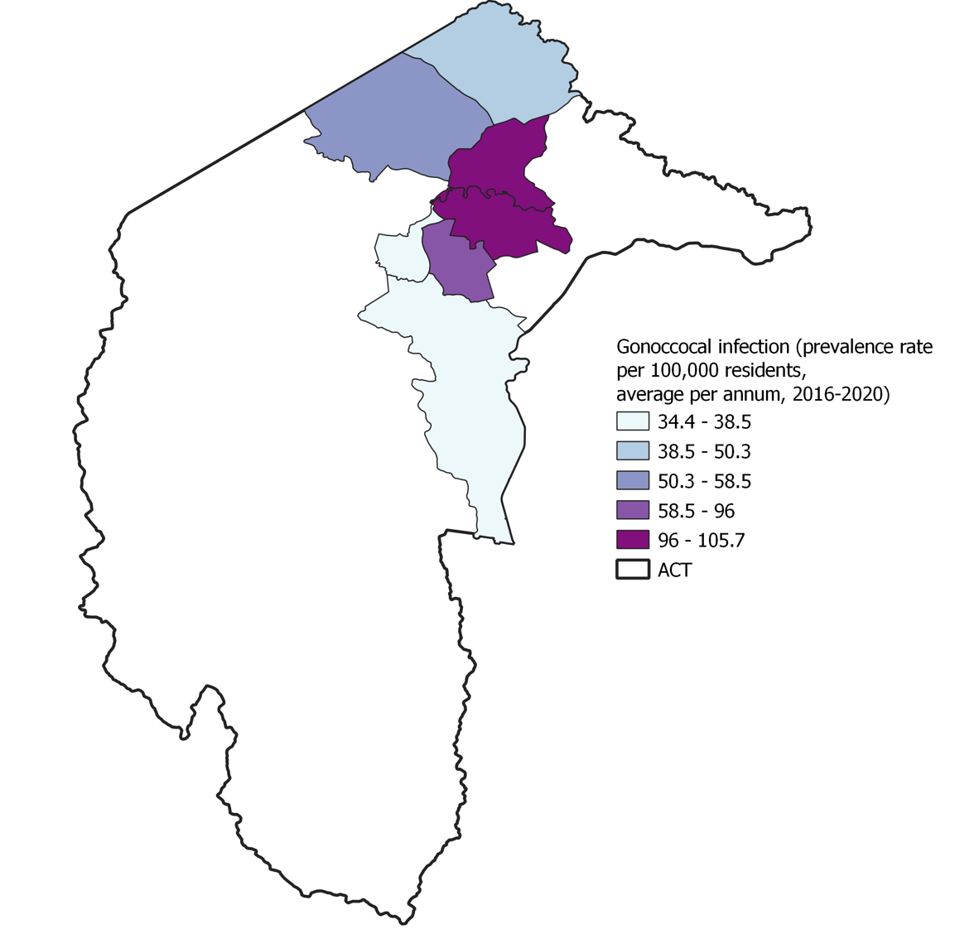
Gonorrhoea in the ACT
Highest number of notifications for gonorrhoea are observed in the inner north, central and inner south regions, followed by Woden and Belconnen.
Notes:
Highest number of notifications for gonorrhoea are observed in the inner north, central and inner south regions, followed by Woden and Belconnen

Slide 20
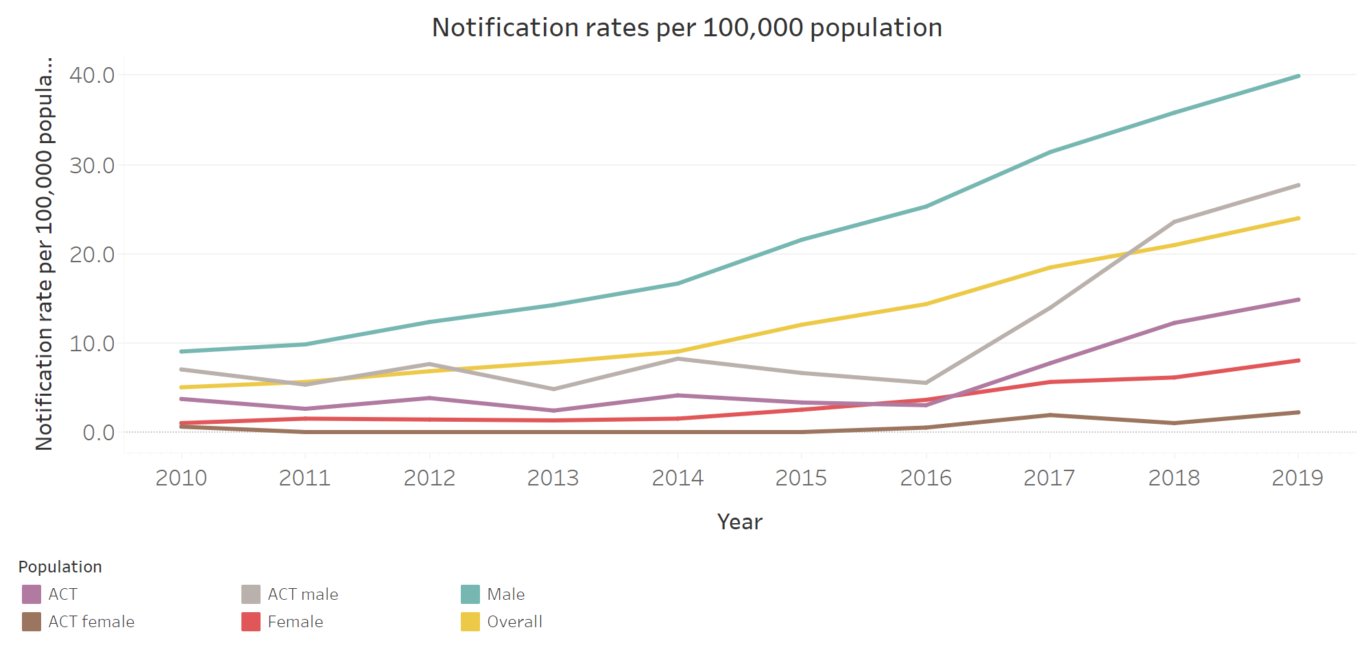
Infectious syphilis in the ACT
Notes:
Notifications of infectious syphillis have increased significantly across Australia over the past decade.
Whilst rural and remote regions across northern, western and some parts of south Australia are in the grips of a syphillis epidemic, in the ACT we are also seeing increased notifications of both syphillis of less than 2 years duration and syphillis cases of greater than 2 years duration or unspecified duration.
Alarmingly, the number of infectious syphilis notifications increased by 136% between 2015 and 2017. the majority of infectious syphilis notifications in the ACT are among males and predominately in males who have sex with other males.
Again, as a result of the pandemic, notifications for quarter 3, 2021 were lower than for the 5 year average but were higher than average for the 12 month period.
In terms of demographics, we are seeing increased notifications in women of reproductive age across the board. In the ACT, approx. 6% of notifications are in women of reproductive age, however this should be interpreted with caution given we have very low numbers overall given our jurisdictional size. None the less, addressing infectious syphillis is high on the sector agenda both locally and nationally given the risks for congenital transmission and associated poor health outcomes for the foetus and infant.
Quarter 3, 2021 saw a 20-40% increase in notifications compared with the 5 year average for <2 years duration and >greater than 2 years duration or unspecified respectively.
Notifications of infectious syphilis are typically highest in the 20-39 age group

Slide 21
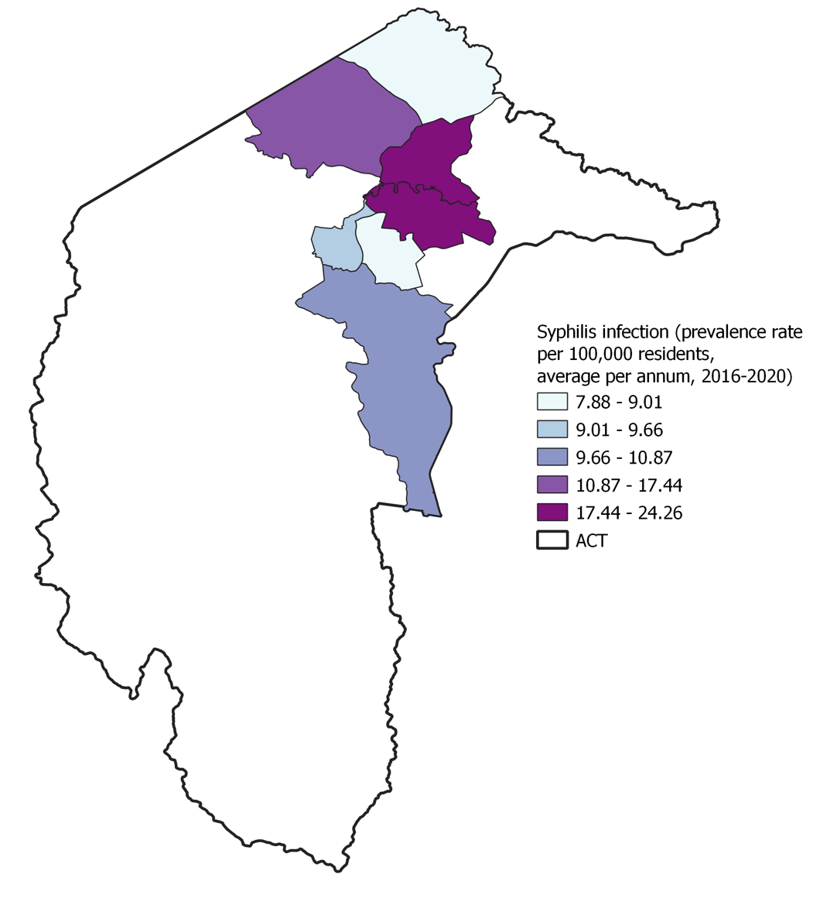
Infectious syphilis in the ACT
Highest rates of infectious syphillis are notified in people residing in the inner north, center and inner south regions of Canberra, followed by Belconnen and Tuggeranong.
Notes:
Highest rates of infectious syphillis are notified in people residing in the inner north, center and inner south regions of Canberra with Belconnen and Tuggeranong recording the next highest number of notifications.

Slide 22
Questions, comments and queries???

Slide 23
Priority populations

Slide 24
Current priority population groups
Young people
Young people aged between 15 and 29 years continue to be significantly impacted by STI
Greater exposure to risk factors of STI (eg high risk sexual contact, misuse of some illicit and licit drugs and risky alcohol consumption)
Aboriginal and Torres Strait Islander people
Notification rates of chlamydia, gonorrhoea and syphilis are significantly higher in the Aboriginal and Torres Strait Islander population, particularly in young people in this population.
Gay men and other men who have sex with men
High prevalence and incidence of almost all STI in this priority population.

Slide 25
Current priority population groups
Sex workers
Sex workers experience specific barriers to accessing health services, including stigma and discrimination and regulatory and legal issues—criminalisation, licensing, registration etc.
People with culturally and linguistically diverse (CALD) backgrounds
Studies have indicated a high prevalence of certain STI in CALD populations, a lack of knowledge of STI and the potential for the emergence and increasing incidence of STI in urban CALD populations.
Travellers and mobile workers
Fly-in fly-out and seasonal workers, and the communities they have contact with, are important sub-populations for consideration in the response to STI.

Slide 26
Current priority population groups
People in custodial settings
There is often limited access to STI prevention education and the tools for prevention for this population, both within and outside of the custodial setting.

Slide 27
Emerging priority population groups
Women of reproductive age
In light of increasing notifications of gonococcal in women of reproductive age in the ACT as well as increasing cases of infectious syphillis in other jurisdictions.
People living with a disability
Conjecture in the literature in terms of risk of STI compared with people not living with disability, however experience vulnerability in terms of stigma and healthcare and community attitudes, impaired knowledge or health literacy, access to services and risk for abuse/exploitation

Slide 28
Questions, comments and queries???

Slide 29
Potential priorities to address through commissioning

Slide 30
What we’ve heard from the sector thus far
Access to education, testing and treatment for STI requires improvement
Need for holistic models/bundles of care which combine testing, treatment and health promotion.
Need for innovative models of care (e.g nurse or peer led STI care)
Need for flexible models of care where people live, work and learn
Need for integration of STI services with other health and community services including AoD and CALD services.
Need to support, train and upskill health workforce to better opportunistically screen for STI across health and community settings
Need access to STI testing pathology data

Slide 31
What we know from the data
We need to build on recent successes to further drive down chlamydia notifications
We need to decrease gonococcal notifications in women of reproductive age give risk for congenital transmission.
We need to continue to monitor outbreak of infection syphillis in Aboriginal and Torres Strait Islander populations across other jurisdictions and increase capacity to respond quickly and appropriately if notifications rise in the ACT.
Priority populations (including young people) continue to experience barriers to STI care in the ACT (including geographic location, opening hours, cost and concerns around stigma and confidentiality).

Slide 32
Questions, comments and queries???

Slide 33
Discussion…

Slide 34
Question 1 (15 minutes)
How are current services working well to meet STI-related need in the ACT? What are our strengths as a sector?
  What is working well and what does success look like in the sector?
  What priority population groups are currently being appropriately or over-serviced?
  What type/mode/models of service are yielding the strongest impact?
  Where are the strong referral pathways?
  How can we leverage and build on successes further through commissioning?

Slide 35
Question 2 (15 minutes)
What challenges are services facing which impacts their ability to meet STI-related need in the ACT?
  What are services struggling with?
  What priority population groups are currently being under or inadequately serviced?
  Where are the friction points within and between services?
  What/where are the current service/service system shortfalls?
  Where can services improve to better meet community need?
  Where do referral pathways need development?
  Where is further integration or coordination of services required?

Slide 36
Question 3 (15 minutes)
What structural/contextual issues are having an impact on the STI service system (either positively or negatively)?
  E.g. service frameworks, regulation, funding, the policy landscape, the broader political sphere, media etc
  What could be done to capitalise on or mediate the identified issues?

Slide 37
Question 4 (15 minutes)
What are the short (0-2yrs), medium (3-5yrs) and long-term (6-10yrs) priorities to address STI related need in the ACT?
  What are your top 2 priorities for either the short, medium, or long term?
  What would constitute an easy win (cheap and quick to implement)?
  What would constitute a longer-term win (more expensive and time/resource-intensive to implement)?
  What specific actions could we take as a sector to address the priority areas identified?

Slide 38
Question 5 (15 minutes)
What outcome measures will best determine and describe success and impact of services and why?
  Quantitative (what/who/how?)
  Qualitative measures (what/who/how?)

Slide 39
Next steps…
Phase 1 (strategise)
Next workshops:
Viral hepatitis this Friday 4th March
HIV next Wednesday 9th March
July 2022-Dev 2023 contract variations
Consultation and drafting March-May
Final sign off June 2022
Consumer engagement:
Engaging consultant: February-March 2022
Phase 1 (surveys): March-April 2022
Consumer one-on-one interviews and focus groups: April-May 2022
Phase 2 (collaborative design)
Five smaller round table discussions to be scheduled monthly between June and October
Decisions from those will be distributed for wider consultation Nov-Dec 2022
Phase 3 (procurement)
Approach to market documents: January-March 2023
Subsector tender process March-September 2023
Tender application review: October 2023
Final procurement decisions and contract drafting: November-December 2023
Phase 4 (deliver outcomes)
Implementation of new contracts: January 2024
*** We are also currently consulting for the next iteration of the Hepatitis B, Hepatitis C, HIV and Sexually Transmissible Infections: ACT Statement of Priorities which is due for release later this year

Slide 40
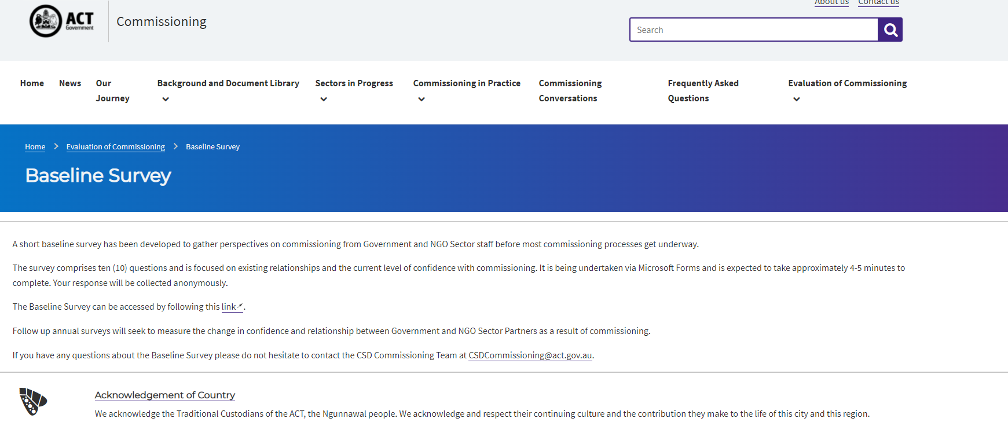

Commissioning Evaluation
The ACT Health Directorate is undertaking an evaluation of Commissioning
The baseline survey (left) is now available on the ACT Health Commissioning website and has also been widely circulated to NGO partners.
The Post-Activity Survey (left) should be undertaken by all attendees post any commissioning engagement activity.
https://www.communityservices.act.gov.au/commissioning/evaluation-of-commissioning/baseline-survey
Commissioning Process - Post-Activity Survey (office.com)

Slide 41
Questions, comments and queries???

Slide 42
References
ACT Health Directorate. (2021). Commissioning for outcomes. https://www.communityservices.act.gov.au/commissioning
ACT Health Directorate (2016). Hepatitis B, Hepatitis C, HIV and Sexually transmissible Infections: ACT Statement of Priorities 2016-2020.
ACT Health Directorate (2021). Territory-wide health services. https://www.health.act.gov.au/about-our-health-system/planning-future/territory-wide-health-services
Akwasi, A. G., Naomi, G., Reindolf, A., Prince, P., Enoch, A., Emmanuel, A., ... & Tsiboe, A. K. (2020). Knowledge on and attitude towards Sexually Transmitted Infections: A qualitative study of people with physical disabilities in a peri-urban district of Ghana. Cogent Medicine, 7(1), 1736249.
Australasian Society for HIV, Viral Hepatitis and Sexual Health Medicine https://hivlegal.ashm.org.au/sex-work/
Fairley, C. K., Chow, E. P., & Hocking, J. S. (2015). Early presentation of symptomatic individuals is critical in controlling sexually transmissible infections. Sexual Health, 12(3), 181-182.
Kirby Institute Latest Sexually Transmissible Surveillance Data: Sexually transmissible Infections. (2020). https://data.kirby.unsw.edu.au/STIs
Kirby Institute. Sexually transmissible infections and blood borne viruses in the ACT: surveillance report 2018. Sydney: Kirby Institute, UNSW Sydney; 2018
Schmidt, E. K., Hand, B. N., Simpson, K. N., & Darragh, A. R. (2019). Sexually transmitted infections in privately insured adults with intellectual and developmental disabilities. Journal of Comparative Effectiveness Research, 8(8), 599-606.
Ward, J. S., Hengel, B., Ah Chee, D., Havnen, O., & Boffa, J. D. (2020). Setting the record straight: sexually transmissible infections and sexual abuse in Aboriginal and Torres Strait Islander communities. Medical Journal of Australia, 212(5), 205-207.
Images
https://www.microscopemaster.com/chlamydia-bacteria.html
https://www.healthdirect.gov.au/blog/antibiotic-resistant-gonorrhoea-has-increased
https://www.npr.org/sections/health-shots/2016/06/10/480643381/despite-rise-of-superbugs-syphilis-still-has-a-kryptonite
https://www.google.com.au/search?q=%3F&safe=active&sxsrf=APq-WBvp_KJJrAWmubi3gsSJxexL48vedw:1645930033089&source=lnms&tbm=isch&sa=X&ved=2ahUKEwjjusmX7572AhU3wjgGHR2yB2cQ_AUoAnoECAEQBA#imgrc=f1w-9FUXA_gWRM
https://www.google.com.au/search?q=%3F&safe=active&sxsrf=APq-WBvp_KJJrAWmubi3gsSJxexL48vedw:1645930033089&source=lnms&tbm=isch&sa=X&ved=2ahUKEwjjusmX7572AhU3wjgGHR2yB2cQ_AUoAnoECAEQBA#imgrc=as1T5pbsnk4wiM

