Slide 1
STIBBV Policy Workshop #2:
Viral hepatitis
Commissioning services to meet the needs of people living with or at increased risk of viral hepatitis in the ACT
Health Protection Service, ACT Health Directorate

Slide 2




Country
‘Meeting Place’
By Leah Brideson
‘
David R Horton (creator), AIATSIS, 1996
Notes:
Acknowledgement of Country

Slide 3
Purpose of the session
Provide a refresher about commissioning and commissioning process in the STIBBV subsector.
Provide an overview of data specific to viral hepatitis burden of disease in the ACT.
Reflect on what we have heard from the sector to date.
Structured question and discussion session to elicit specific information to inform commissioning in the STIBBV subsector.

Slide 4
Housekeeping and introductions

Slide 5
Who we are as a service sector and what we do?

Slide 6
The ACT viral hepatitis service sector
Primary health services
General Practitioners (private and bulk-billing)
Non-government primary health services (e.g Hepatitis ACT and Directions ACT)
Publicly funded primary health services (e.g ACT Walk-in-Clinics and Justice Health)
Speciality services
Canberra Sexual Health Center (only ACT specialist service)
Tertiary Services
Hospital services including emergency departments and the Canberra Hospital Liver Clinic
Notes:
In the ACT, viral hepatitis services are provided through a combination of publicly funded primary, specialist and tertiary services, as well as private and non-Government primary health organisations.

Slide 7
Key service types
Clinical services (screening, diagnosis and treatment)
Prevention and harm reduction initiatives (including provision of condoms, pre-exposure prophylaxis (PrEP), post-exposure prophylaxis (PEP) and needle syringe programs)
Health promotion and education programs
Support and advocacy
Community development and engagement activities
Workforce training and development
Clinical and practice support services
Disease surveillance, data management and research
Notes:
The STIBBV Subsector currently involves a small collective of government and NGOs who are funded through ACTHD to provide a multitude of local responses to address the burden of STIBBV in the ACT. Key initiatives include:

Slide 8
Sector stakeholders
Primary stakeholders for commissioning | Potential ACT Government Stakeholders | other non-Government stakeholders
The STIBBV Health Advisory Committee
Consumers | STIBBV Policy Unit (ACTHD) | The Junction Youth Health Service (Anglicare)
Meridian Incorporated | Communicable Disease Control (ACTHD) | Winnunga Nimmityjah Aboriginal Health Service
Sexual Health and Family Planning ACT | Canberra Sexual Health Clinic (CHS) | Canberra Alliance for Harm Minimisation and Advocacy (CAHMA)
Hepatitis ACT | The Liver Clinic/Emergency and gynaecology departments (CHS) | Directions ACT
Capital Health Network-HIV Program | The Women’s Health Service (CHS) | Sex Worker Outreach Program (SWOP)
Australasian Society for HIV, Viral Hepatitis and Sexual Health Medicine (ASHM) | Health System Strategies and Program Support (Health planning) (ACTHD) | The Scarlett Alliance
Haemophilia Foundation ACT | Justice Health | The Youth Coalition of the ACT
 | Other commissioning subsectors/business units (including AoD, Family & Inclusion, Chronic Conditions, Aboriginal and Torres Strait Islander Health & Mental Health) | Health Care Consumers Association
 | The Commissioning Team (ACTHD) | A Gender Agenda
 | ACT Walk-in Centers | The Kirby Institute
 | The School Youth Health Nurse Program (CHS) | Gugan-Gulwan Youth Aboriginal Corporation
 | The Child at Risk Health Unit (CHS) | Companion House
 | Forensic and Medical Sexual Assault Care (CHS) | Multicultural Hub Canberra
Notes:
This table depicts a sector wide consortium of stakeholders including those which provide both STI and BBV services
Stakeholders include a mix of providers who are currently funded by the STIBBV budget, providers who also provide STIBBV related services but of whom may be funded within a different subsector as well as publicly funded STIBBV services, peer workers, peak bodies, academic partners and consumers.

Slide 9
Commissioning…a refresher

Slide 10
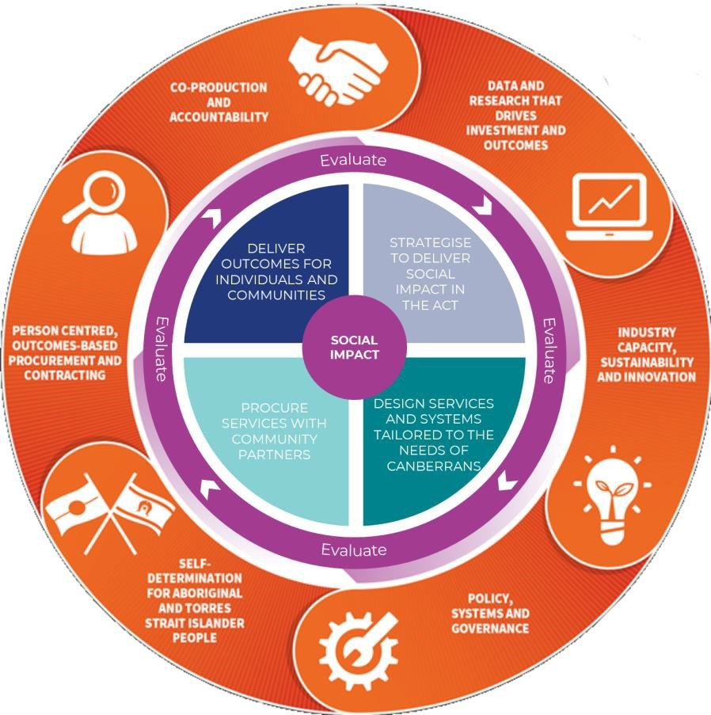
The Commissioning Cycle
Commissioning cycle
Strategise
  Data gathering
  Understand current services and population need
  Identify current over-servicing and service gaps
  Identify current and emerging priorities
  Define system outcomes we are seeking to achieve
  Engage with service providers, service users and other stakeholders to test and refine understanding
Design
Procure
Deliver
Continuous evaluation
Notes:
Commissioning Cycle

Slide 11
Strategic alignment
Statement of Priorities
Commissioning
Sexual Health Services Plan
The Kirby Institute ACT Surveillance Report
Sustainable Development Goals
Notes:
In terms of the STIBBV subsector in the ACT, we see the following pieces of work as integrated and co-dependant.

Slide 12
Scope for commissioning in the STIBBV subsector
To define scope for commissioning activities, the following World Health Organization definition will apply:
‘sexually transmissible infections (STIs) and blood borne viruses (BBVs) are infections which are spread through unprotected sexual contact and through contact with infected blood and blood products. Some STIs and BBVs can also be transmitted from mother to infant during pregnancy and childbirth.’
Notes:
In line with the title of our subsector and our specific budget remit, commissioning and procurement decisions will relate specifically to services which seek to decrease the burden of disease for viral hepatitis and blood borne viruses.

Slide 13
Framework for Commissioning in the STIBBV subsector
Information gathering
Literature review, needs & economic analysis, broad/narrow stakeholder input, consumer engagement
Service system design
Agree on and prioritise services to be provided within the sector from 2024 and beyond and outcomes
Change management
Plan and map incremental change over the short, medium and long term
Procurement
Evaluation of tender applications and final procurement decisions making. Contracts drafted and signed
Tender for agreed services
Draft approach to market documents, Statement of Requirements, services specifications and other required documentation
Service implementation
Implement new services in line with contracts. Continuous review and evaluation
Identification of current & emerging priorities
Identify priority & health system priorities, models of care, current service gaps and potential duplication/overlap of services
Notes:
We have outlined a basic framework for commissioning activities in the STIBBV subsector over the next 18 months and beyond

Slide 14



Questions, comments and queries???

Slide 15


Setting the scene
Viral hepatitis in the ACT
Notes:
Although there are several notifiable strains of viral hepatitis in the ACT, national and jurisdictional surveillance data tends to focus on hepatitis B and C.

Slide 16
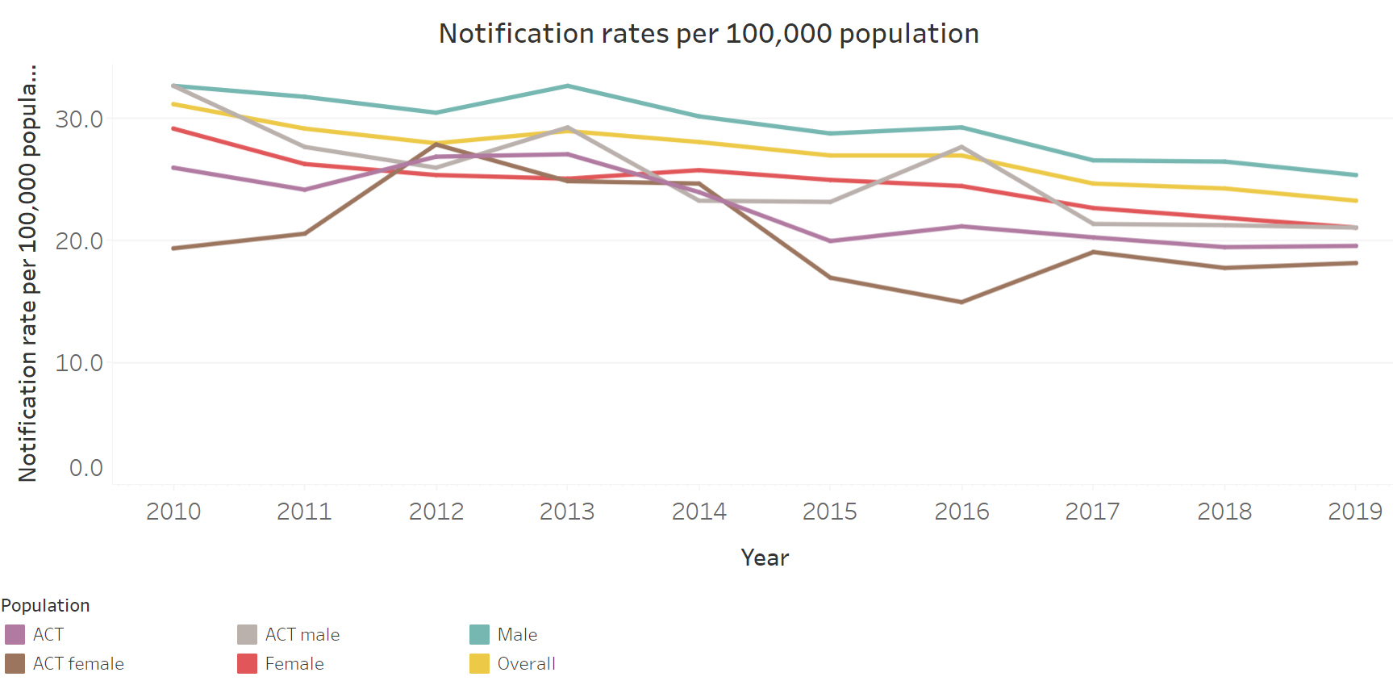
Hepatitis B in the ACT
Notes:
Pleasingly, rates of hepatitis B in the ACT remain lower than the national average
In the ACT, people from culturally and linguistically diverse populations are over represented in our hep B notification data. Improving access to testing and treatment for this group is important in further reducing incidence of hepatitis B and subsequent burden of disease.
Hepatitis B vaccination coverage rates for children remains high in the ACT, however hepatitis B vaccination coverage at 12 months is still lower in Aboriginal and Torres Strait Islander children compared to non‑Indigenous children. Hepatitis B vaccination rates for Aboriginal and Torres Strait Islander children aged 2 years, is slightly higher than for non-Indigenous children
The fluctuation in coverage at 12 months may reflect the effect of small numbers, however, the lower rates at 12 months in Aboriginal and Torres Strait Islander children suggests issues around engagement with child and family health services in the first year of life and timeliness of completion of the vaccination course, which may lead to increased risk of disease acquisition.

Slide 17
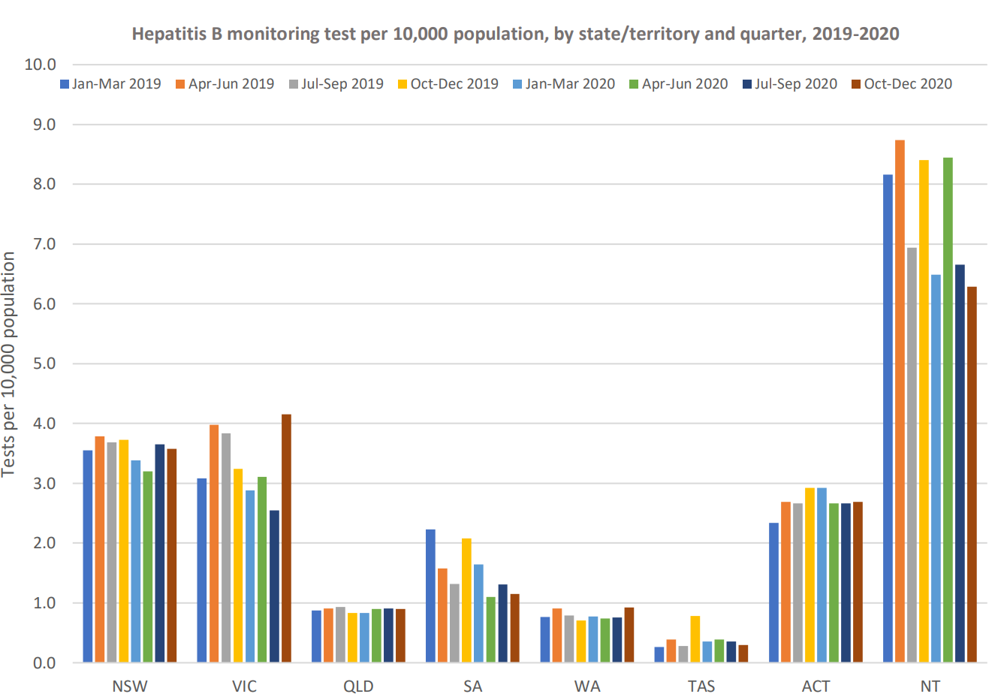
Hepatitis B in the ACT: Monitoring
MacLachlan, J. (2021). Impacts of COVID 19 on BBVSTI testing, care and treatment: Medicare data analysis. WHO Collaborating Center for Viral Hepatitis. Doherty Institute for Infection and Immunity.
Notes:
Hepatitis B (unspecified duration)
We are doing reasonably well in terms of testing for hepatitis B in the ACT, however there is certainly more we can be doing. As you can see, testing rates are highest in the NT, however they have the highest prevalence of chronic hep B in Australia

Slide 18
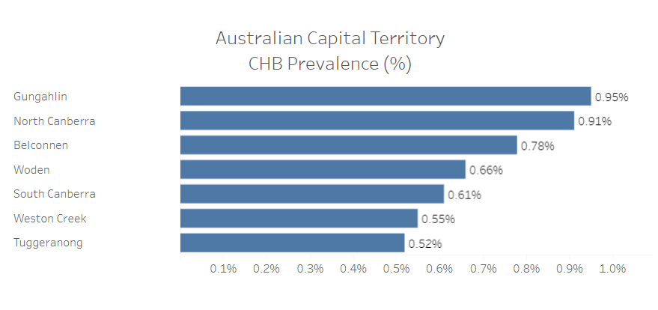
Hepatitis B in the ACT: Prevalence
Notes:
This slide shoes chronic hepatitis B in the ACT by geographic area. Gungahlin has the highest prevalence of hepatitis B, followed by north Canberra and Belconnen.

Slide 19
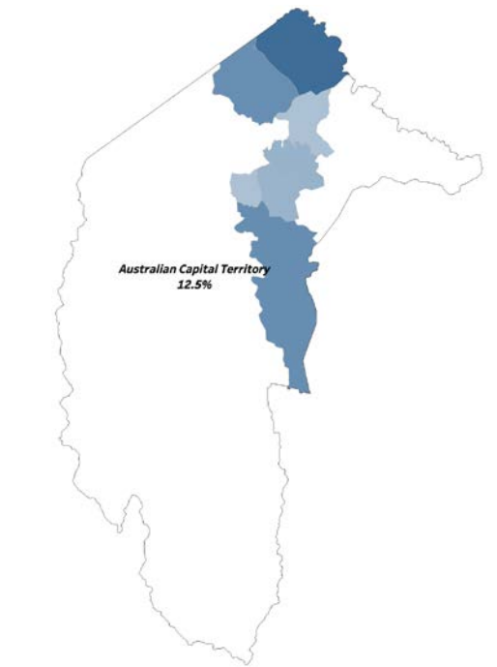
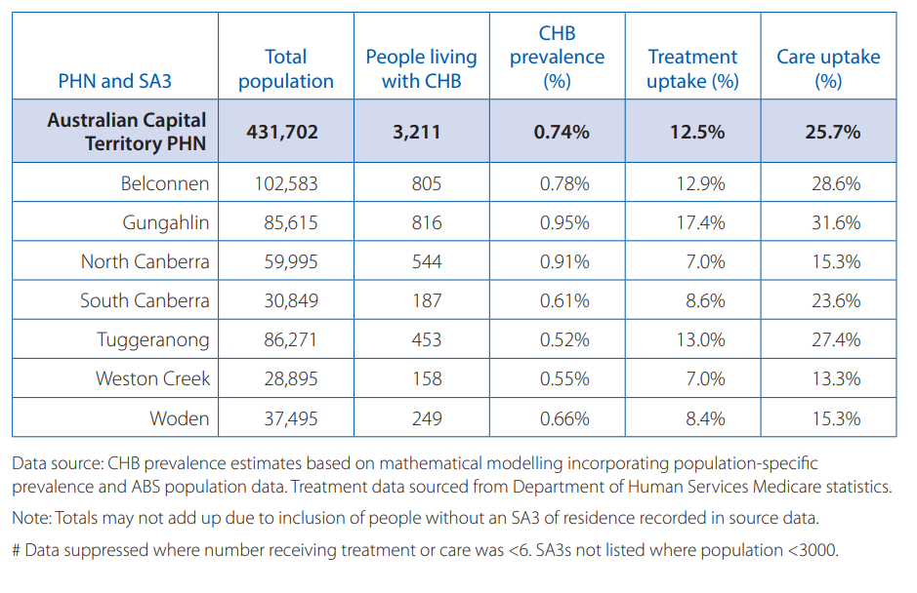
Hepatitis B in the ACT: Treatment uptake
Source: MacLachlan JH, Stewart S, Cowie BC. Viral Hepatitis Mapping Project: National Report 2020. Darlinghurst, NSW, Australia: Australasian Society for HIV, Viral Hepatitis, and Sexual Health Medicine (ASHM), 2020; https://www.ashm.org.au/programs/ Viral-Hepatitis-Mapping-Project/
Notes:
The following geographical maps relate to treatment uptake for hepatitis B across the ACT by geographical area.
Treatment uptake for hepatitis B in the Act overall in 2020 was 12.5%, higher than the national average of 10.7%.
Within the ACT, uptake was highest in Gungahlin, Tuggeranong and Belconnen. Notably, these were also the only three regions which continued to see an increase in treatment numbers during 2020, with uptake in Gungahlin and Belconnen increasing more rapidly than during the previous year. In contrast, treatment uptake in the remaining regions declined during 2020, and were all below the national average.
Care uptake for hepatitis B in the ACT was also higher than the national average. Variations by area largely reflect those of treatment uptake; however, South Canberra had relatively higher monitoring uptake and so reached care levels similar to the national average. The number of viral load monitoring tests conducted decreased considerably across most of the ACT, except for Belconnen which observed an increase of 38%, meaning that on average the monitoring uptake in ACT remained stable.

Slide 20
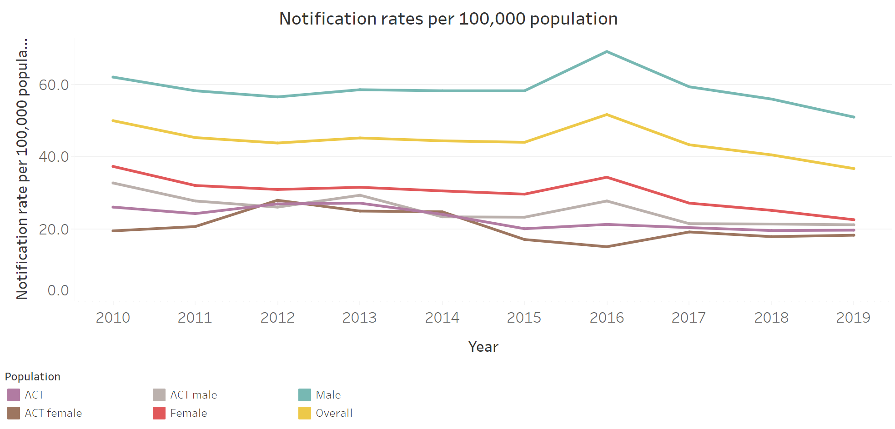
Data –HEPATITIS C IN THE ACT)
Notes:
There were five cases of newly acquired hepatitis C virus (HCV) infection notified in quarter 2, 2021.
The quarterly and 12-month notifications for new Hepatitis C were also higher than the respective 5-year average. The rate of notifications in the ACT was also higher than the Australian rate for the past 12 months 2020 through 2021.
As the total number of HCV (new and unspecified duration) was lower for the 2nd quarter of 2021 and the year compared with the historical averages, it is possible that the observed increase in new cases is due to better case classification.
Almost all cases of hepatitis C in the ACT identify previous intravenous drug use, and a significant proportion identify either previous or current imprisonment. Individuals who identify as homeless also experience a disproportionate burden of hepatitis C infection. These demographics are all consistent with the national picture.
Treatment uptake for chronic hepatitis C in ACT at the end of 2020 was 46.0%, just below the national average of 47.0% − ACT ranked 4th of eight states and territories for treatment uptake for hepatitis C − However, declines in treatment uptake in ACT have been more rapid than what has been observed nationally which warrants attention within our subsector.

Slide 21
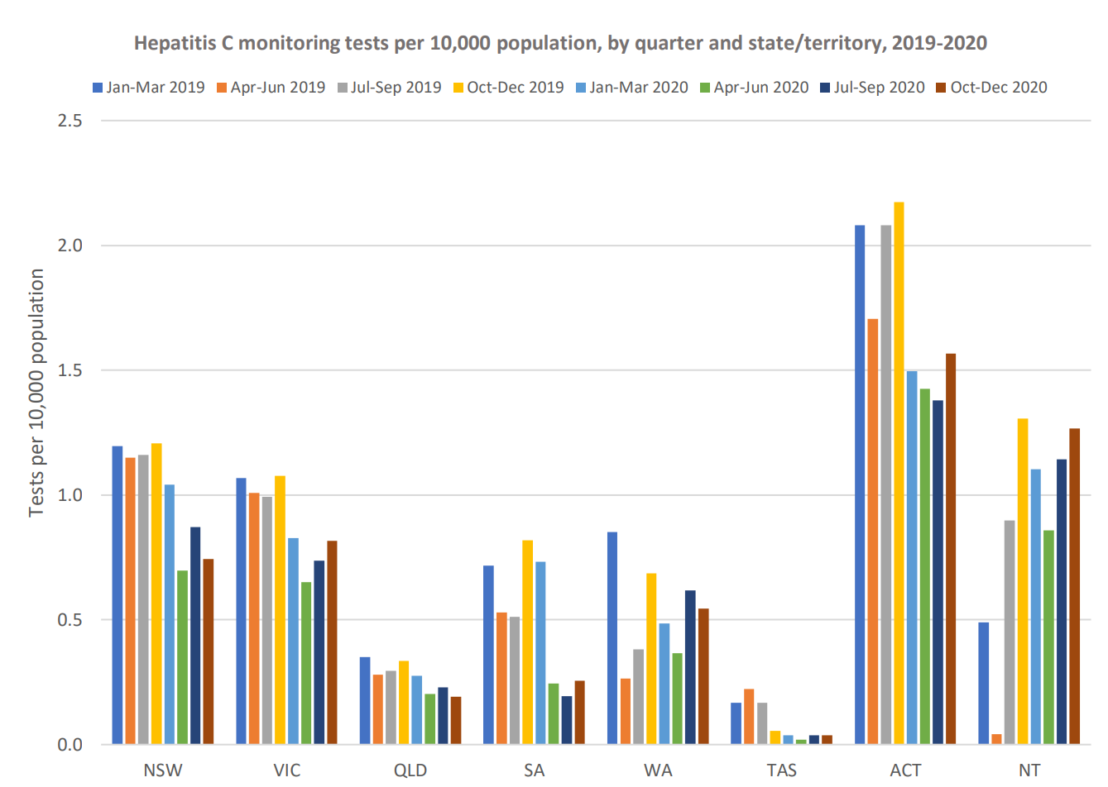
Hepatitis C in the ACT: Testing
MacLachlan, J. (2021). Impacts of COVID 19 on BBVSTI testing, care and treatment: Medicare data analysis. WHO Collaborating Center for Viral Hepatitis. Doherty Institute for Infection and Immunity.
Notes:
In terms of testing for hepatitis C, the ACT are doing exceptionally well, compared with other jurisdictions.

Slide 22

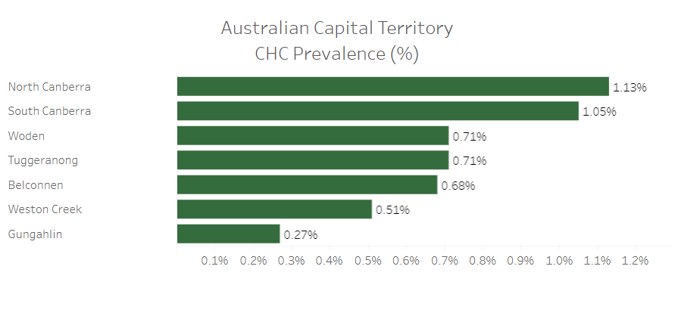
Hepatitis C in the ACT: Prevalence
Notes:
This slide displays the geographic distribution and prevalence of hepatitis C in the ACT. In the map on the right, regions in a darker green have a higher prevalence of hepatitis C. As you can see the inner north, central and inner south have the highest rates of hepatitis C, followed by Woden.

Slide 23
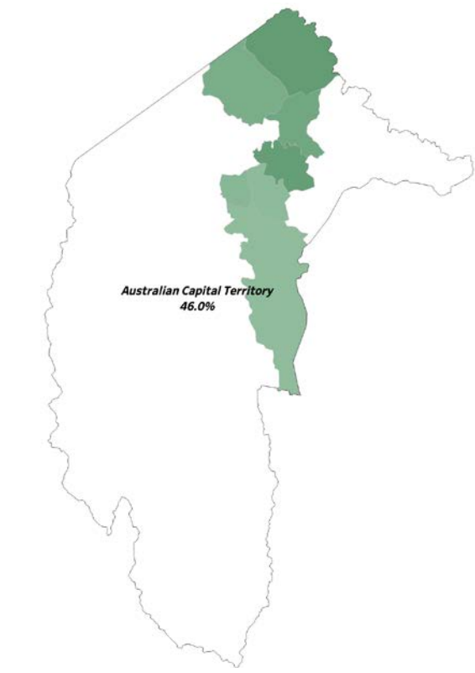
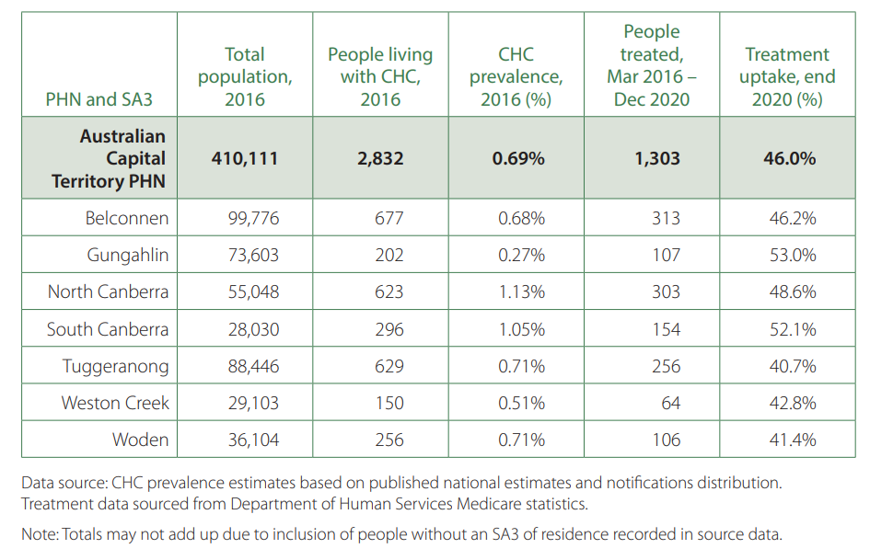
Hepatitis C in the ACT: Treatment uptake
Source: MacLachlan JH, Stewart S, Cowie BC. Viral Hepatitis Mapping Project: National Report 2020. Darlinghurst, NSW, Australia: Australasian Society for HIV, Viral Hepatitis, and Sexual Health Medicine (ASHM), 2020; https://www.ashm.org.au/programs/ Viral-Hepatitis-Mapping-Project/
Notes:
By the end of 2020, 46.0% of people living with chronic hepatitis C in the ACT were engaged with treatment.
Variation in treatment uptake overall was minimal across geographical areas in the ACT, ranging from 40.7% in Tuggeranong to 53.0% in Gungahlin. Uptake was highest in Gungahlin and South Canberra. Again, as mentioned previously, declines in treatment uptake after 2016 were more significant in the ACT compared to declines in treatment uptake observed elsewhere in Australia. The only exception was for North Canberra where engagement in treatment still declined, albeit more gradually than other areas within the ACT.

Slide 24
Questions, comments and queries???

Slide 25
Priority populations

Slide 26
Hepatitis B priority populations in Australia
People living with hepatitis B
Majority are overseas-born or are Aboriginal and Torres Strait Islander people
Culturally and linguistically diverse people
Majority of hepatitis B in Australia is experienced by people born overseas in hepatitis B endemic areas
Aboriginal and Torres Strait Islander people
Hepatitis B continues to disproportionately impact Aboriginal and Torres Strait Islander people, particularly those from rural and remote communities.
Unvaccinated adults
The vast majority of people who develop chronic hepatitis B acquire the infection at birth or in childhood.

Slide 27
Hepatitis C priority populations in Australia
People living with hepatitis C
Individuals who are fully diagnosed, partially diagnosed (no RNA test) and not yet diagnosed
People who currently inject or have previously injected drugs
Receptive needle and syringe sharing is the primary cause of transmission in Australia.
People in custodial setting
Heightened risk of hepatitis C transmission due to the high hepatitis C prevalence among prison entrants and limited harm reduction programs
Aboriginal and Torres Strait Islander people
Lack of access to testing and treatment, over-representation in custodial settings and complex social and medical factors increase risk
Culturally and linguistically diverse people
Including people born in countries with high hepatitis C prevalence

Slide 28
Questions, comments and queries???

Slide 29
Potential priorities to address through commissioning

Slide 30
What we’ve heard from the sector thus far
Need better data around access to STIBBV services for priority population groups
Increased capacity for hepatitis screening including point of care testing at established syringe exchange centres
Scale up of Hepatitis B services and programs from people from CALD backgrounds
We need to better engage people in the viral hepatitis care cascade
Strengthening STIBBV screening/treatment capacity in primary care to reduce the burden of chronic disease on the tertiary hospital system.
Need for innovative models of care (e.g nurse or peer led viral hepatitis care)
Need for flexible models of care where people live, work and learn
Need for integration of viral hepatitis services with other health and community services including AoD and homelessness/housing services.

Slide 31
What we know from the data
In viral hepatitis, and particularly in hepatitis C, retention of clients in treatment programs throughout the care cascade remains a priority.
Identifying hepatitis B amongst overseas–born and migrant communities remains a priority.
Viral hepatitis incidence, prevalence and treatment uptake differs between subareas in the ACT.
Priority populations continue to experience barriers to access of viral hepatitis services, particularly harm minimisation services for people who are incarcerated.

Slide 32
Questions, comments and queries???

Slide 33
Discussion…

Slide 34
Question 1 (15 minutes)
How are current services working well to meet viral hepatitis-related need in the ACT? What are our strengths as a sector?
  What is working well and what does success look like in the sector?
  What priority population groups are currently being appropriately or over-serviced?
  What type/mode/models of service are yielding the strongest impact?
  Where are the strong referral pathways?
  How can we leverage and build on successes further through commissioning?

Slide 35
Question 2 (15 minutes)
What challenges are services facing which impacts their ability to meet viral hepatitis-related need in the ACT?
  What are services struggling with?
  What priority population groups are currently being under or inadequately serviced?
  Where are the friction points within and between services?
  What/where are the current service/service system shortfalls?
  Where can services improve to better meet community need?
  Where do referral pathways need development?
  Where is further integration or coordination of services required?

Slide 36
Question 3 (15 minutes)
What structural/contextual issues are having an impact on the viral hepatitis service system (either positively or negatively)?
  E.g. service frameworks, regulation, funding, the policy landscape, the broader political sphere, media etc
  What could be done to capitalise on or mediate the identified issues?

Slide 37
Question 4 (15 minutes)
What are the short (0-2yrs), medium (3-5yrs) and long-term (6-10yrs) priorities to address viral hepatitis related need in the ACT?
  What are your top 2 priorities for either the short, medium, or long term?
  What would constitute an easy win (cheap and quick to implement)?
  What would constitute a longer-term win (more expensive and time/resource-intensive to implement)?
  What specific actions could we take as a sector to address the priority areas identified?

Slide 38
Question 5 (15 minutes)
What outcome measures will best determine and describe success and impact of services and why?
  Quantitative (what/who/how?)
  Qualitative measures (what/who/how?)

Slide 39
Next steps…
Phase 1 (strategise)
Next workshops:
HIV next Wednesday 9th March
July 2022-Dev 2023 contract variations
Consultation and drafting March-May
Final sign off June 2022
Consumer engagement:
Engaging consultant: February-March 2022
Phase 1 (surveys): March-April 2022
Consumer one-on-one interviews and focus groups: April-May 2022
Phase 2 (collaborative design)
Five smaller round table discussions to be scheduled monthly between June and October
Decisions from those will be distributed for wider consultation Nov-Dec 2022
Phase 3 (procurement)
Approach to market documents: January-March 2023
Subsector tender process March-September 2023
Tender application review: October 2023
Final procurement decisions and contract drafting: November-December 2023
Phase 4 (deliver outcomes)
Implementation of new contracts: January 2024
*** We are also currently consulting for the next iteration of the Hepatitis B, Hepatitis C, HIV and viral hepatitis: ACT Statement of Priorities which is due for release later this year

Slide 40
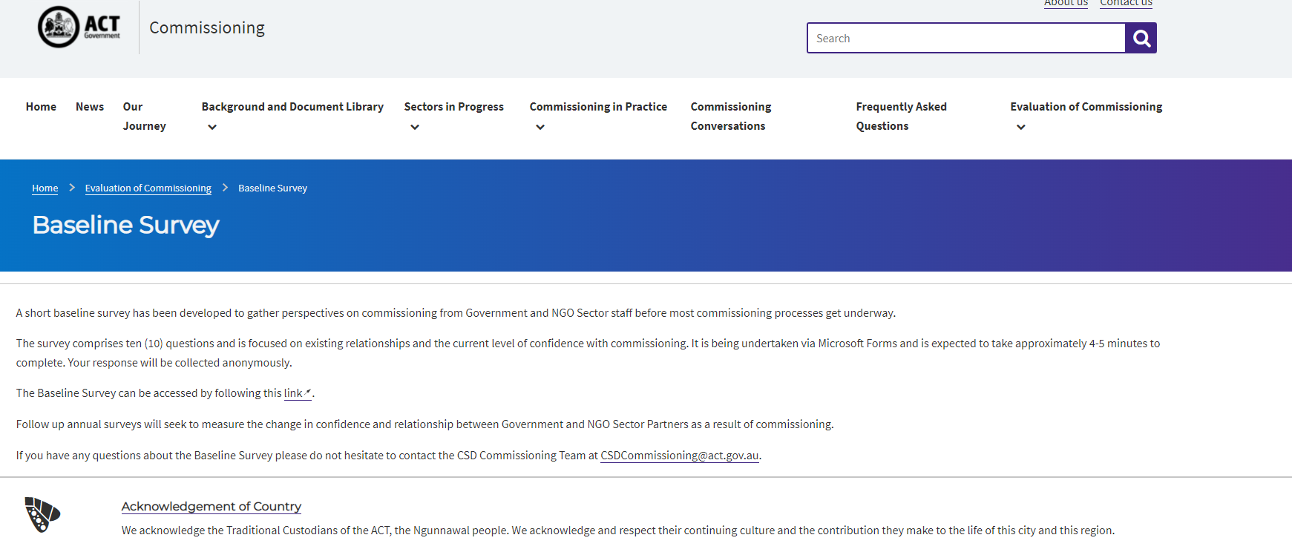

Commissioning Evaluation
The ACT Health Directorate is undertaking an evaluation of Commissioning
The baseline survey (left) is now available on the ACT Health Commissioning website and has also been widely circulated to NGO partners.
The Post-Activity Survey (left) should be undertaken by all attendees post any commissioning engagement activity.
https://www.communityservices.act.gov.au/commissioning/evaluation-of-commissioning/baseline-survey
Commissioning Process - Post-Activity Survey (office.com)

Slide 41
Questions, comments and queries???

Slide 42
References
ACT Health Directorate. (2021). Commissioning for outcomes. https://www.communityservices.act.gov.au/commissioning
ACT Health Directorate (2016). Hepatitis B, Hepatitis C, HIV and viral hepatitis: ACT Statement of Priorities 2016-2020.
ACT Health Directorate (2021). Territory-wide health services. https://www.health.act.gov.au/about-our-health-system/planning-future/territory-wide-health-services
Akwasi, A. G., Naomi, G., Reindolf, A., Prince, P., Enoch, A., Emmanuel, A., ... & Tsiboe, A. K. (2020). Knowledge on and attitude towards Sexually Transmitted Infections: A qualitative study of people with physical disabilities in a peri-urban district of Ghana. Cogent Medicine, 7(1), 1736249.
Australasian Society for HIV, Viral Hepatitis and Sexual Health Medicine https://hivlegal.ashm.org.au/sex-work/
Fairley, C. K., Chow, E. P., & Hocking, J. S. (2015). Early presentation of symptomatic individuals is critical in controlling viral hepatitis. Sexual Health, 12(3), 181-182.
Kirby Institute Latest Sexually Transmissible Surveillance Data: viral hepatitis. (2020). https://data.kirby.unsw.edu.au/STIs
Kirby Institute. viral hepatitis and blood borne viruses in the ACT: surveillance report 2018. Sydney: Kirby Institute, UNSW Sydney; 2018
Schmidt, E. K., Hand, B. N., Simpson, K. N., & Darragh, A. R. (2019). Sexually transmitted infections in privately insured adults with intellectual and developmental disabilities. Journal of Comparative Effectiveness Research, 8(8), 599-606.
Ward, J. S., Hengel, B., Ah Chee, D., Havnen, O., & Boffa, J. D. (2020). Setting the record straight: viral hepatitis and sexual abuse in Aboriginal and Torres Strait Islander communities. Medical Journal of Australia, 212(5), 205-207.
Images
https://www.healio.com/news/infectious-disease/20211230/adults-on-probation-disproportionately-impacted-by-hepatitis-c
https://www.gavi.org/vaccineswork/routine-vaccines/extraordinary-impact-hepatitis-b
https://www.google.com.au/search?q=%3F&safe=active&sxsrf=APq-WBvp_KJJrAWmubi3gsSJxexL48vedw:1645930033089&source=lnms&tbm=isch&sa=X&ved=2ahUKEwjjusmX7572AhU3wjgGHR2yB2cQ_AUoAnoECAEQBA#imgrc=f1w-9FUXA_gWRM
https://www.google.com.au/search?q=%3F&safe=active&sxsrf=APq-WBvp_KJJrAWmubi3gsSJxexL48vedw:1645930033089&source=lnms&tbm=isch&sa=X&ved=2ahUKEwjjusmX7572AhU3wjgGHR2yB2cQ_AUoAnoECAEQBA#imgrc=as1T5pbsnk4wiM

