Slide 1

Commissioning in the sexually transmissible infections and blood borne viruses (STIBBV) subsector:
A progress update
ACT Health Protection Service

Slide 2
Commissioning intent
The goal of commissioning in the sexually transmissible infections and blood borne viruses (STIBBV) subsector is for ACTHD, in partnership with community partners to collaboratively design a STIBBV service system which meets the evolving needs of the ACT community.
ACTHD envisions a service system which is appropriate, equitable, accessible, and affordable for all individuals, with a particular focus on priority populations as identified in the Hepatitis B, Hepatitis C, HIV and Sexually Transmissible Infections: ACT Statement of Priorities.

Slide 3
ACTHD position:
Commissioning in the STIBBV subsector
STIBBV service providers in the ACT have demonstrated their willingness and capacity to adapt and respond to emerging needs and growing demand, particularly in light of the COVID-19 pandemic, and more recently, monkeypox.
Nonetheless, we recognise that burden of disease is constantly shifting and there is scope for exploration of how services can innovate and integrate to best meet current, emerging and future demand.
We are also aware that some individuals continue to experience barriers to STIBBV care in the ACT. We endeavour to seek clarity around service access constraints so that they can be addressed through commissioning.

Slide 4
Strategic alignment
Sustainable Development Goals
Global policy
National Policy
ACT policy
WHO Global Sector Strategies on HIV, viral hepatitis and Sexually Transmissible Infections 2022-2030
5 National Strategies
National clinical guidelines
Hepatitis B, Hepatitis C, HIV and Sexually Transmissible Infections ACT Statement of Priorities
ACT Health Services Plan, Sexual Health Services Plan, ACT Preventive Health Plan, Wellbeing Framework, Triple Bottom Line Assessment & ACT Procurement Framework
Notes:
Commissioning in the STIBBV subsector is aligned with global, national and territory policy and strategy
At the global level, the sustainable development goals provide a broad framework for activities to reduce inequitable burden of disease.
Goal 3 (good health and wellbeing), goal 4 (gender inequality), goal 10 (reduce inequality) and goal 16 (peace, justice and strong institutions- which for us includes strong and transparent relationships between community and Government) are particularly relevant to the work of the STIBBV subsector and the commissioning process more broadly.
The HIV, viral hepatitis and sexually transmitted infections Global Health Sector Strategies 2022-2030 frames STIBBV as a global public health issue…which it is. If efforts are scaled up, particularly in low and middle income countries, this has a flow on effect to incidence and burden of disease in the ACT, especially for HIV, which as we know is often acquired overseas in high prevalence countries.
The 5 national strategies encompass the 8th National HIV strategy, the 5th National Aboriginal and Torres Strait Islander BBV and STI Strategy, the 4th National STI strategy, the 5th National Hepatitis C Strategy and the 3rd National Hepatitis B strategy. Collectively, these strategies set the direction for Australia’s response to STIs and BBVs and frame national STIBBV related priorities so that Commonwealth funding can be appropriately directed. The next iteration of the national strategies are currently under development and we anticipate their release early next year.
At the territory level, the Hepatitis B, Hepatitis C, HIV and sexually Transmissible Infections and Blood Borne Viruses is our jurisdictional strategic document. It identifies priority population groups and sector priorities to guide STIBBV related investment and work effort. The next iteration of the Statement of Priorities is currently under development.
There are also a number of other key strategic documents in the ACT which support our policy and service delivery work. The ACT Health Services Plan is a roadmap for improving the health of Canberrans. The need for sexual health services planning was a key finding to come out of the ACT Health Services Plan. This work is currently been explored in relation to the Northside Clinical Services Plan. There is also a plan to develop a specific sexual health services plan in the near future. The design of STIBBV services through commissioning will be a valuable conduit to this project.

Slide 5
Aligning key work in the STIBBV subsector
Statement of Priorities
Commissioning
Sexual Health Services Planning
The Kirby Institute ACT Surveillance Report
Sustainable Development Goals
Notes:
In terms of the STIBBV subsector in the ACT, we see the following pieces of work as integrated and to a significant extent-co-dependant.
Information collected through one piece of policy work will inform and support the others. This is important for strategic alignment across the territory, to best focus efforts and investment and to avoid unnecessary duplication of work.

Slide 6

Stakeholders
Consumers
The STIBBV Health Advisory Committee
Currently funded community partners | ACT Government Stakeholders | other non-Government stakeholders
Meridian Incorporated | STIBBV business unit in HPS (ACTHD) | The Junction Youth Health Service (Anglicare)
Sexual Health and Family Planning ACT | Communicable Disease Control (ACTHD) | Winnunga Nimmityjah Aboriginal Health Service
Hepatitis ACT | Canberra Sexual Health Centre (CHS) | Canberra Alliance for Harm Minimisation and Advocacy (CAHMA)
Capital Health Network-HIV Program | The Liver Clinic/Emergency and gynaecology departments at the Canberra Hospital (CHS) | Directions Health
Australasian Society for HIV, Viral Hepatitis and Sexual Health Medicine (ASHM) | The Women’s Health Service (CHS) | Sex Worker Outreach Program (SWOP)
 | Health System Strategies and Program Support (Health planning) (ACTHD) | The Scarlett Alliance
 | Justice Health | The Youth Coalition of the ACT
 | ACT Walk-in Centers | Health Care Consumers Association (HCCA)
 | The Commissioning Team (ACTHD) | A Gender Agenda
 | The School Youth Health Nurse Program (CHS) | The Kirby Institute (UNSW)
 | The Child at Risk Health Unit (CHS) | Gugan-Gulwan Youth Aboriginal Corporation
 | Forensic and Medical Sexual Assault Care (CHS) | Companion House
 | Other commissioning subsectors/business units | Multicultural Hub Canberra
 | Chief Minister, Treasury and Economic Development | The Forcibly Displaced Person’s Network
 |  | Australian National University and University of Canberra Medical and Counselling Services
 |  | Local General Practice services
Notes:
This table outlines the list of stakeholders who were identified as having important contribution to the commissioning process in the STIBBV subsector.
Stakeholders have verifying interest, motivations and capacity for participating in commissioning, however, we welcome a broad range of views and input, particularly acknowledging the cross-cutting nature of STIBBV services with other areas of health including the alcohol and other drugs sector, women’s, youth and reproductive health, Aboriginal and Torres Strait Islander health, mental health, chronic disease and LGBTIQ+ health.
We are aware that engaging in commissioning activities adds to the time and workload pressures already experienced by our sector partners. On behalf of the business unit, I want to take this opportunity to thank all of our sector partners and our wider stakeholder network for your time, expertise and contribution thus far. The process has not been without its challenges but we are confident that the collective input will strengthen the service system into the future.
* CHN ceased their agreement with us recently, however they remain a valued stakeholder.

Slide 7
The STIBBV subsector
STIBBV stakeholders comprise a collective of government and non-government organisations who provide a multitude of local responses to address the burden of STIBBV in the ACT. Key initiatives include:
clinical services (including screening, diagnosis, treatment, care, and monitoring);
prevention and harm reduction initiatives (including provision of condoms, pre-exposure prophylaxis (PrEP), post-exposure prophylaxis (PEP) and needle syringe programs);
health promotion and education programs;
support and advocacy (including counselling services)
community development and engagement activities;
workforce training and development;
clinical and practice support services; and
disease surveillance, data management and research.
Notes:
Organisations who provide STIBBV related services, provide services across one or more of these 8 focus areas
ACT Health Directorate aims to procure a range of services across these focus areas as part of a multi-pronged, sustainable response to STIs and BBVs.

Slide 8
Timelines and progress
Strategise
August 2021-July 2022
Design
August-December 2022
Discuss findings from phase 1
Procure
January-December 2023
Deliver
January 2024 onwards
Identify data sources
Identify current and emerging health needs
Literature review
Amalgamate findings
Consult and provide feedback
Consumer engagement
Solidify health needs
Prioritise health needs
Explore evidence based care considerations to address identified needs
Explore outcomes and metrics to determine success
Articulate commissioning intentions
Undertake tender process
Communicate to providers
Draft approach to market documents
Finalise programs/services for procurement
Clarify procurement processes in line with legislation and guidelines
Draft new agreements
Implement new agreements
Continuous evaluation
Identify key stakeholders
Notes:
The green elements on this slide signify pieces of work that have been completed, orange elements are ongoing and red items remain on the to-do-list.
The STIBBV subsector are currently in phase two of commissioning which will continue until the end of 2022.
During this time the business unit will further refine the Planning and Funding Framework and Health Needs Analysis, and will continue to explore and unpack outcomes. Key priorities to be considered in procurements will be articulated in a commissioning Intentions document which will be circulated to our stakeholders towards the end of the year.
The business unit is committed to sharing insights from this commissioning process with other associated business units including Alcohol and Other Drugs, Family and Inclusion (young people and LGBTIQ+ health), Chronic Conditions, Aboriginal and Torres Strait Islander Health and Mental Health.

Slide 9
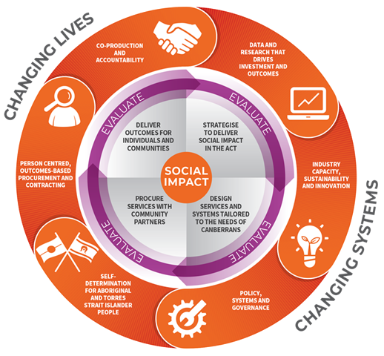
Commissioning - A new approach to delivering and procuring services

Slide 10
Snapshot of phase 1 activities
Strategise
Broad stakeholder webinars
Consumer engagement activities
Service mapping
Literature review
Data from academic institutions
Benchmarking with other jurisdictions
Notes:
This slide details some of the key activities undertaken in phase 1.
This body of work has culminated in a data set to inform commissioning and future service procurement.
The business unit acknowledges some limitations in available data and there are some data points which are still being refined in consultation with sector partners.

Slide 11
Snapshot of phase 2 activities
Design
Sharing and discussion of data
Prioritisation of health needs
Discussion of care and service considerations
Preliminary exploration of outcomes and metrics
Solidifying health needs
Notes:
This slide highlights the key activities which have been undertaken to date in the design phase, as well as some which are still ongoing.

Slide 12
Successes and celebrations
Stakeholders have demonstrated commitment and willingness to engage with commissioning as a change management process for sector sustainability.
Strong relationships between the business unit and a broad range of stakeholders strengthens connectivity and visibility within the sector.
Regular and ongoing opportunities for stakeholder engagement has facilitated the exchange and sharing of valuable information and expertise to inform commissioning.
Amplifying the voices of consumers and services users has been critical to inform commissioning in the STIBBV subsector.
The Planning and Funding Framework and Health Needs Analysis brings together a comprehensive range of information to inform commissioning and other STIBBV related policy activities.
Notes:
(read out points from slide)

Slide 13
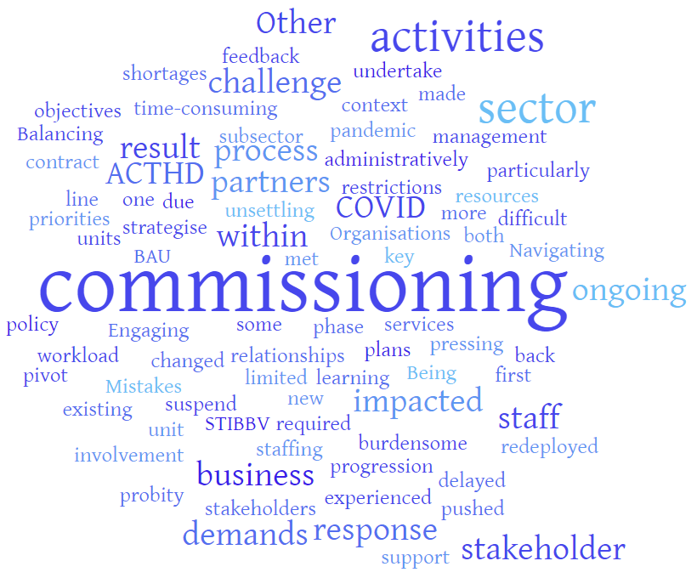
Challenges
Notes:
Engaging in commissioning activities can be time-consuming and administratively burdensome for sector partners. This has impacted the ongoing involvement of some key stakeholders.
As a new process, commissioning has been unsettling for both business units and sector partners.
Being the first ACTHD subsector to undertake commissioning has been a challenge and a learning process. Mistakes have been made and plans have been changed when objectives have not been met and in response to stakeholder feedback.
Balancing the demands of commissioning with other BAU activities within the business unit has been an ongoing challenge due to staffing and limited resources. Other policy priorities have been delayed as a result of commissioning. Or commissioning activities pushed back as a result of more pressing workload demands.
Navigating probity and stakeholder relationships (particularly in the context of existing contract management) can be difficult.
COVID-19 impacted progression of phase one (strategise) within the STIBBV sector as ACTHD staff were redeployed to support the COVID-19 response. Organisations also experienced staff shortages or were required to pivot or suspend services in line with pandemic restrictions.

Slide 14
Lessons learnt
Explore capacity for additional resourcing early on within business units. If you are considering procuring consultants to support your commissioning processes, clarify process, expectations and intended outcomes early to avoid miscommunication. Allow enough time to procure consultants in line with ACTHD policy and allow sufficient time for consultants to complete their work effectively. Business units need to factor these elements into overall commissioning timelines.
Subsectors need to factor in additional time for commissioning activities noting there may be amendments to business unit work demands and timelines throughout the process. Flexibility with activities may be required in response to stakeholder feedback or to address specific commissioning or research questions which arise during the process.
Ensure phase one (strategise) has completely wrapped up before commencing phase two (collaborative design) and ideally with a break of a few weeks in between. This break allows the sector and business unit to reset for maximum engagement and productivity. This should also be applied in the transition from phase two (collaborative design) into phase three (procurement).
Notes:
(read out points from slide)

Slide 15
Lessons learnt- continued
Communicate regularly with stakeholders to maintain buy-in and engagement and so that issues and concerns can be addressed early. Communicate stakeholder participation expectations clearly from the outset so that activities are focused and productive.
Don’t be afraid to change the flow/content/timing of commissioning activities following stakeholder feedback (subject to your overall timelines). This demonstrates that you are listening and learning through the process.
Hybrid engagement activities (a mix of online and in-person participation) are not optimally productive as online participants are often not engaged equitably. Consider facilitation either completely face-to-face or completely online, noting online may be preferable and practical to maxamise wider stakeholder attendance.
Develop a plan for managing probity and mitigating probity risks early. Communicate probity constraints and boundaries with stakeholders clearly.
Notes:
(read out points from slide)

Slide 16



Questions and comments

