Slide 1

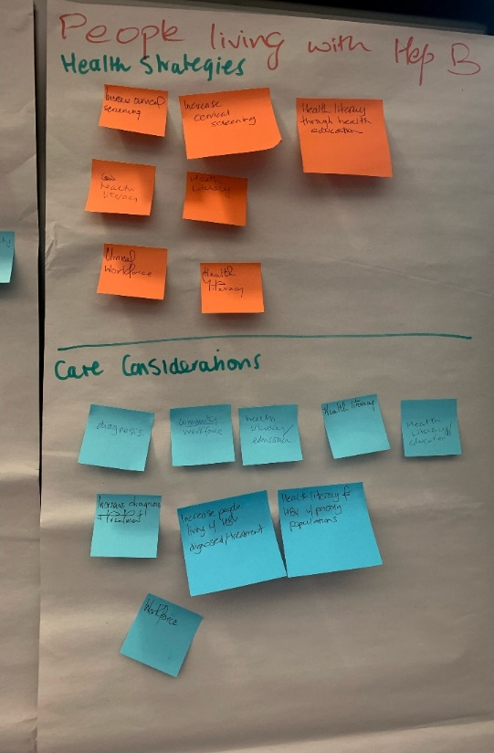
Community Commissioning –
Collaborative Design
Workshop #4 Draft Outputs
8 September 9:30am – 12:30pm
Sexually Transmissible Infections and Blood Borne Viruses
Public Health Regulation and Projects
Health Protection Service ACT Health Directorate
Notes:
Ground Rules
Share all relevant information.
Everyone’s input is equally valued.
Only one conversation will go on at once (unless subgroups are working on a topic)
Respect each speaker: Don’t take part in side conversations; listen and ask clarifying questions.
Cut to the chase.
The group is responsible for the deliverables. 
Off-target discussions are limited to two minutes and then recorded as issues.
Spend time on other issues only if the deliverables are completed and everyone agrees there is value in addressing the issue.
Discussions and criticisms will focus on interests, not people.
All members are expected to participate in all phases of the process (if you leave the room, you are responsible for getting filled in and agree to support any group decision).
Respect differences
Be supportive rather than judgmental.
Share “air time.”

Slide 2
STIBBV Commissioning Collaborative Design
No | Time | Agenda item and content | Facilitator
 | 9.00am | Tea and Coffee available
1 | 9.30am | Welcome and introduction Acknowledgement of country | Sean Lowry
2 | 9.40am | Brief recap Where are we up to in the commissioning process | Fellon Gaida
3 | 9.45am | Context and aims of the workshop Amalgamation of information Outline of prioritisation/prioritisation considerations Prioritisation to inform future procurement of STIBBV services (balanced against available funding) | Sean Lowry
4 | 9.50am | Introduction to group activity and facilitated discussion Prioritisation activity- highlighting key health goals and the strategies and care considerations identified to date (see Excel Spreadsheet) | Sean Lowry
 | 10.00am | Working morning tea
5 | 10.00am 11.00am 12.00pm | Round 1: Prioritising strategies for action (individual activity and large group discussion) Round 2: Prioritising care considerations/initiatives/interventions to address strategies and achieve health goals (individual activity and large group discussion) Round 3: Identifying potential outcomes and metrics to determine success (small and large group discussion) | All
6 | 1.00pm | Summing up key findings and closing comments | Sean Lowry
7 | 1.15pm | Light lunch
Notes:
Collab designed commissioning framework
Webinar – discussed ideas and care consideration
Workshop #1 – Process and challenges – why its not perfect but why it is an improvement on the status quo
Workshop #2 – Productive focus on Care Considerations
Workshop #3 – Health Needs Assessment – available data and evidence base and analysis to inform commissioning priorities
Workshop #4 – prioritise and debate the priorities groups, the strategies and the care considerations – and attempt to identify the metrics which will tell us if we are having an impact and ultimately making a difference

Slide 3

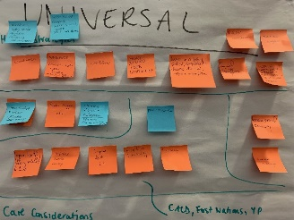
#1 Prioritising Strategies by Disease Group
Strategies to achieve health goals to be considered through commissioning
Participants were invited to choose their top three priority Strategies per Disease category ( STI, HBV, HCV, HIV) on the designated Post It notes (using the colour that relates to the disease group) and place it on their chosen Population Target Group or in the Universal category. Once all participants have had a chance to record and place their priority Strategies, a robust feedback and discussion on several of the most popular target groups and strategies took place.
Improve health literacy related to STIs, with a particular focus on young people, CALD communities, women of reproductive health age, gay, bisexual and other men who have sex with men and First Nations people
Increase screening for chlamydia, gonorrhea and infectious syphilis
Invest in a highly skilled, competent and diverse clinical, support and peer workforce
Reduce stigma and discrimination related to STIs
Invest in a highly skilled, competent and diverse clinical, support and peer workforce
Provide choice in testing options for people living with HIV who are undiagnosed
Increase health literacy related to HIV (with a particular focus on gay, bisexual and other men who have sex with men, women and the LGBTIQ+ community
Optimise quality of life for people living with HIV
Increase awareness, uptake and use of prevention, including PrEP, PEP, treatment as prevention and needle and syringe programs
Expand reach of peer-led support programs for sex workers and Asian born gay men
Invest in a highly skilled, competent and diverse clinical, support and peer workforce (including increasing s100 prescribers for HIV)
Invest in a highly skilled, competent and diverse clinical, support and peer workforce (including increasing s100 prescribers for HBV) - consider upskilling existing workforce, other GPs and community options
Workforce strategy to consider existing capacity and capability, headcount, planning, education and sustainability
Increase the number of individuals living with HBV who have been diagnosed and who are receiving treatment
Increase health literacy related to HBV (with a particular focus on people from countries of high prevalence and First Nations people)
Increase the number of individuals living with HCV who have been tested, diagnosed and who have completed treatment – esp. multi-modal testing
Increase health literacy related to HCV (with a particular focus on people who inject drugs and individuals residing/or who have resided in a correctional setting)
Increase access to and use of clean injecting equipment for every injecting episode (NSP in correctional settings)
Invest in a highly skilled, competent and diverse clinical, support and peer workforce
AOD sector have made enormous inroads from which we can learn from

Slide 4

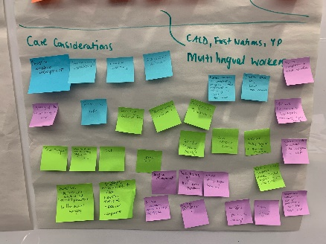
#2 Prioritising care considerations to address Strategies and achieve health goals
Participants were then invited to choose their top three Care Considerations per Strategy on the designated coloured Post It notes and place it on their chosen Population target group or on the Universal butchers paper. Once all participants have had a chance to record and place their Care Considerations, robust feedback and discussion on several of the most popular target groups and strategies took place.
Youth-focused initiatives
Health promotion/education campaigns that specifically address stigma and increase health literacy
Outreach, flexible and mobile screening activities
Workforce development activities to increase opportunistic screening
Invest in a highly skilled, competent and diverse clinical, support and peer workforce
Health education/promotion interventions which normalise and address PrEP and PEP use
Targeted interventions for trans/non-binary people living with HIV
Peer support models of care
Multi-option testing including clinic based, outreach and via vending machines (as in other jurisdictions)
Invest in multidisciplinary workforce (both community/peer based and clinicians)
Activities which increase diagnosis and treatment uptake
Observe and possibly emulate NT’s model of care as it is the only successful program (Underway)
Focus on cohorts from high prevalence countries noting patterns of transmission
Develop programs which address liver disease prevention in the primary care setting
Nurse/NP led programs (between the hospital, NGOs, other community settings and homes)
Improve GP education (to increase opportunistic vaccination, diagnosis, treatment and care)
Increase focus on people from high prevalence countries (particularly health messaging related to overseas transmission following medical procedures/ tattoos)
Continued focus on people who inject drugs (a key route of transmission in Australia)
Range of testing options including point of care testing, clinic based, outreach, dried blood spot testing
Activities to engage marginalised and hard-to-reach groups in testing, treatment and care
Incentivised participation in models of care and activities
Peer / clinician team models
A specific sector workforce strategy
Capacity building activities
Workforce planning

Slide 5
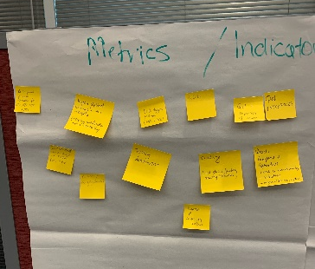
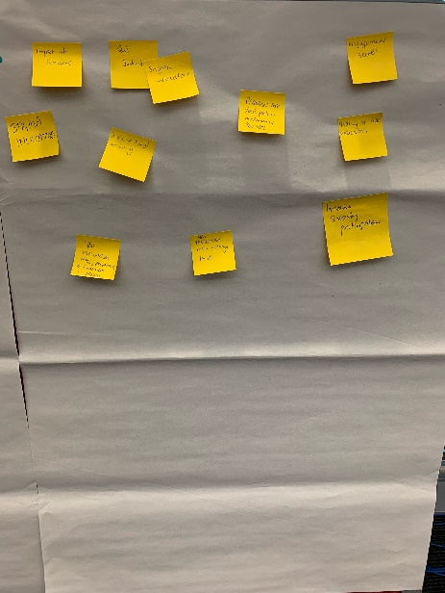
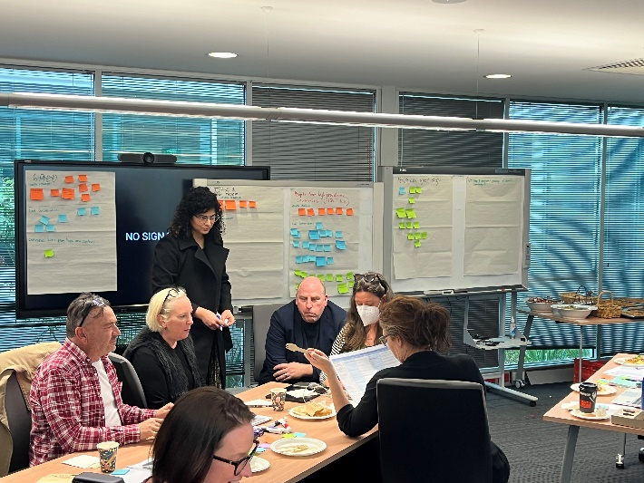
#3 Measures, Indicators and Outcomes
Potential outcomes and metrics – Participants were asked to suggest the Outcomes and Metrics for Population group / strategy /care considerations that they expect will provider the best determination for tracking impact and outcomes. Outcome and metrics discussions will be ongoing when commissioning intentions are finalised.
Facilitator encouraged the tables and individuals to justify their choices and prioritisations and where possible enable consensus.
Each point of care cascade for HCV, HBV, HIV and STIs.
Progress against national and ACT targets – eventually reducing notification rates
Increase in engagement in care behaviours for HBV
Reach and engagement with a service or provider (2)
Late diagnosis indicator ( HBV and HCV)
Testing and screening denominators ( i.e. total testing volume per month) (3)
Quality of Life (QoL) indicators (3)
Clinical practice quality indicators
Number of community workers
Expression of or experience of stigma (3)
Reach – (actual reach compared with estimated reach) – including in community collectively and by program, by service and by activity.
Impact of services
HBV vaccination rates, prevalence and treatment in prisons and among PWID
Practices which do not currently push out notifications of BBV-STIs

Slide 6
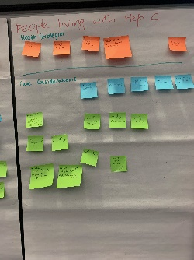
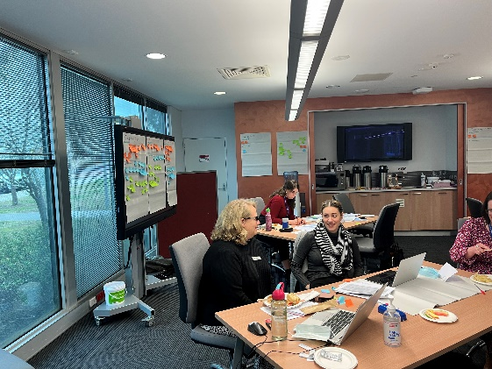
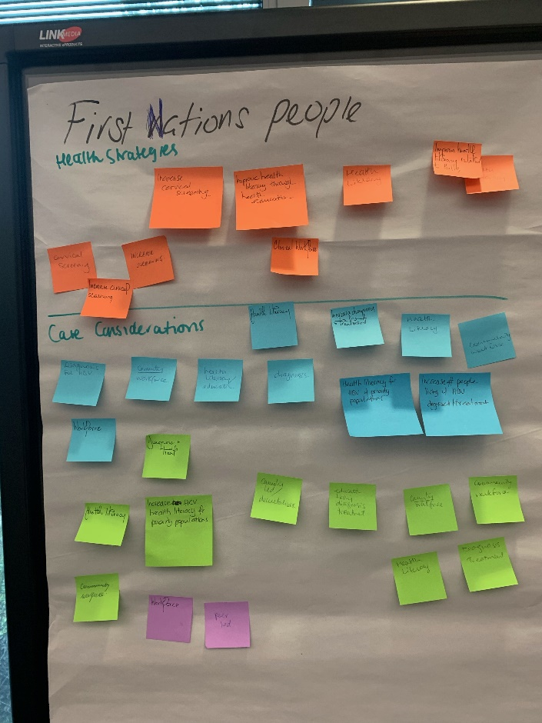
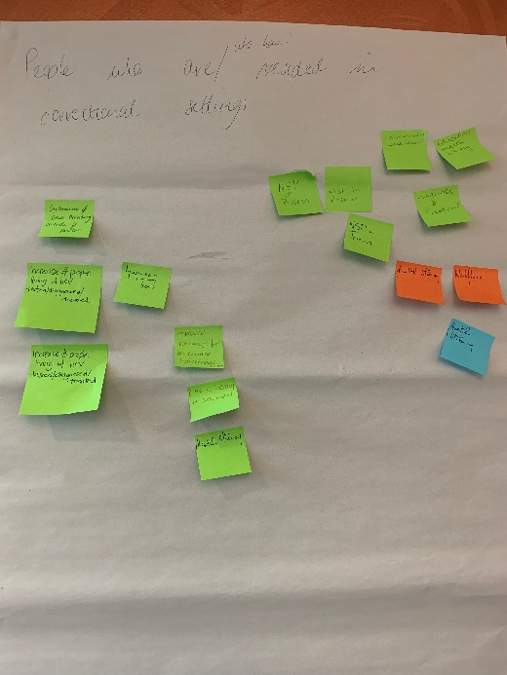
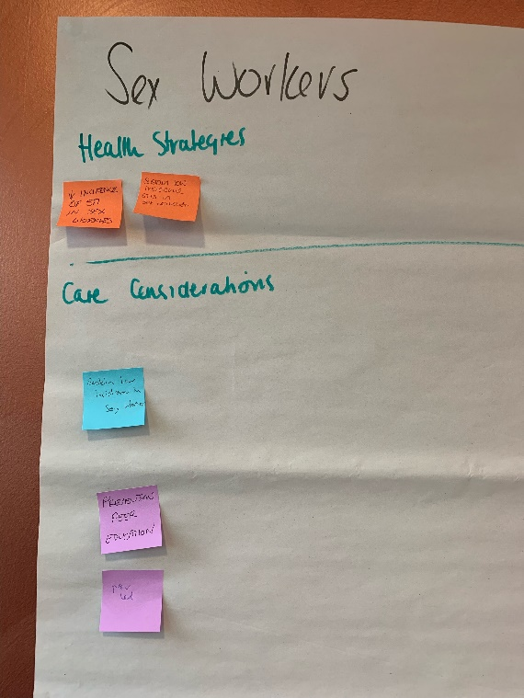
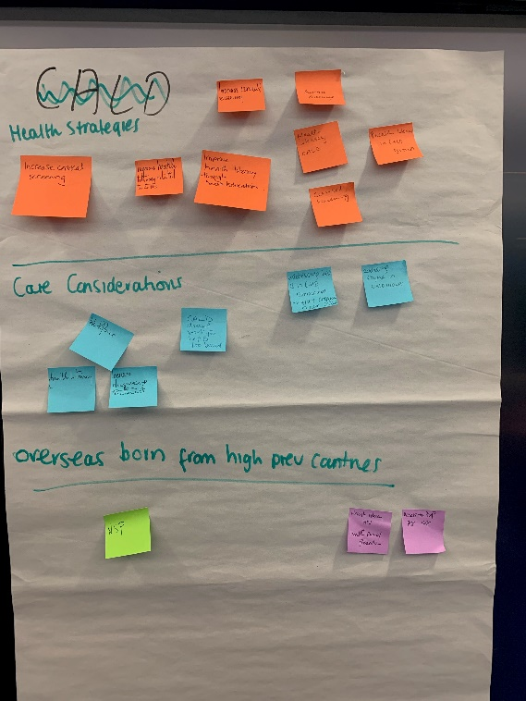
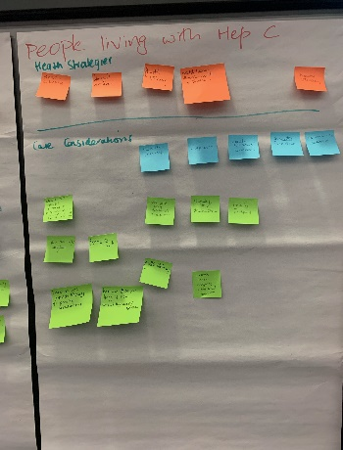

Slide 7
