Slide 1
STIBBV Policy Workshop #3:
HIV
Commissioning services to meet the needs of people living with or at increased risk of HIV in the ACT
Health Protection Service, ACT Health Directorate

Slide 2




Country
‘Our journey’
by Leah Cummins
David R Horton (creator), AIATSIS, 1996
Notes:
Acknowledgement of Country

Slide 3
Purpose of the session
Provide a refresher about commissioning and commissioning process in the STIBBV subsector.
Provide an overview of data specific to HIV burden of disease in the ACT.
Reflect on what we have heard from the sector to date.
Structured question and discussion session to elicit specific information to inform commissioning in the STIBBV subsector.

Slide 4
Housekeeping and introductions

Slide 5
Who we are as a service sector and what we do?

Slide 6
The ACT HIV service sector
Primary health services
General Practitioners (private and bulk-billing)
Non-government primary health services (e.g Meridian and CHN-HIV Program)
Publicly funded primary health services (e.g ACT Walk-in-Clinics and Justice Health)
Speciality services
Canberra Sexual Health Center (only ACT specialist service)
Tertiary Services
Hospital services including emergency departments and infectious disease units.
Notes:
In the ACT, HIV services are provided through a combination of publicly funded primary, specialist and tertiary services, as well as private and non-Government primary health organisations.

Slide 7
Key service types
Clinical services (screening, diagnosis and treatment)
Prevention and harm reduction initiatives (including provision of condoms, pre-exposure prophylaxis (PrEP), post-exposure prophylaxis (PEP) and needle syringe programs)
Health promotion and education programs
Support and advocacy
Community development and engagement activities
Workforce training and development
Clinical and practice support services
Disease surveillance, data management and research
Notes:
The STIBBV Subsector currently involves a small collective of government and NGOs who are funded through ACTHD to provide a multitude of local responses to address the burden of STIBBV in the ACT. Key initiatives include:

Slide 8
Sector stakeholders
Primary stakeholders for commissioning | Potential ACT Government Stakeholders | other non-Government stakeholders
The STIBBV Health Advisory Committee
Consumers | STIBBV Policy Unit (ACTHD) | The Junction Youth Health Service (Anglicare)
Meridian Incorporated | Communicable Disease Control (ACTHD) | Winnunga Nimmityjah Aboriginal Health Service
Sexual Health and Family Planning ACT | Canberra Sexual Health Clinic (CHS) | Canberra Alliance for Harm Minimisation and Advocacy (CAHMA)
Hepatitis ACT | The Liver Clinic/Emergency and gynaecology departments (CHS) | Directions Health
Capital Health Network-HIV Program | The Women’s Health Service (CHS) | Sex Worker Outreach Program (SWOP)
Australasian Society for HIV, HIV and Sexual Health Medicine (ASHM) | Health System Strategies and Program Support (Health planning) (ACTHD) | The Scarlett Alliance
Haemophilia Foundation ACT | Justice Health | The Youth Coalition of the ACT
 | Other commissioning subsectors/business units (including AoD, Family & Inclusion, Chronic Conditions, Aboriginal and Torres Strait Islander Health & Mental Health) | Health Care Consumers Association
 | The Commissioning Team (ACTHD) | A Gender Agenda
 | ACT Walk-in Centers | The Kirby Institute
 | The School Youth Health Nurse Program (CHS) | Gugan-Gulwan Youth Aboriginal Corporation
 | The Child at Risk Health Unit (CHS) | Companion House
 | Forensic and Medical Sexual Assault Care (CHS) | Multicultural Hub Canberra
Notes:
This table depicts a sector wide consortium of stakeholders including those which provide both STI and BBV services
Stakeholders include a mix of providers who are currently funded by the STIBBV budget, providers who also provide STIBBV related services but of whom may be funded within a different subsector as well as publicly funded STIBBV services, peer workers, peak bodies, academic partners and consumers.

Slide 9
Commissioning…a refresher

Slide 10
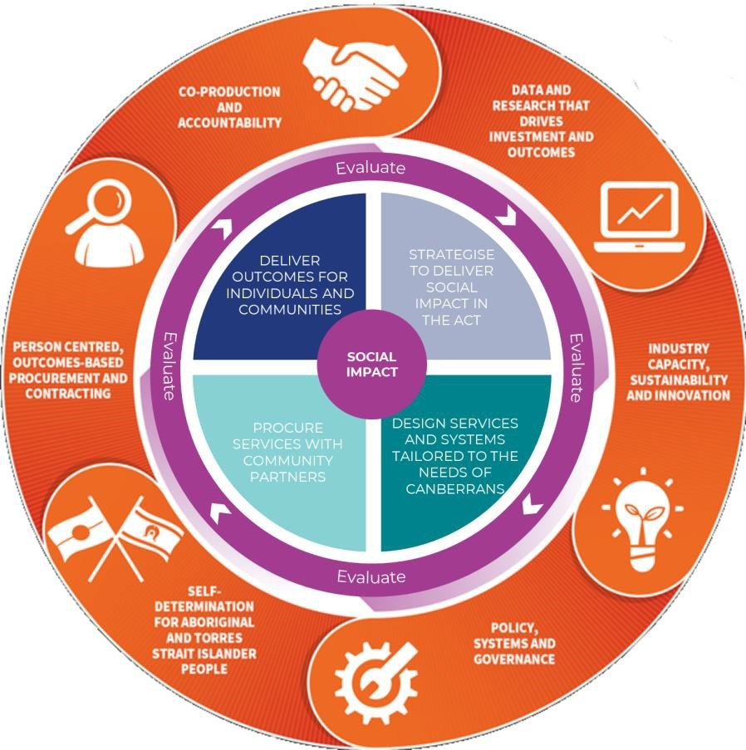
The Commissioning Cycle
Commissioning cycle
Strategise
  Data gathering
  Understand current services and population need
  Identify current over-servicing and service gaps
  Identify current and emerging priorities
  Define system outcomes we are seeking to achieve
  Engage with service providers, service users and other stakeholders to test and refine understanding
Design
Procure
Deliver
Continuous evaluation
Notes:
Commissioning Cycle

Slide 11
Strategic alignment
Statement of Priorities
Commissioning
Sexual Health Services Plan
The Kirby Institute ACT Surveillance Report
Sustainable Development Goals
Notes:
In terms of the STIBBV subsector in the ACT, we see the following pieces of work as integrated and co-dependant.

Slide 12
Scope for commissioning in the STIBBV subsector
To define scope for commissioning activities, the following World Health Organization definition will apply:
‘sexually transmissible infections (STIs) and blood borne viruses (BBVs) are infections which are spread through unprotected sexual contact and through contact with infected blood and blood products. Some STIs and BBVs can also be transmitted from mother to infant during pregnancy and childbirth.’
Notes:
In line with the title of our subsector and our specific budget remit, commissioning and procurement decisions will relate specifically to services which seek to decrease the burden of disease for HIV and blood borne viruses.

Slide 13
Framework for Commissioning in the STIBBV subsector
Information gathering
Literature review, needs & economic analysis, broad/narrow stakeholder input, consumer engagement
Service system design
Agree on and prioritise services to be provided within the sector from 2024 and beyond and outcomes
Change management
Plan and map incremental change over the short, medium and long term
Procurement
Evaluation of tender applications and final procurement decisions making. Contracts drafted and signed
Tender for agreed services
Draft approach to market documents, Statement of Requirements, services specifications and other required documentation
Service implementation
Implement new services in line with contracts. Continuous review and evaluation
Identification of current & emerging priorities
Identify priority & health system priorities, models of care, current service gaps and potential duplication/overlap of services
Notes:
We have outlined a basic framework for commissioning activities in the STIBBV subsector over the next 18 months and beyond

Slide 14



Questions, comments and queries???

Slide 15
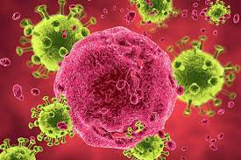
Setting the scene
HIV in the ACT

Slide 16
Questions, comments and queries???

Slide 17
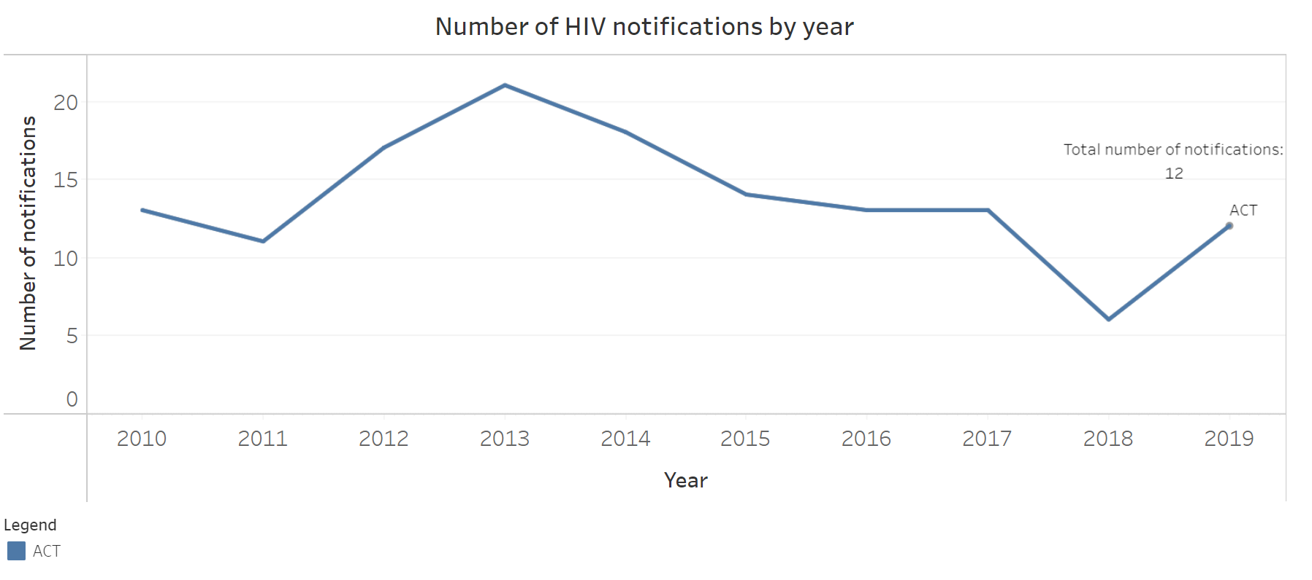
HIV in the ACT: Incidence
Notes:
In Quarter3, 2021, there were no new cases of HIV identified in the ACT. In terms of the 12 monthly average compared with the rolling 5 year average, cases of HIV of unspecified duration were up by 40%, but again we are dealing with such small numbers of HIV in the ACT so this only represents an extra couple of cases overall.
Most HIV notifications in the ACT are attributed to sexual contact transmission and only a very small proportion attributed to injecting drug use.
In the past few years, more than two thirds of HIV notifications in the ACT have been attributed to male to male sex. This is actually a decrease from previous years. Conversely, the proportion attributed to heterosexual contact has increased over this time period.
Whist a proportion of our cases are acquired overseas, most are being diagnosed in Australia.
Between 2016-2020, 95% of people with HIV were engaged in treatment. It is important to note that some cases were referred for treatment interstate, and as such, their degree of treatment engagement in other jurisdictions cannot be confirmed.

Slide 18
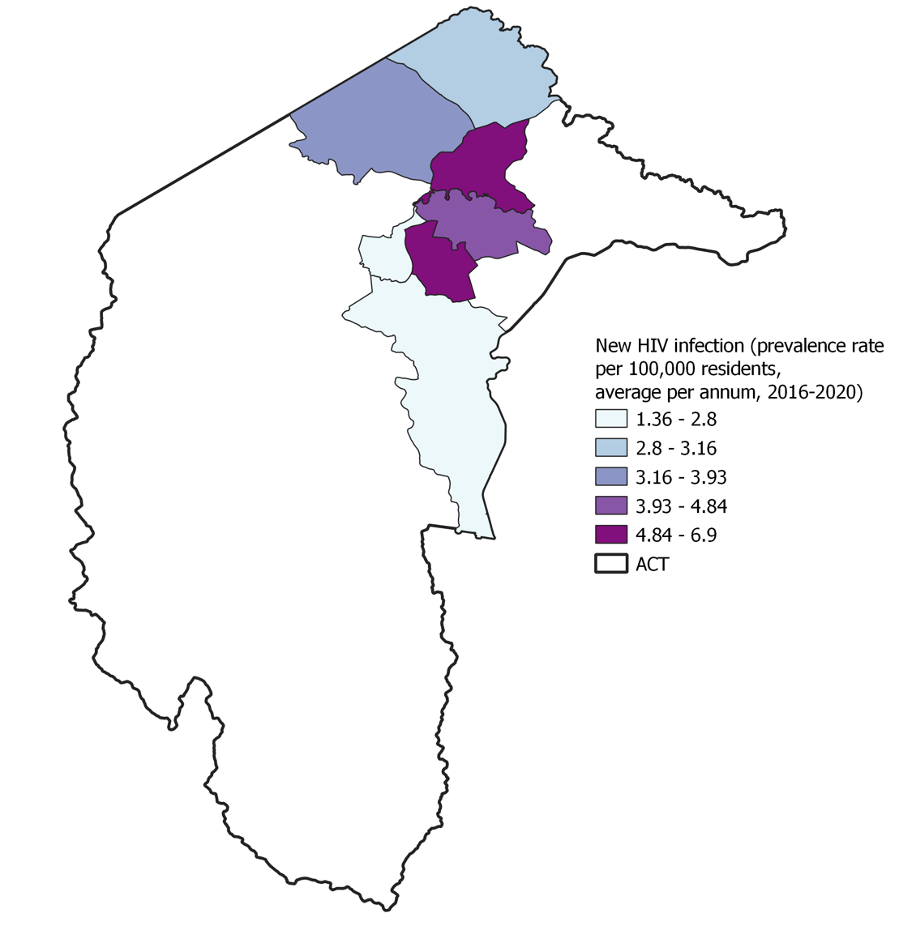
HIV in the ACT: Incidence
Notes:
The highest number of notifications are observed in the inner north and Woden areas, followed by Belconnen and Gungahlin.

Slide 19
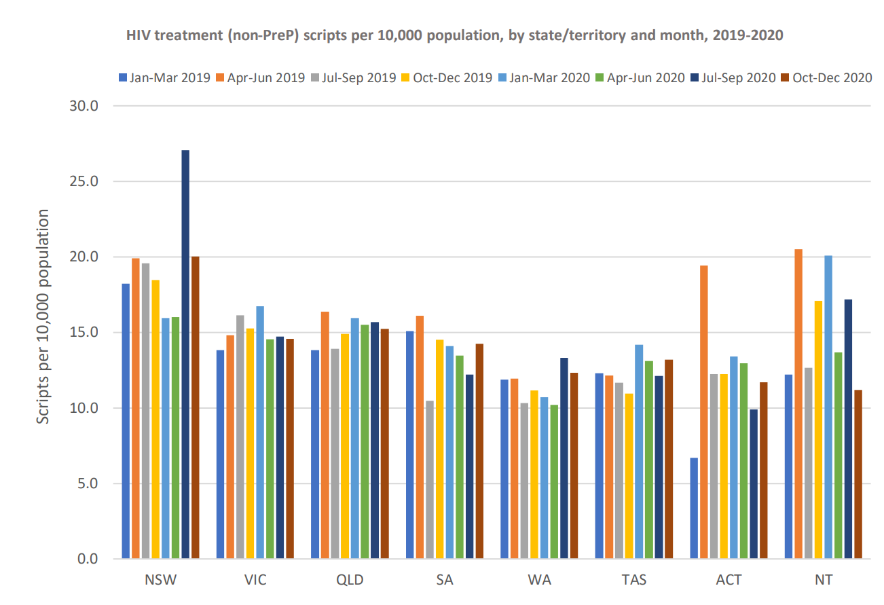
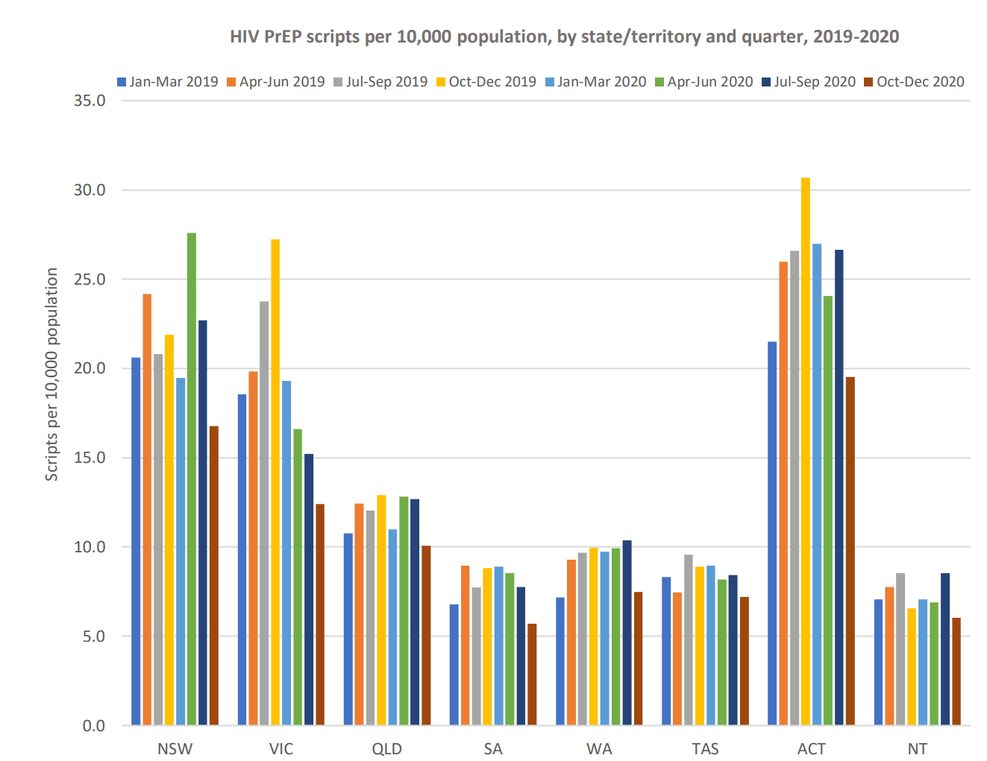
HIV in the ACT: Treatment
MacLachlan, J. (2021). Impacts of COVID 19 on BBVSTI testing, care and treatment: Medicare data analysis. WHO Collaborating Center for Viral Hepatitis. Doherty Institute for Infection and Immunity.
Notes:
These two graphs illustrate scripts for ART therapy and Pre-exposure prophylaxis in the ACT.
As per the graph on the right, we can see that the ACT is leading the pack when it comes to scripts for PrEP. It is great to see that the pandemic did not seem to hamper efforts.

Slide 20
Priority populations

Slide 21
HIV priority populations in Australia
People with HIV
Despite the availability of effective antiretroviral treatments, people with HIV also experience comorbidities and other health issues associated with HIV infection.
Gay men and other men who have sex with men (MSM)
HIV in Australia remains concentrated among gay men and other MSM.
Aboriginal and Torres Strait Islander people
In this population, gay men and other MSM remain the group at greatest risk of HIV.
However, Aboriginal and Torres Strait Islander people more likely to acquire HIV from heterosexual contact and needle and syringe sharing when compared with non-Indigenous populations.

Slide 22
HIV priority populations in Australia
Culturally and linguistically diverse people from high HIV prevalence countries, people who travel to high-prevalence countries, and their partners
New HIV diagnoses have increased for people from high HIV prevalence countries and their partners
Sex workers
Sex workers are a priority population due to the potential higher exposure risk associated with sex work.
People who inject drugs
Low infection rates, but remains priority due to potential risks associated with receptive needle and syringe sharing
People in custodial settings
At higher risk of shared use of injecting equipment, unsafe tattooing and condomless sex.
Trans and gender diverse people
Minimal data in Australia, yet potentially increased prevalence of HIV

Slide 23
Questions, comments and queries???

Slide 24
Potential priorities to address through commissioning

Slide 25
What we’ve heard from the sector thus far
Additional peer-led sexual health promotion, STI/BBV prevention and early intervention activities in community-based settings particularly among priority, hard-to-reach or vulnerable groups.
Increased education and training for health professionals around discrimination and stigma.
Importance of practice support initiatives (including GP, primary care and emergency departments).
Need for a community-based led PrEP Clinic (beyond existing outreach testing) to meet increasing community demand and relieve pressure on GPs and other services.
Need for more flexible, innovative models of care where people live, work and play
NGO’s highlighted a need for rapid HIV testing and comprehensive sexual health testing in outreach settings.
Need for holistic health and social case management including support for long-term chronic complications as well as aged care, housing, AoD and legal supports
Need for increased psychosocial services to support people living with HIV and their partners/families.
Need to explore free and more subsidised treatment options for HIV
Need to increase the S100 prescribing workforce

Slide 26
What we know from the data
The small numbers of HIV in the ACT present some difficulties when analysing and interpreting data. Incidence of HIV has remained relatively stable over the last ten years and thanks to the ongoing efforts, numbers of HIV in the ACT remain very low.
While men who have sex with men (MSM) are a priority group, rates of heterosexual transmission of HIV is rising.
A high proportion of people with HIV are engaged in treatment, however there is work to be done in engaging some priority groups in screening, treatment and ongoing care.

Slide 27
Questions, comments and queries???

Slide 28
Discussion…

Slide 29
Question 1 (15 minutes)
How are current services working well to meet HIV-related need in the ACT? What are our strengths as a sector?
  What is working well and what does success look like in the sector?
  What priority population groups are currently being appropriately or over-serviced?
  What type/mode/models of service are yielding the strongest impact?
  Where are the strong referral pathways?
  How can we leverage and build on successes further through commissioning?

Slide 30
Question 2 (15 minutes)
What challenges are services facing which impacts their ability to meet HIV-related need in the ACT?
  What are services struggling with?
  What priority population groups are currently being under or inadequately serviced?
  Where are the friction points within and between services?
  What/where are the current service/service system shortfalls?
  Where can services improve to better meet community need?
  Where do referral pathways need development?
  Where is further integration or coordination of services required?

Slide 31
Question 3 (15 minutes)
What structural/contextual issues are having an impact on the HIV service system (either positively or negatively)?
  E.g. service frameworks, regulation, funding, the policy landscape, the broader political sphere, media etc
  What could be done to capitalise on or mediate the identified issues?

Slide 32
Question 4 (15 minutes)
What are the short (0-2yrs), medium (3-5yrs) and long-term (6-10yrs) priorities to address HIV related need in the ACT?
  What are your top 2 priorities for either the short, medium, or long term?
  What would constitute an easy win (cheap and quick to implement)?
  What would constitute a longer-term win (more expensive and time/resource-intensive to implement)?
  What specific actions could we take as a sector to address the priority areas identified?

Slide 33
Question 5 (15 minutes)
What outcome measures will best determine and describe success and impact of services and why?
  Quantitative (what/who/how?)
  Qualitative measures (what/who/how?)

Slide 34
Next steps…
Phase 1 (strategise)
July 2022-Dev 2023 contract variations
Consultation and drafting March-May
Final sign off June 2022
Consumer engagement:
Engaging consultant: February-March 2022
Phase 1 (surveys): March-April 2022
Consumer one-on-one interviews and focus groups: April-May 2022
Phase 2 (collaborative design)
Five smaller round table discussions to be scheduled monthly between June and October
Decisions from those will be distributed for wider consultation Nov-Dec 2022
Phase 3 (procurement)
Approach to market documents: January-March 2023
Subsector tender process March-September 2023
Tender application review: October 2023
Final procurement decisions and contract drafting: November-December 2023
Phase 4 (deliver outcomes)
Implementation of new contracts: January 2024
*** We are also currently consulting for the next iteration of the Hepatitis B, Hepatitis C, HIV and HIV: ACT Statement of Priorities which is due for release later this year

Slide 35
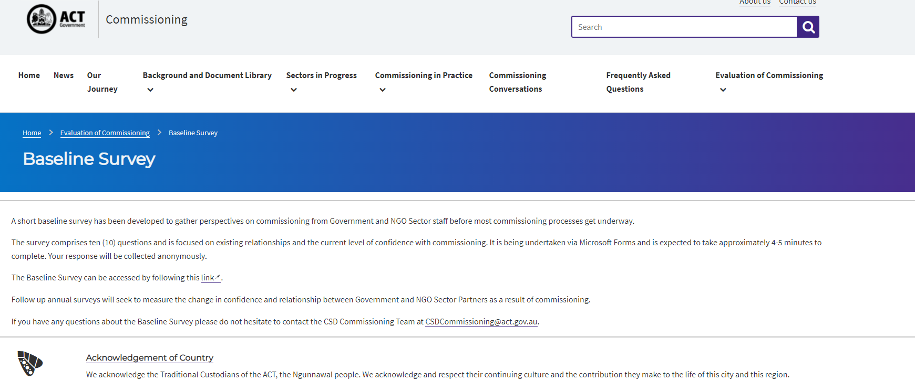

Commissioning Evaluation
The ACT Health Directorate is undertaking an evaluation of Commissioning
The baseline survey (left) is now available on the ACT Health Commissioning website and has also been widely circulated to NGO partners.
The Post-Activity Survey (left) should be undertaken by all attendees post any commissioning engagement activity.
https://www.communityservices.act.gov.au/commissioning/evaluation-of-commissioning/baseline-survey
Commissioning Process - Post-Activity Survey (office.com)

Slide 36
Questions, comments and queries???

Slide 37
References
ACT Health Directorate. (2021). Commissioning for outcomes. https://www.communityservices.act.gov.au/commissioning
ACT Health Directorate (2016). Hepatitis B, Hepatitis C, HIV and HIV: ACT Statement of Priorities 2016-2020.
ACT Health Directorate (2021). Territory-wide health services. https://www.health.act.gov.au/about-our-health-system/planning-future/territory-wide-health-services
Akwasi, A. G., Naomi, G., Reindolf, A., Prince, P., Enoch, A., Emmanuel, A., ... & Tsiboe, A. K. (2020). Knowledge on and attitude towards Sexually Transmitted Infections: A qualitative study of people with physical disabilities in a peri-urban district of Ghana. Cogent Medicine, 7(1), 1736249.
Australasian Society for HIV, HIV and Sexual Health Medicine https://hivlegal.ashm.org.au/sex-work/
Fairley, C. K., Chow, E. P., & Hocking, J. S. (2015). Early presentation of symptomatic individuals is critical in controlling HIV. Sexual Health, 12(3), 181-182.
Kirby Institute Latest Sexually Transmissible Surveillance Data: HIV. (2020). https://data.kirby.unsw.edu.au/STIs
Kirby Institute. HIV and blood borne viruses in the ACT: surveillance report 2018. Sydney: Kirby Institute, UNSW Sydney; 2018
Schmidt, E. K., Hand, B. N., Simpson, K. N., & Darragh, A. R. (2019). Sexually transmitted infections in privately insured adults with intellectual and developmental disabilities. Journal of Comparative Effectiveness Research, 8(8), 599-606.
Ward, J. S., Hengel, B., Ah Chee, D., Havnen, O., & Boffa, J. D. (2020). Setting the record straight: HIV and sexual abuse in Aboriginal and Torres Strait Islander communities. Medical Journal of Australia, 212(5), 205-207.
Images
https://www.theemra.com.au/products/our-journey-home-network-b?variant=40416757514389
https://www.google.com/search?q=HIV&safe=active&rlz=1C1GCEA_enAU953AU953&sxsrf=APq-WBszhfDfwj0p5I11vSlgA1yR0q5yLQ:1646173660437&source=lnms&tbm=isch&sa=X&ved=2ahUKEwjS95Li-qX2AhWd63MBHZ3fDnIQ_AUoAnoECAIQBA&biw=1280&bih=619&dpr=2
https://www.google.com.au/search?q=%3F&safe=active&sxsrf=APq-WBvp_KJJrAWmubi3gsSJxexL48vedw:1645930033089&source=lnms&tbm=isch&sa=X&ved=2ahUKEwjjusmX7572AhU3wjgGHR2yB2cQ_AUoAnoECAEQBA#imgrc=f1w-9FUXA_gWRM
https://www.google.com.au/search?q=%3F&safe=active&sxsrf=APq-WBvp_KJJrAWmubi3gsSJxexL48vedw:1645930033089&source=lnms&tbm=isch&sa=X&ved=2ahUKEwjjusmX7572AhU3wjgGHR2yB2cQ_AUoAnoECAEQBA#imgrc=as1T5pbsnk4wiM

