Slide 1

Commissioning Standard Presentation 2022 - 2024
MEETING
DAY DATE
PRESENTED BY:
NAME
Notes:
xxx

Slide 2

We acknowledge the Traditional Custodians of the ACT, the Ngunnawal people.
We acknowledge and respect their continuing culture and the contribution they make to the life of this city and this region.
Notes:
We acknowledge the Traditional Custodians of the ACT, the Ngunnawal people.
We acknowledge and respect their continuing culture and the contribution they make to the life of this city and this region.
I extend my respects to any Aboriginal and Torres Strait Islander people with us today.

Slide 3
How to use this slide pack
This slide pack helps you explain your commissioning cycle.
Always take the opportunity to start with the shared vision
Always provide context for where you are in your cycle/process
Select the slides which apply

Slide 4


Improving our wellbeing means aligning our efforts to the needs of Canberrans
Notes:
We collectively developed, through extensive community consultation in 2019, the ACT Wellbeing Framework
Measuring our wellbeing helps us understand how we can improve the lives of all Canberrans and support those who need it most
We use the Wellbeing Framework to inform Government priorities, policies and investment decisions - including through the Budget and Cabinet processes.
Government invests in services that deliver wellbeing outcomes

Slide 5
Together we support Canberrans to thrive in the community.
We approach commissioning as an opportunity to:
do things better
foster greater flexibility, creativity, innovation and early support
Shared Vision

Slide 6
A 10 year reform for the Human Service System to be:
More responsive to community need
Strongly linked between services
Reducing pressure on our hospitals and crisis services
Delivering better health and wellbeing outcomes for priority populations
Supporting sector sustainability
What is commissioning?

Slide 7
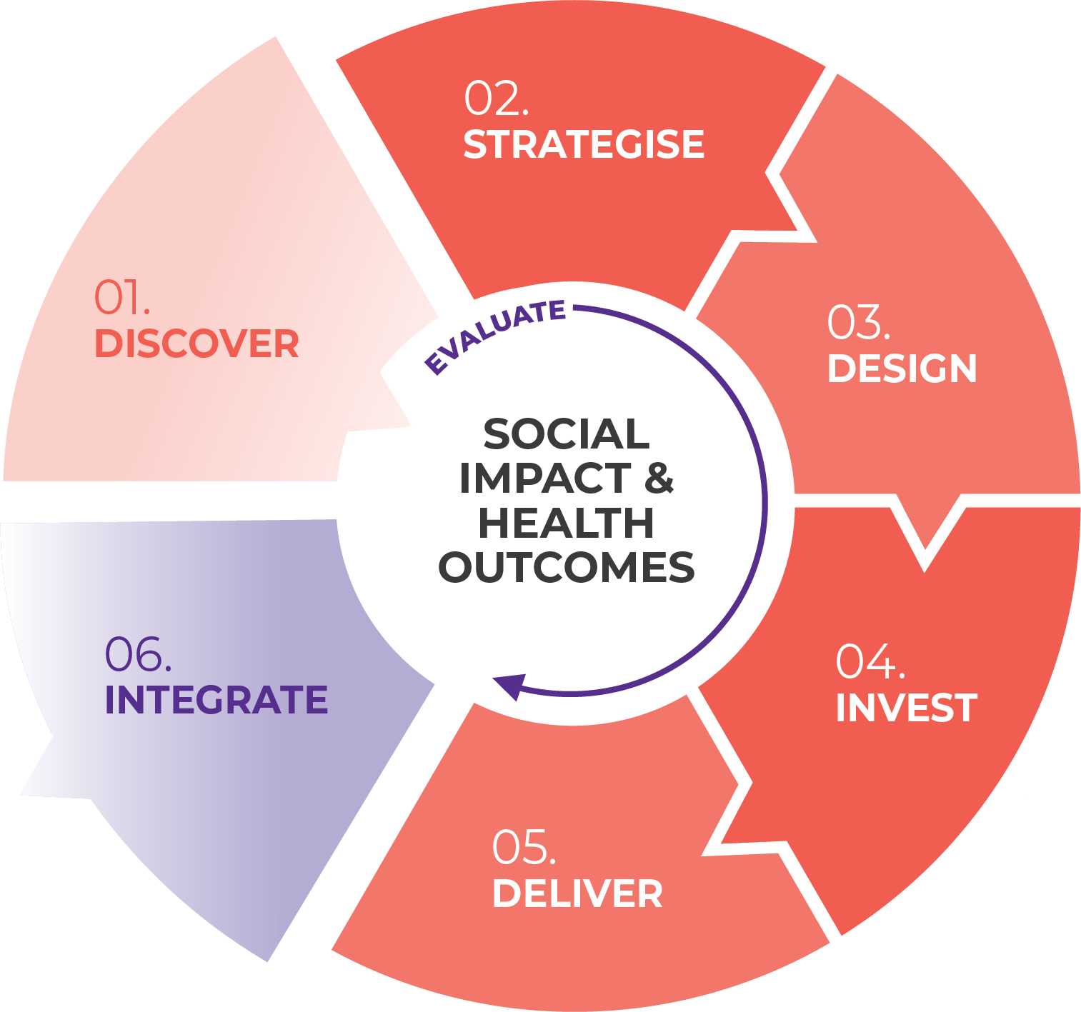
Every commissioning cycle drives reform
We examine community needs together
We collaborate across the sector and government to address service delivery gaps
We explore opportunities to provide services in new ways
What is commissioning?

Slide 8
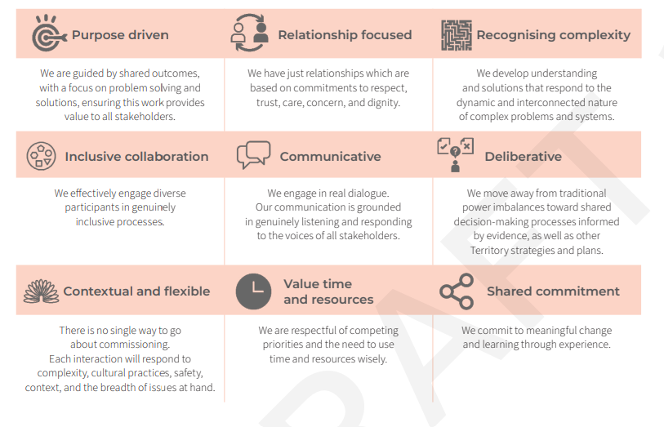
Every cycle is guided by shared principles
What is commissioning?

Slide 9
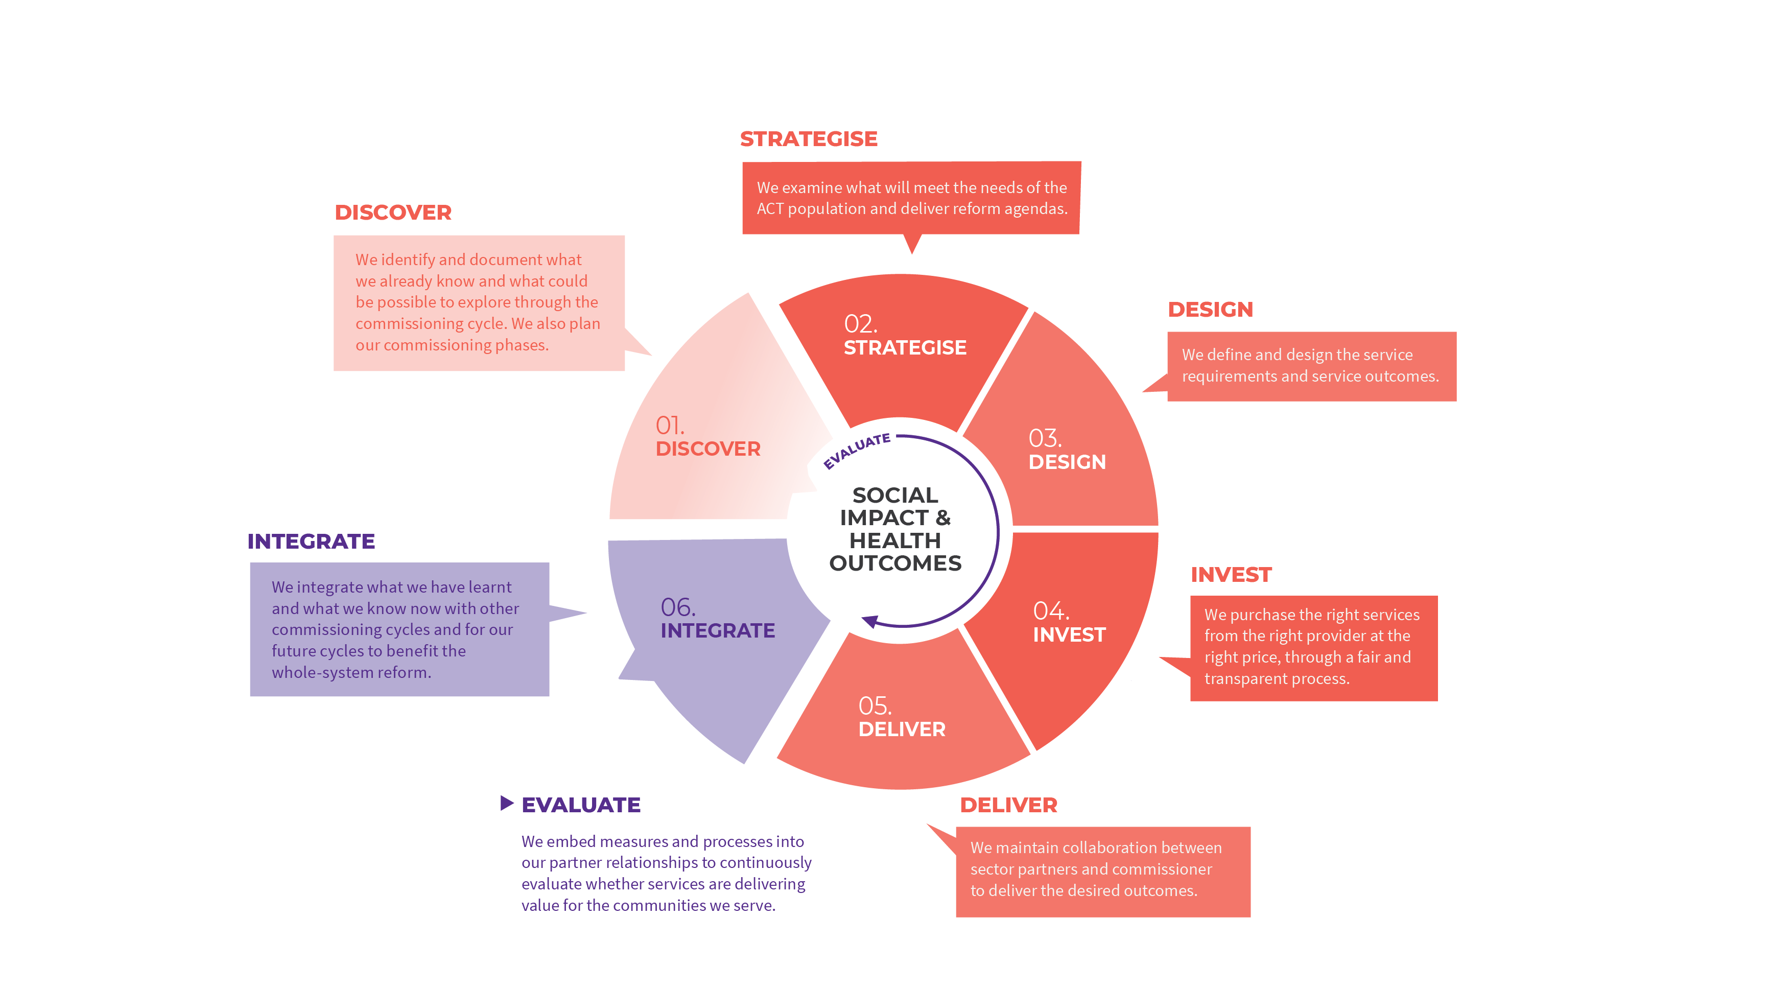
Commissioning is a consistent way for us to work together

Slide 10
WE ARE HERE
Choose the slide that shows your current commissioning phase
Choose the slide with the standard text to describe your current commissioning phase

Slide 11


WE ARE HERE <provide context>
Current focus
Strategise activities
We identify what we already know and what could be possible to explore through the commissioning cycle.
We have planned our commissioning phases.
We examine what will meet the needs of the ACT population and deliver reform agendas.
Discussion paper – what are the CYFSP interfaces?
Workshop – Government Interface Roundtable (government)
Workshop – Needs and problem framing (government and sector)
World Café – service user journeys and experiences of frontline workers
OCT | NOV | DEC/JAN | FEB | MAR | APR | MAY | JUN | JUL | AUG | SEP | OCT | NOV
PLAN | STRATEGISE |  |  |  |  | DESIGN |  |  |  | INVEST

Slide 12
COMMISSIONING CYCLE

Slide 13
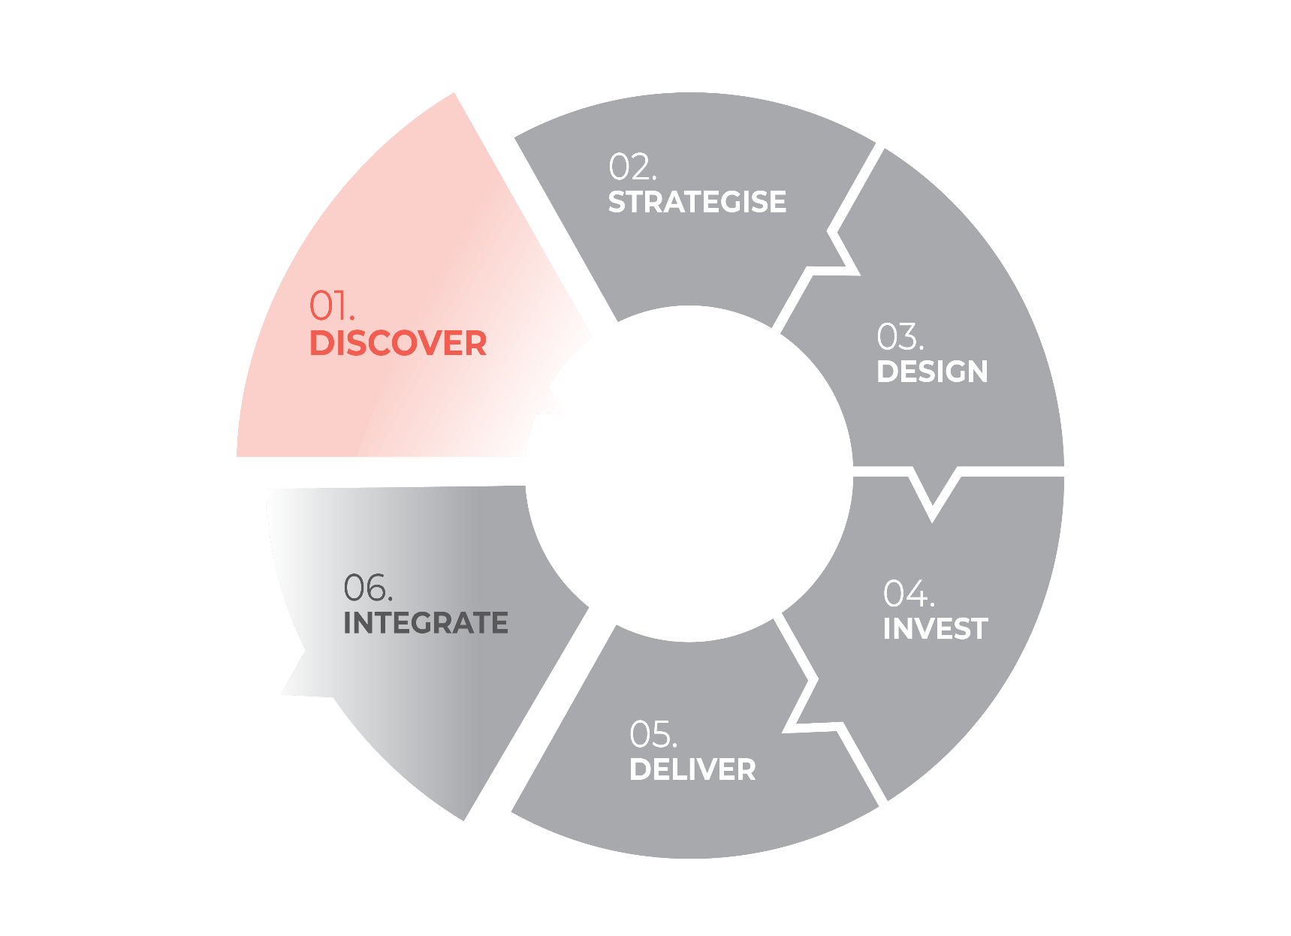
WE ARE HERE
We identify and document what we already know and what could be possible to explore through the commissioning cycle.
We also plan our commissioning phases.

Slide 14
WE ARE HERE
Undertake a discovery – what do we already know? What questions do we need to explore?
Identify who could be involved in the commissioning cycle
Plan the timings of the commissioning cycle through to delivery
Plan engagement and collaboration activities and timings
Establish the webpage to keep participants informed
What are we doing in this phase?

Slide 15
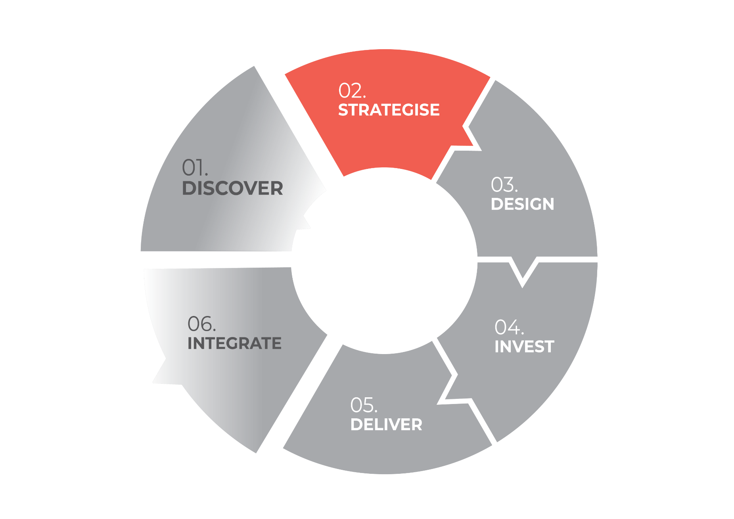
WE ARE HERE
We examine what will meet the needs of the ACT population and deliver reform agendas.

Slide 16
WE ARE HERE
Review the Discovery Discussion Paper together – what do we already know?
Validate and prioritise needs – who needs this service or program?
Determine our framing statement – what problem are we trying to solve?
Assess the market – who could provide services?
Identify service design opportunities – what service/s could we design together to meet the needs?
What are we doing in this phase?

Slide 17
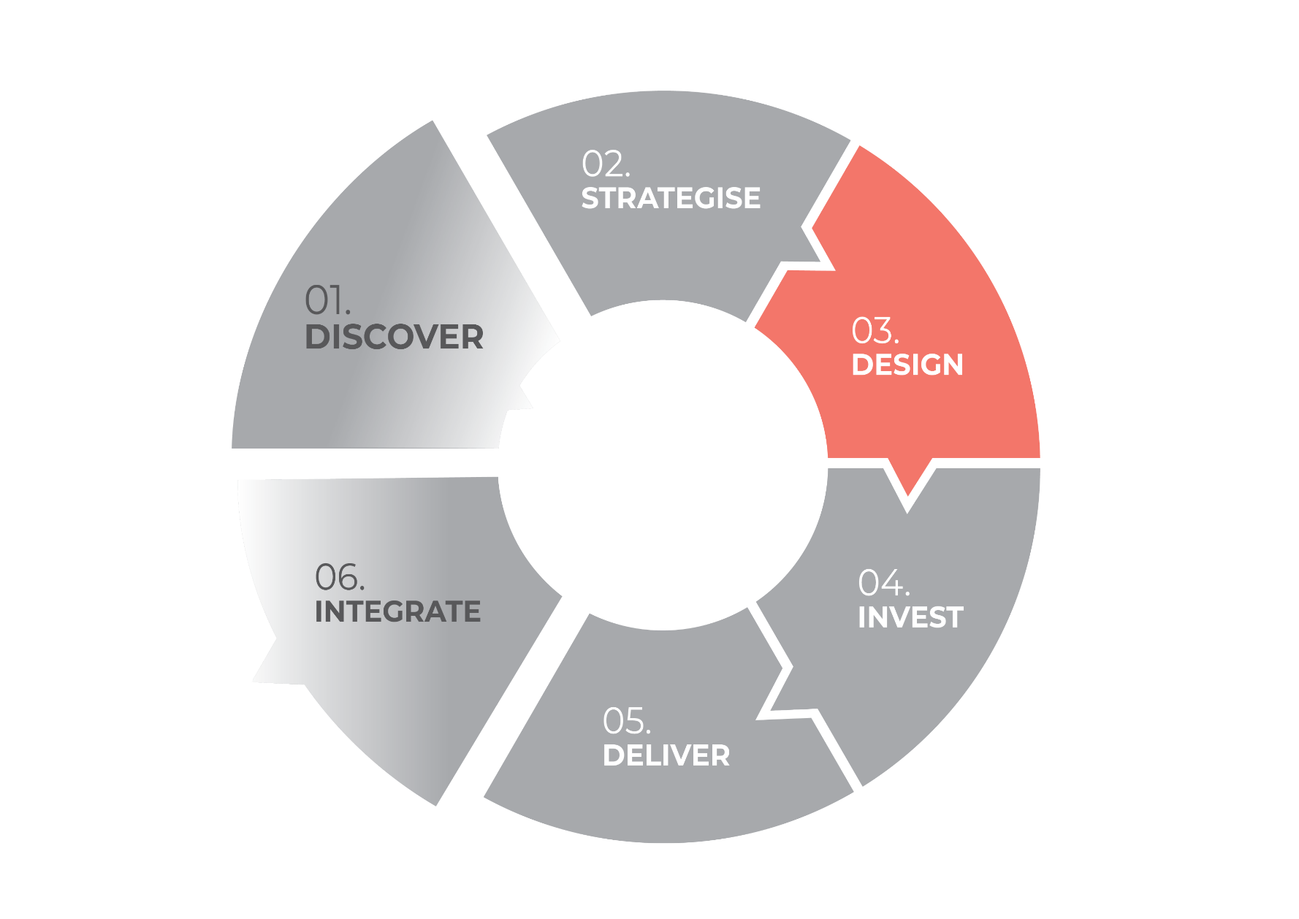
WE ARE HERE
We define and design the service requirements and service outcomes.

Slide 18
WE ARE HERE
Engage and collaborate to define the service specifications that meet the community need
Develop the outcomes for the community that the service will deliver
  Share insights, background, discussion notes from previous phases
  Invite partners, providers and people with lived experience to collaborate
  Facilitate collaborative activities that generate discussion, ideas and ways to deliver services to meet identified needs
  Report what has been heard and evaluate the participant experience
What are we doing in this phase?

Slide 19
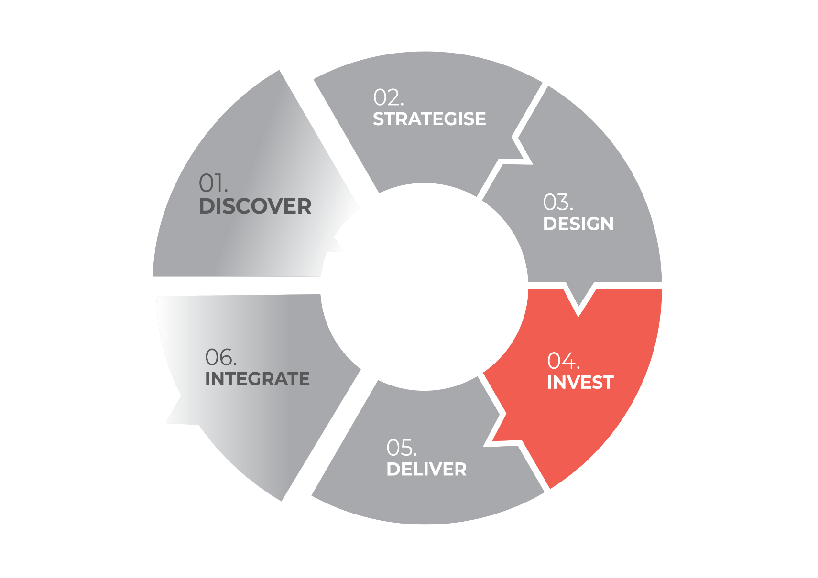
WE ARE HERE
We purchase the right services from the right provider at the right price, through a fair and transparent process.

Slide 20
WE ARE HERE
Use the service specifications and outcomes framework developed during design
  What are we investing in?
  And for what outcomes?
Reassess the market – who can provide services to the specifications developed?
Select appropriate investment method(s)
Publish approach to the market or a sounding paper that indicates investment intentions
Negotiate procurement arrangements with preferred providers and potential partners
Finalise agreement
What are we doing in this phase?

Slide 21
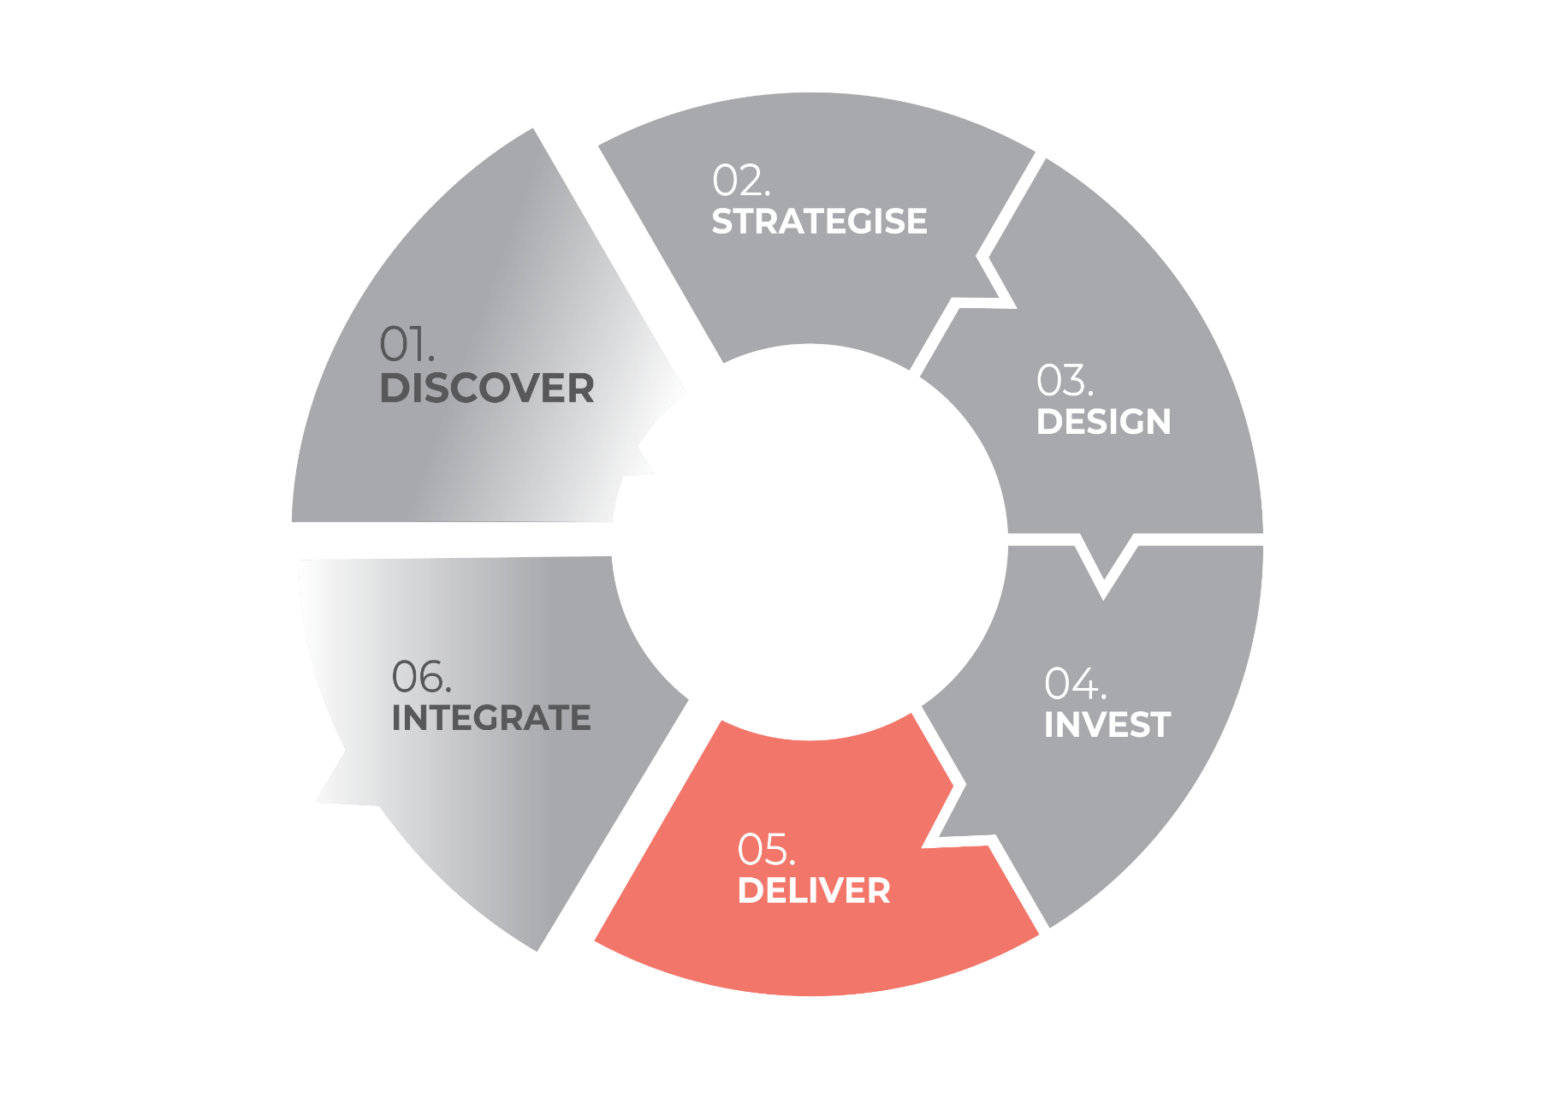
WE ARE HERE
We maintain collaboration between sector partners and commissioner to deliver the desired outcomes.
Notes:
Establish our partnership that ensures:
service outcomes are met and evidenced with data
the voices of people with lived experience continuously inform service delivery
maintain dialogue that meets the needs of commissioner and service provider
promote open, transparent conversations regarding risks, challenges, and opportunities
Cultivate flexible service delivery
Demonstrate impact through outcomes reporting
Deliver in partnership to meet the needs of the community through the service

Slide 22
WE ARE HERE
Establish our partnership that ensures:
  Service outcomes are met and evidenced with data
  The voices of people with lived experience continuously inform service delivery
  Maintain dialogue that meets the needs of commissioner and service provider
  Promote open, transparent conversations regarding risk, challenges and opportunities
Cultivate flexible service delivery
Demonstrate impact through outcomes reporting
Deliver in partnership to meet the needs of the community through the service
What are we doing in this phase?

Slide 23
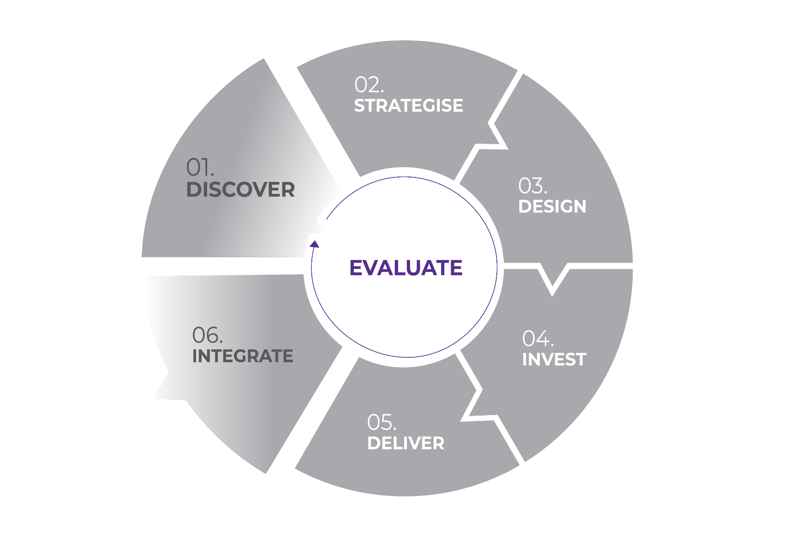
WE ARE HERE
We embed measures and processes into our partner relationships to continuously evaluate whether services are delivering value for the communities we serve.

Slide 24
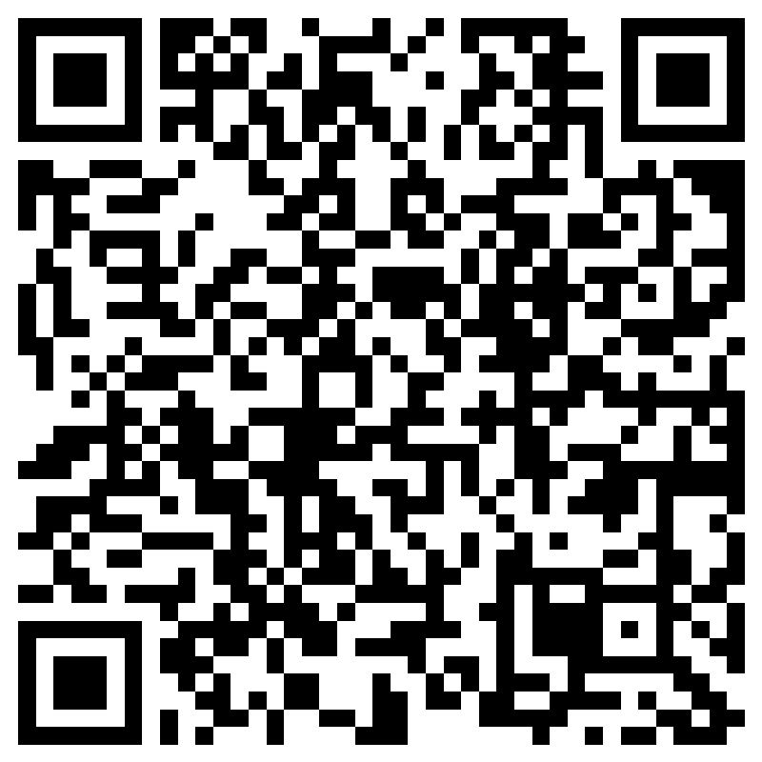
WE ARE HERE
Help us keep improving commissioning experiences
Take the post activity survey
  Visit: communityservices.act.gov.au/commissioning/evaluation
Share your experience of commissioning

Slide 25
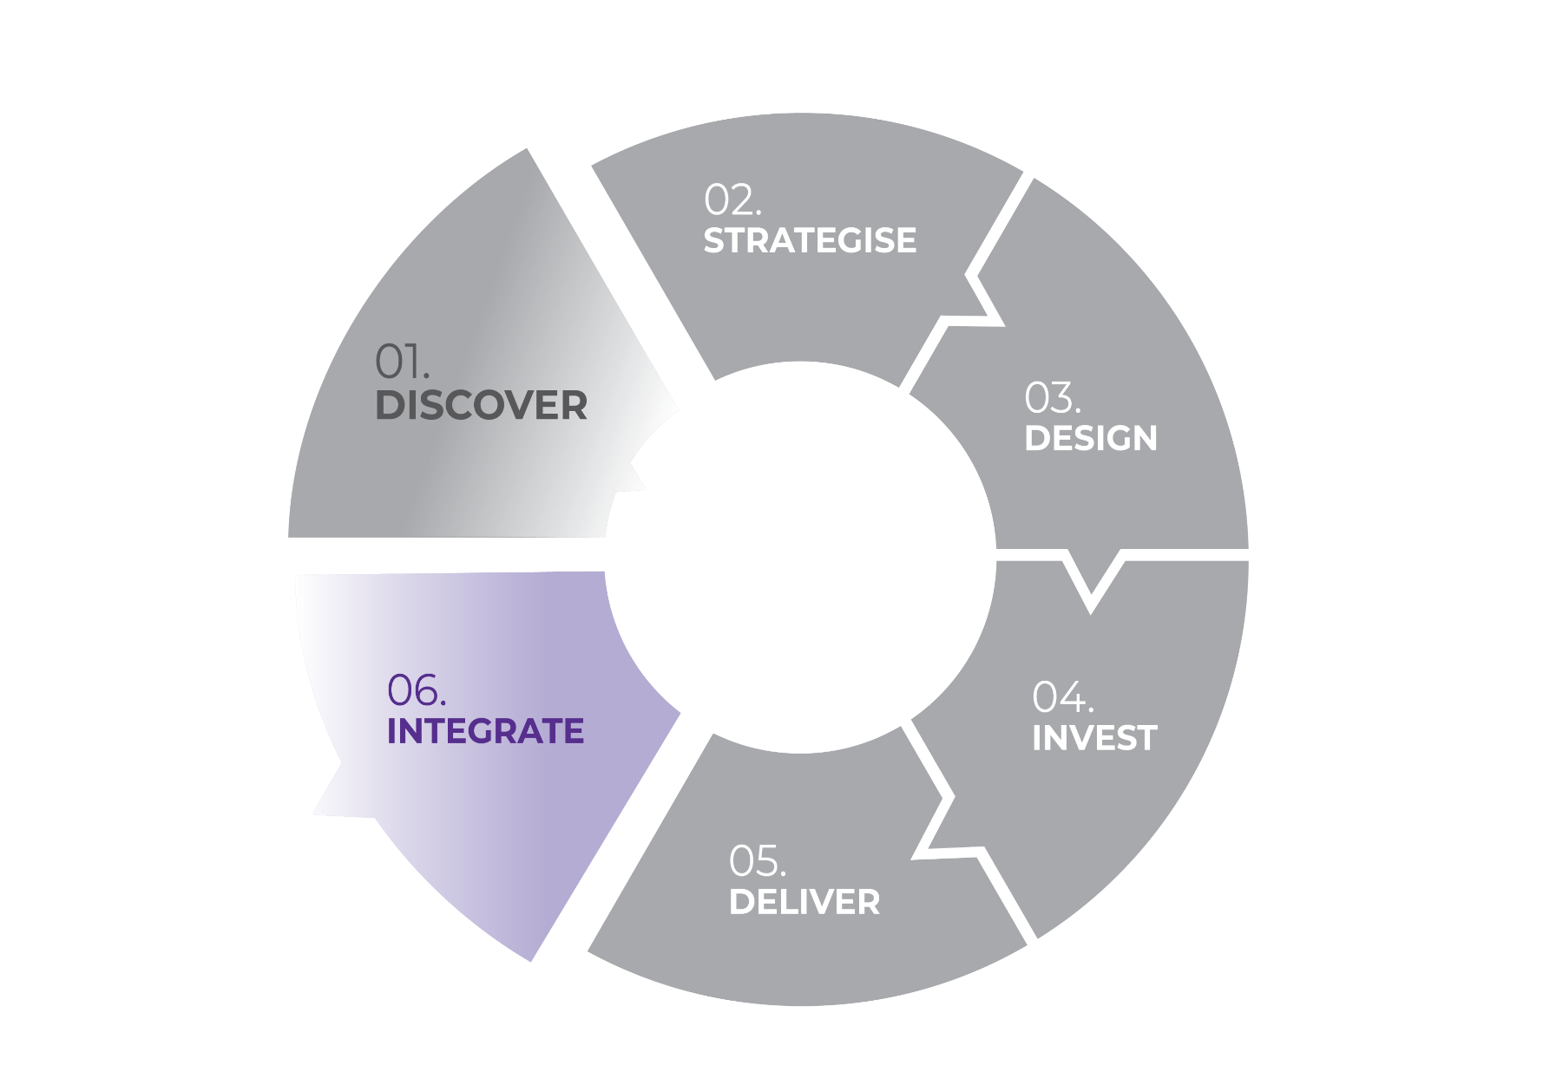
WE ARE HERE
We integrate what we have learnt and what we know now with other commissioning cycles and for our future cycles to benefit the whole system reform.

Slide 26
WE ARE HERE
Package up and socialise everything we have learnt for other commissioners or commissioning cycles
Undertake a lessons learnt assessment against the shared principles
Prepare a case study – tell the story of how you commissioned
Connect with other related cycles and share insights
Prepare for future cycles by developing a next commissioning intentions document
What are we doing in this phase?

