Slide 1
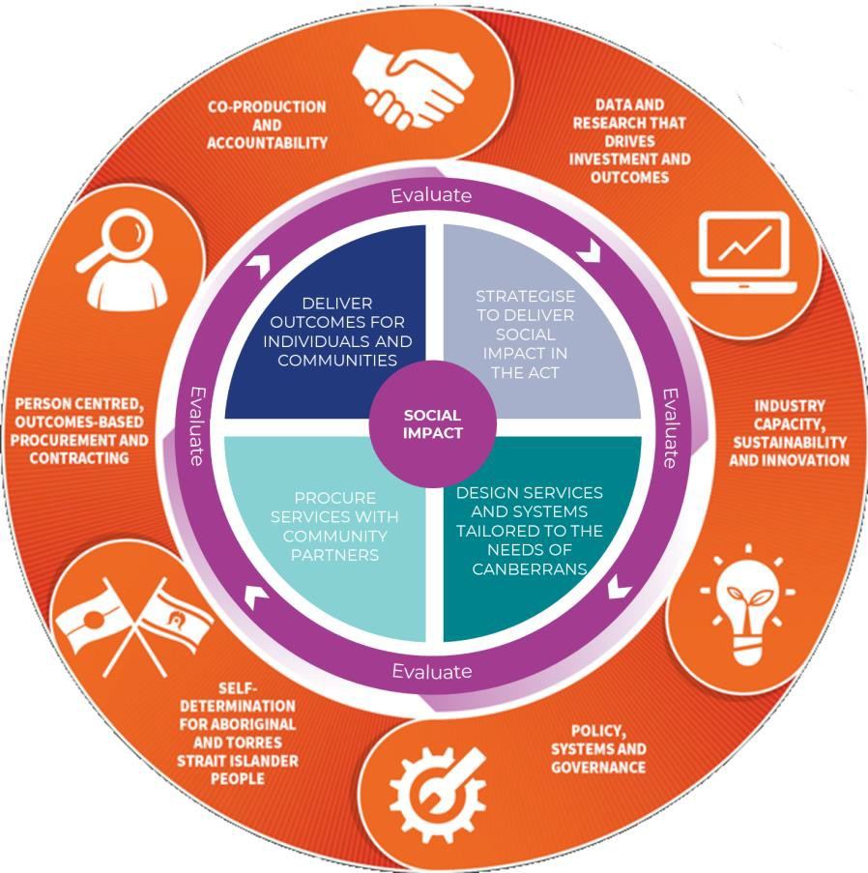
COMMISSIONING IN THE STIBBV SUBSECTOR
BACKGROUND
The Australian Capital Territory Health Directorate (ACTHD) provides funding to several Non-government Organisations (NGOs) to deliver a range of services to reduce the burden of sexually transmissible infections and blood-borne viruses (STIBBV) in the ACT. For the past decade, ACTHD has utilised traditional procurement processes to select and fund these services. From 2022 however, ACTHD is moving towards a commissioning approach for the future delivery of community health services. Commissioning is a strategic, evidence-based approach to the design, planning and funding of health and community services. The goal of commissioning in the STIBBV subsector is for the ACTHD and ACTHD- funded NGOs to collaboratively design a STIBBV service system that meets the evolving needs of the ACT community.
PURPOSE & PRIORITIES
SCOPE
GOVERNANCE
Purpose of commissioning
Commissioning in the STIBBV subsector seeks to guide sector capacity building activities so that the final procurement of STIBBV services reflects the contemporary needs of the ACT community
The ACTHD envisions a service system which is appropriate, equitable, accessible, and affordable for all individuals, with a particular focus on priority populations as identified in the Hepatitis B, Hepatitis C, HIV and Sexually Transmissible Infections ACT Statement of Priorities
The priorities for commissioning are:
Undertake a full review of community needs and existing services within the subsector to inform collaborative design activities and subsequent procurement processes
The review will include mapping current service provision, service duplication and service gaps to help identify services for commissioning. Comprehensive stakeholder and consumer consultation is central to commissioning in the STIBBV subsector
The project scope is the range of constituent activities and project outputs. The scope of commissioning as a process will include an evaluation, determination and procurement of services which specifically seek to address STIBBV burden of disease.
The project will include:
Development of a project plan and risk management plan
A review of the current ACTHD-funded STIBBV services and contracting arrangements to inform the collaborative design process scheduled in 2022
A gap/needs analysis of the STIBBV service sector
An ongoing dialogue of discussions with stakeholders regarding commissioning in the STIBBV subsector
Consumer/service user research to determine barriers and enablers to service access in the ACT as well as service acceptability
A series of collaborative design roundtable meetings with interested/invested stakeholders to identify services and packages/modes of service to be delivered from 1 January 2024
Various reports to reflect stakeholder inputs and other data to inform decision-making
Open tender process, procurement and contracting
Commissioning evaluation methodology and report
The Project requires strong generic and specialist capabilities in:
Project management
Policy development
Data analysis
Stakeholder engagement
Grants/contracts management and evaluation
Commissioning
STIBBV service provision
User/customer research design
Evaluation
A shared governance structure will be employed to support the commissioning process. The ACT Health Protection Service (HPS) will drive commissioning related activities supported by the ACTHD Commissioning Team. Input will be sought from a broad range of STIBBV stakeholders (including the STIBBV Health Advisory Committee and ACTHD Commissioning Executive Hub) and consumers/service users.
Resourcing is determined internally within the HPS. The following members will lead and drive commissioning in the STIBBV subsector:
Project Manager: Fellon Gaida (STIBBV policy lead)
Project Officer: Lauren Gleed (STIBBV policy officer)
The HPS Project Sponsor: Victor Martin (Executive Branch Manager)
Team Oversight: Tory Christensen (Director)
KEY STAKEHOLDERS
Non-Government community stakeholders for the project include:
Sexual Health & Family Planning ACT (SHFPACT)
Meridian Incorporated (MI)
Hepatitis ACT (HACT)
Capital Health Network-HIV Program (CHN-HIV)
Australasian Society for HIV, Viral Hepatitis and Sexual Health Medicine (ASHM)
Other NGOs (including: The Junction Youth Health Service, Winnunga Nimmityjah Aboriginal Health Service, Directions ACT, Companion House, The Scarlett Alliance, A Gender Agenda, ATODA, Multicultural Hub Canberra, Youth Coalition of the ACT and the Health Care Consumers Association.)
ACT Government stakeholders include:
Canberra Sexual Health Clinic
The Liver Clinic
The Women’s Health Service
ACTHD’s Communicable Disease Control
ACTHD’s Commissioning team and other business units
Justice Health
Walk-in centres
COMMISSIONING APPROACH
The Commissioning Cycle
The ACT has developed a Commissioning Cycle to guide commissioning related activities moving forward. The commissioning cycle is comprised of four key phases:
Strategise to deliver social impact in the ACT
Design services and systems tailored to the needs of Canberrans
Procure services with community partners
Deliver outcomes for individuals and communities
Collaborative Design
The collaborative design process is at the centre of ACTHD’s shift to commissioning and will involve ACTHD working with community partners to identify and shape health services that meet community need and ensure best value investment. All collaborative design activities and decisions will be informed by evidence collated during Phase 1 of the project (Strategic planning).
The goal of the collaborative design process is for participants to create an ideal STIBBV service system for 2024 and beyond.

Slide 2
PROJECT GANTT CHART
 | 2021 |  | 2022 |  |  |  | 2023 |  |  |  | 2024
KEY OUTPUT / ACTIVITY | Q3 | Q4 | Q1 | Q2 | Q3 | Q4 | Q1 | Q2 | Q3 | Q4 | Q1
Desk review of the STIBBV subsector
Needs analysis & mapping of current funding against national & ACT strategies
Commissioning webinar & discussions w/ current partners
Consumer engagement/user research report
Discuss & finalise collaborative design methodology
Collaborative design roundtable discussions
Draft & finalise collaborative design report
Finalise contract variations for existing partners
Draft Approach to Market Documents
Tender Process, application review & signing of new contracts
Implementation of new subsector contracts
Formal commissioning evaluation
Phase 1
Phase 2
Phase 3
Phase 4
TBD
Completed

